Slide 1
EPA Teaching Principles

Slide 2
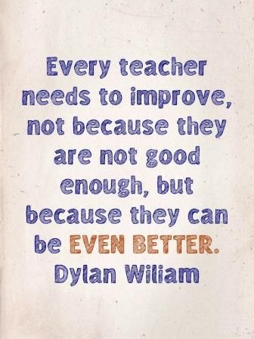
“If we are going to be sure all students have formed secure understanding, teachers should not assume that knowledge aired and shared in the public space of the classroom has been absorbed and learned by any individual.” ― Tom Sherrington
Rosenshine's Principles in Action
So that……
“If we teach today's students as we taught yesterday's, we rob them of tomorrow.”
— John Dewey
EPA Teaching Principles

Slide 3
EPA Teaching Principles
Why do we have a common approach?
Teaching Principles
Increase shared understanding of ‘what works best’
Allows more precise identification of development areas
Incorporates research informed ‘best practice’ ideas
EPA Teaching Principles

Slide 4
Look out for:
web resource
High expectations of learning behaviour
Quality of Instruction
Subject Mastery
video resource
Online courses:
The science of learning
Making it stick
Adaptive teaching
Effective Feedback
The science of learning – what every teacher should know

Slide 5
EPA Teaching Principles
High expectations of learning behaviour
Quality of instruction
Subject mastery
Making it stick
Adaptive teaching
Effective feedback
So that……
EPA Teaching Principles

Slide 6
EPA Teaching Principles

Slide 7
EPA Teaching Principles

Slide 8
EPA Teaching Principles
Your next steps
– review each of the short teaching principle videos
- Add any questions to the faq section next to each TP video
High expectations of learning behaviour
Quality of instruction
Subject mastery
Making it stick
Adaptive teaching
Effective feedback
EPA Teaching Principles

