Slide 1
What is the role of the RSL?

Slide 2
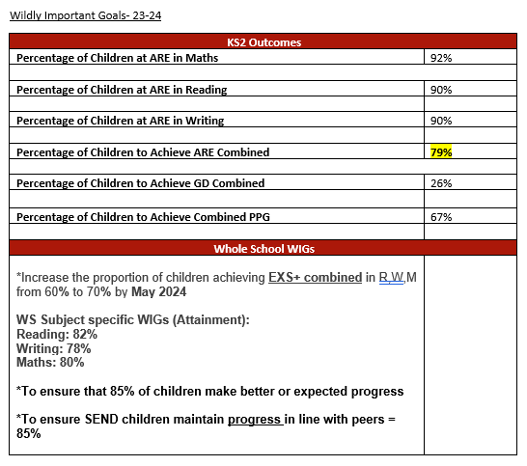
To Help Define Wildly Important Goals (WIGs)
Intent
Set this Early (Year 5)

Slide 3
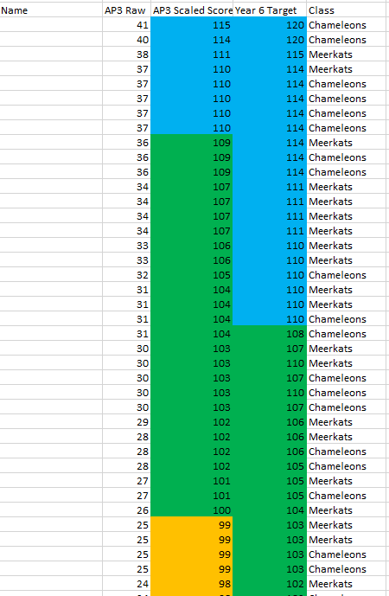
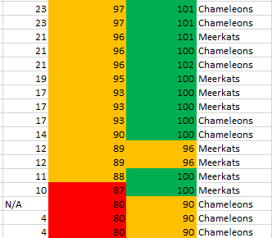
To Help Define Wildly Important Goals (WIGs)
Intent
Using robust, internal data to set the WIGs

Slide 4
Carry out Pre-Mortems
Implementation
Helping to plan strategies to achieve the WIG
-Address ongoing barriers towards the WIGs.
-Resources
-Room Bookings
-ICT access
-Staff expertise
-etc

Slide 5
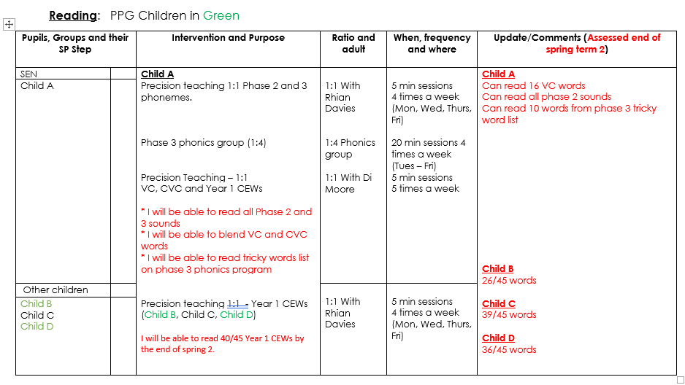
Carry out Pre-Mortems
Implementation
Planning Interventions and
Modifications to QFT

Slide 6
Support the Use of PiXL Resources to Achieve the WIG(s)
Implementation

Slide 7
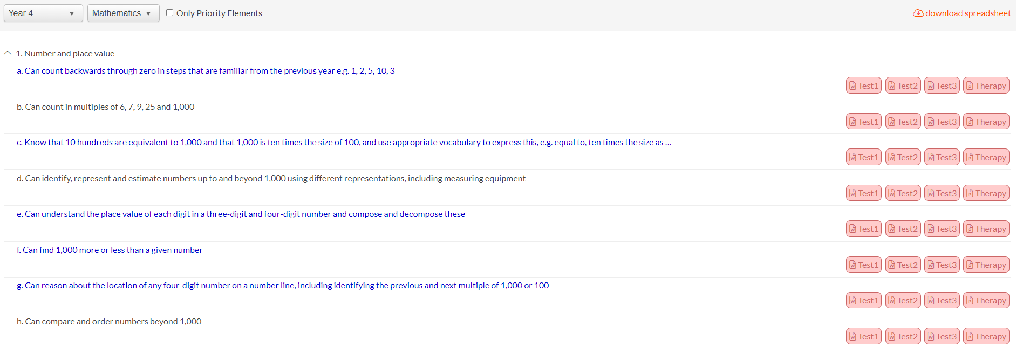
Support the Use of PiXL Resources to Achieve the WIG(s)
Implementation
Using PiXL Resources
Very much linked to the QLAs (at class, group and individual level)

Slide 8
Support the Use of PiXL Resources to Achieve the WIG(s)
Implementation
Over-learning and
consolidating the
core skills and
knowledge

Slide 9
Training for TAs (Familiarising with resources)
Implementation
Ensure TAs know how to access and use the interventions.

Slide 10
Meetings with the Associate
Implementation
Using the associate’s knowledge of PiXL

Slide 11
Accessing PiXL Training
Implementation
-Attending conferences
-Booking training that PiXL offers

Slide 12
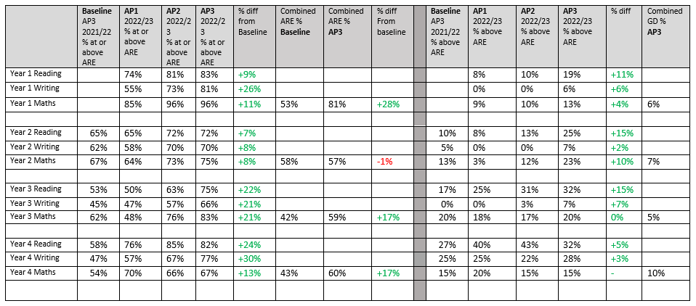
To Analyse Data and Gap Analysis
Impact and Implementation

Slide 13
To Analyse Data and Gap Analysis
Impact and Implementation

Slide 14
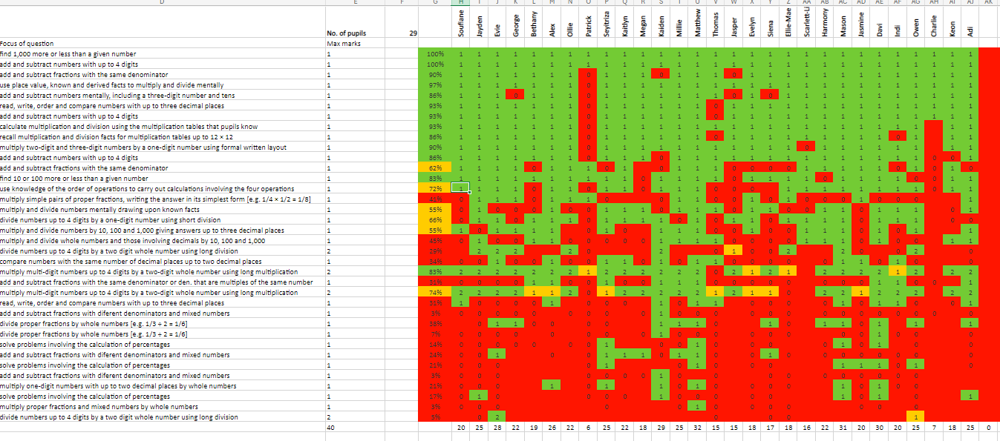
To Analyse Data and Gap Analysis

Slide 15
To Analyse Data and Gap Analysis
-Use of IFTs

Slide 16
Communicate with staff
Impact and Implementation
-What the data shows,
-Attendance at pupil progress meetings
-Work with the head and other leaders
-Chair “core-team” meetings, or staff meetings.
-Help manage difficult conversations and keep everyone on track, with the discipline to see things through.

Slide 17
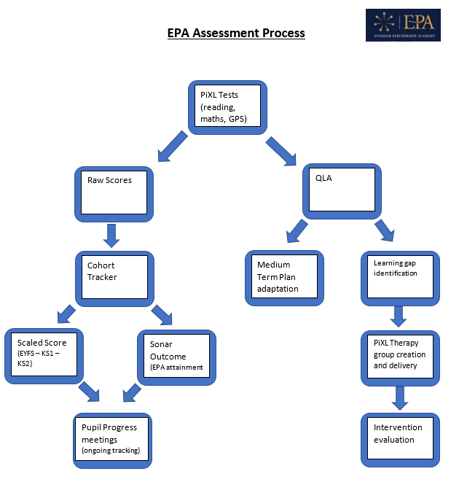
To Support the Implementation of the EPA Assessment Process
Summary
Assessment is cyclical
The process repeats after every
assessment point

