Slide 1
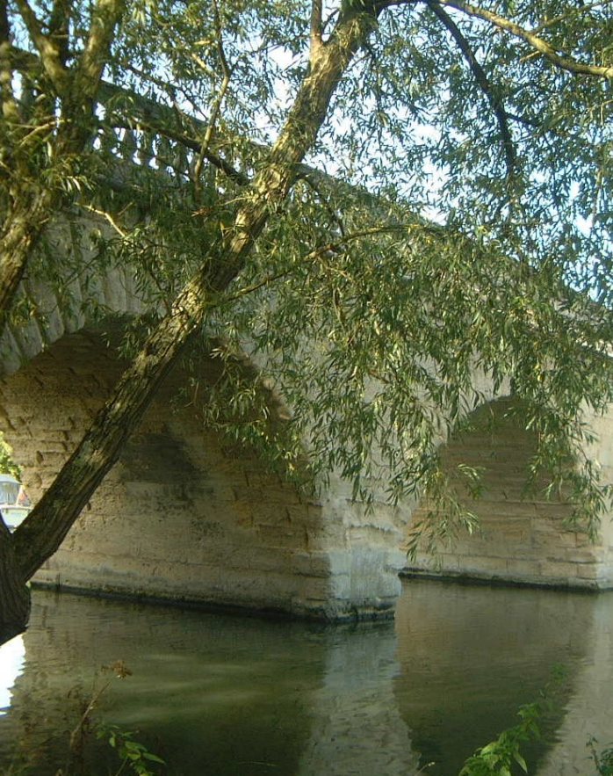
Developing teaching and learning
Questioning
EPA Primary Joint INSET, January 2024

Slide 2
- Our ideas on questioning - Questioning – common pitfalls - The purpose of questioning - Types of questions - Planning for questioning - The future of questioning

Slide 3
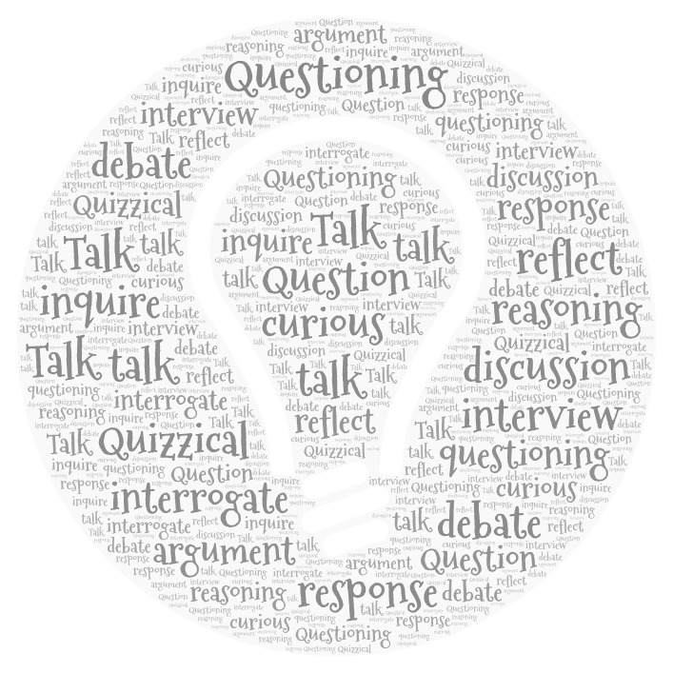
Our ideas on questioning

Slide 4
Questioning also shifts the focus onto purpose. Framing questions means that we have to think about the subject in order to get to the substance. As a teacher, I need to ask myself: what is the key point here? What is the main concept that needs to be developed over time, so that pupils can make sense of the material?” Mary Myatt
Bruner again argues, several lines of research - on intersubjectivity, on the nature of the human mind, on metacognition and on collaborative learning - all converge on the principle that children must think for themselves before they truly know and understand, and that teaching must provide them with those linguistic opportunities and encounters which will enable them to do so. These ideas have been given a further boost by neuroscientific research. It is now understood that talk is necessary not just for learning but also for the building of the brain itself as a physical organism, thereby expanding its power. Robin Alexander: Towards Dialogic Teaching
“Students need to practice new material. The teacher’s questions and student discussion are major ways of providing this necessary practice. The most successful teachers in these studies spent more than half of the class time lecturing, demonstrating and asking questions.” Barak Rosenshine
In order for fertile questions to be imposed on teachers it’s reasonable to ask that their efficacy would have to clear a very high evidential bar. As things stand, I’m not aware of any such evidence base. The best that we can currently say is that they may be an effective way to introduce some areas of the curriculum, sometimes. D. Didau https://learningspy.co.uk/featured/whats-the-big-deal-with-big-questions/
“Sometimes I think that we, as teachers, are so eager to get to the answers that we do not devote sufficient time to developing the question.” Daniel T. Willingham: Why Don't Students Like School?
In my experience, great questioning is the hallmark of a really effective teacher and sits right at the top of the list for things teachers can and should improve. It’s far, far more important to support teachers with questioning than, for example, to fuss about the quality of their marking or accuracy of their data entry. Posted by Tom Sherrington accessed May 2021 https://teacherhead.com/author/teacherhead/
When pupils are encouraged to reason and argue about ideas they are being invited to adopt the habits of critical inquiry that test existing orthodoxies and challenge the natural order of things. Sylvia Wolfe: Argumentation and dialogic teaching: alternative pedagogies for a changing world
Complex questions promote complex thinking, argue researchers Degener and Berne (2016). But is it really that simple? There is a lack of consensus in the literature. Some researchers have found higher-cognitive questions superior to lower ones while others have not. In general, the level of teachers’ questions is low. Around 60 per cent of questions expect only factual information from students (Lee and Kinzie, 2012). Samson et al (1987) found that higher-cognitive questioning strategies have a positive effect on learning, but this was not as large as has been previously suggested. Simply asking higher-cognitive questions does not necessarily produce higher-cognitive responses from students. Jonathan Doherty, Impact Magazine Set 2017
Wilkinson (1965) introduced the term oracy as a way for people to think about the role that oral language plays in literacy development, defining it as "the ability to express oneself coherently and to communicate freely with others by word of mouth." Wilkinson noted that the development of oracy would lead to increased skill in reading and writing as users of the language became increasingly proficient—as James Britton (1983) put it so eloquently, "Reading and writing float on a sea of talk”. Douglas Fisher, Nancy Frey and Carol Rothenberg: Content-Area Conversations.
We need to regard questions as a key part of planning. And we can do this without preparing masses of additional resources. We need to recognise that their effectiveness and their efficiency – the questions themselves are the resource. Mary Myatt
Notes:
This is the quotes quilt for this topic. It is a collection of views/opinions from a selection of people across education. Please share this and ask your staff to discuss the view points – are there any views that resonate? Any views they disagree with? There is a reflection jotter on the next page should you want to use it with staff. These will also be in the additional resource for this topic.

Slide 5
What do I think about Questioning?
Reflections from the quotes quilt
Notes:
Reflection jotter

Slide 6
Think about your class.
Which pupils do you think receive more of your attention during questioning?
What might possible reasons be for this?
Which pupils, on reflection, do you question least?
What might possible reasons be for this?

Slide 7
Think about your class.
Which pupils do you think receive more of your attention during questioning?
What might possible reasons be for this?
Which pupils, on reflection, do you question least?
What might possible reasons be for this?

Slide 8
What is a Question?
“We need to regard questions as a key part of planning. And we can do this without preparing masses of additional resources. We need to recognise their effectiveness and their efficiency – the questions themselves are the resource.”
Mary Myatt in Back on Track
Conventions:
Has the undertone of a command
Indicates the desire for reciprocity
Eliciting a response that includes information
A bridge by which we connect through language
Can include spoken, written or a thoughtful response
Reciprocity – the response is closely related to the nature of the question, e.g. general, specific, detailed, analytical etc.
Non verbal cues can sometimes form questions
Notes:
This slide introduces the idea of what questions are and makes some points about their function in the classroom.

Slide 9
Research Evidence
“…of the questions recorded by his research team, 67% invited recall or simple deductions, fewer than 20% required complex responses and 13% were concerned with speculation, feelings or management. The tendency to ask only simple questions was less true of arts than science teachers”
Wragg and Brown, 2001
The research differentiated to discuss cognitive domain (recall deduction, justification, problem solving, evaluation) and the speculative affective and management domains (inviting speculation, encouraging expression of feelings, directing attention and asserting control).
Notes:
This slide represents some different views and approaches to questioning.
Alexander discusses 8 repertoires which he describes as sub categories of interaction. The 8 repertoires (pgs. 135-165) are Interactive culture, Interactive settings (Relations, Grouping, Space and Time), Learning talk, Teaching talk, Questioning, Extending, Discussing/Deliberating and Arguing.
https://impact.chartered.college/article/doherty-skilful-questioning-beating-heart-pedagogy/ accessed Jan 2021
One of a number of studies which consistently show the low level of questioning – rapid, low-level thinking required

Slide 10
Questioning – common pitfalls
asking too many questions at once
asking a question and answering it yourself
asking a difficult question too early
always asking the same type of question
asking a question in a threatening way
not using probing questions
not giving students enough time to think
ignoring answers
not correcting wrong answers
failing to see the implications of answers
failing to build on answers
Notes:
Temptation to show this twice.
The first time – the typical ‘what’s in my head’ question – What are the common pitfalls of questioning?
The second time – show this – and then ask higher level – or combine with a reflecting evaluation (I have prepared one)

Slide 11
The purpose of questioning

Slide 12
Questioning = Effective Learning
Paramore J (2017) Questioning to stimulate dialogue, in Paige R, Lambert S and Geeson R (eds) Building skills for Effective Primary Teaching, London: Learning Matters
Effective Questioning
Subject and Pedagogical knowledge
Mental Engagement
Knowledge of Learners
He identifies an imbalance of questions often found in teaching, saying there is a dominance of teacher talk and an over-reliance on closed questions, providing only limited assessment for learning (AfL) information for a teacher.
Notes:
Figure 8.1 pg. 124 in Questions to Stimulate Dialogue by John Paramore. Effective questioning depends on all the above 3 factors. Without effective subject pedagogy we do not frame the correct questions and without knowledge our learners cannot explore or deliver a response. We need to be “… actively engaged in making sense of the students’ understanding of their learning and it is as important to develop this disposition as it is to be aware of the sorts of questions available to you.” pg. 123

Slide 13
Why ask questions? – The Meta Question (asking questions about our questions) Paramore highlights 3 motives/reasons which can be facilitated individually or in combination:
What is the name of…?
Explain X…
Can you remember…?
Can you explain why?
Can you use what you know about X to solve Y?
Can you use X to explain Y?
Which is the most significant…?
What have these got in common?
Can you find another example of Y?
How do these compare/link/contrast?
Motive 1 – To probe knowledge and understanding
To TEST pupils’ knowledge and explore their reasoning through probing understanding
To enable pupils to APPLY their knowledge in a new situation and solve a problem
To enable pupils to analyse based upon defined properties
Notes:
The next 3 slides highlight the 3 “motives” for using questions as highlighted by Paramore. It is interesting to note that this was published in a Primary teaching resource.

Slide 14
Motive 2 – To generate knowledge
Ideas include:
To help pupils generate/create and synthesise knowledge
Generate critical learning in learning that has taken place
Promote new learning
Encourage pupils to become creative, extend understanding, make links, connections and generate their own examples
“Learning is seen as a process of intra-mental activity (thinking on your own to make sense of the world) and/ or inter-mental activity (i.e. things shared among groups of learners who learn from each other)”. Eventually, pupils will then be able to ask themselves and others questions.
Can you find a better example of…? Why is it better?
Explain why this is the key feature.
Can you do this a different way?
Would that be an improvement?
What if…?
Could we …?

Slide 15
What do you think…?
What is the evidence for…?
What do you see…?
What is your opinion on…?
How far…?
To what extent…?
How important…?
What did I find challenging about that?
What could I do to improve?
Motive 3 – To problematise knowledge
Creating a reasoned decision or judgement
Engage with knowledge that is contingent*
This takes place though participation in a dialogue
Self evaluation (being metacognitive) is vital in some contexts
Notes:
That ideas are open to change and review and that they depend on “what you know at any one point and with new knowledge these views are open to change” pg. 131 Paramore

Slide 16
Paramore highlights 3 motives/ reasons which can be facilitated individually or in combination:
Why ask a question?
2. To generate knowledge
3. To problematise knowledge
1. To probe knowledge and understanding
Can you find a better example of…? Why is it better?
Explain why this is the key feature.
Can you do this a different way?
Would that be an improvement?
What if…?
Could we…?
What is the name of…?
Explain X…
Can you remember…?
Can you explain why?
Can you use what you know about X to solve Y?
Can you use X to explain Y?
Which is the most significant…?
What have these got in common?
Can you find another example of Y?
How do these compare/link/contrast?
What do you think…?
What is the evidence for…?
What do you see…?
What is your opinion on…?
How far…?
To what extent…?
How important…?
What did I find challenging about that?
What could I do to improve?
Paramore J (2017) Questioning to Stimulate Dialogue, in Paige R, Lambert S and Geeson R (eds) Building skills for Effective Primary Teaching, London: Learning Matters
Notes:
This slide highlights all 3 “motives” for using questions as highlighted by Paramore. Paramore J (2017) Questioning to Stimulate Dialogue, in Paige R, Lambert S and Geeson R (eds) Building skills for Effective Primary Teaching, London: Learning Matters

Slide 17
Questioning Techniques and Approaches

Slide 18
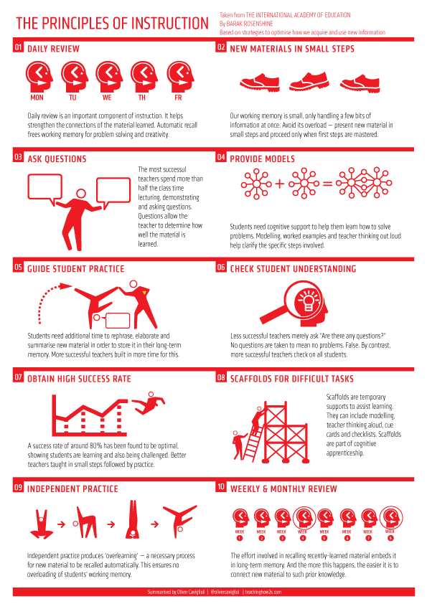
Rosenshine evidenced that the most effective teachers:
asked more questions
involved more students
probed more in depth
spent more time explaining, clarifying and checking for understanding
asked students to ‘think aloud’

Slide 19
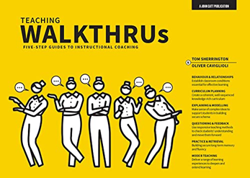
Tom Sherington: questioning techniques ‘in action’ – based on evidence collected by Rosenshine.

Slide 20
Questioning technique: 1. Cold-calling
OBJECTIVE: to engage all students in teacher-student dialogue with time to think, preventing students from being overlooked, dominating or hiding from involvement in dialogue.
PRACTICE:
Formulate question sequences in advance – as part of planning.
All students should be involved.
For this method, don’t get students to raise hands.
Ask questions and select students to respond based on your knowledge of the class.
Students should not be allowed to hide, dominate or be overlooked.
SHERRINGTON SAYS: “This [strategy] needs to be the default mode for most questions – absolutely routine. ….Teachers ask questions and …select students to respond based on their knowledge of the class, avoid the pitfalls of hands-up or calling out”

Slide 21
Questioning technique: 2. No opt-out
OBJECTIVE: for students to feel safe offering answers of which they are unsure and not form a habit of “I don’t know” as a get out
PRACTICE:
When students say they don’t know the answer or get an answer incorrect, ‘move to other[s] … or provide the correct answer … then go back to all those students who made errors or couldn’t answer’.
If students ‘don’t know or get things wrong, they should be given the opportunity to gain confidence by consolidating correct or secure answers’.
SHERRINGTON SAYS: “This strategy aims to give those students who don’t know the answer or get an answer incorrect opportunities to learn from others in the class and to practise. It also avoids fostering the defensive habit of ‘I don’t know’.”

Slide 22
Questioning technique: 3. Say it again, better
OBJECTIVE: to provide students with a second opportunity to reframe and respond to questions using well-constructed sentences with technical vocab and more developed responses.
PRACTICE:
Provide students with ‘an immediate opportunity to give an improved response’.
Use prompts if needed: "That's great but make sure you add in X and link to Y."
Don’t ‘inhibit students when they are unsure’.
Don’t ‘allow [students] to assume mediocre answers are good enough’.
SHERRINGTON SAYS: “This strategy aims to help students add ‘depth, accuracy and sophistication’ to their answers.”

Slide 23
Questioning technique: 4. Think, pair, share
OBJECTIVE: giving students the opportunity to discuss questions with a partner before answering improves their engagement and learning.
PRACTICE:
Put students in pairs. Give them a specific, time-cued task. Give them time to think, discuss their thoughts, prepare to give answers and rehearse them to one another. On time, bring the class together with a signal. ‘Then engage in probing, cold-call questioning, asking them to report back … [Or] get them to explain things to each other or … take turns to quiz each other’.
SHERRINGTON SAYS: “….students should be put in pairs, allow students ‘space to think, … air their initial thoughts, … confess their lack of knowledge and … prepare to give good answers, to rehearse. To ensure this, the teacher will need to select pairs appropriately.”

Slide 24
Questioning technique: 5. Whole class response
OBJECTIVE: to get a response from every single student in the class at the same time, to provide feedback about the success of the teaching and learning.
PRACTICE:
Get a response from all students in the class to a question, problem or task – e.g., multiple-choice questions, diagrams or calculations. This can be done verbally or through a written task – mini-whiteboards, online polling, ABCD cards etc.
Engage with ‘responses and then adjust your teaching accordingly’.
SHERRINGTON SAYS: “This strategy can provide quick feedback about the success of teaching and learning exchanges, identify students who need further input and ‘can help direct subsequent questions or exercises as you respond to … feedback”. Sherrington suggests, individual student whiteboards can be used.

Slide 25
Questioning technique: 6. Probing Questioning
OBJECTIVE: to ask each student multiple, responsive questions, to explore their level of knowledge and understanding. To encourage thoughtful, deep and explanatory responses.
PRACTICE:
Sherrington recommends that teachers should make ‘it the default that, in any given exchange, [teachers] are asking each student three/four/five questions, before moving on’. This allows the teacher to probe for understanding, check for misconceptions, add extra challenge, and provide scaffolding.
SHERRINGTON SAYS: “….this strategy is a ‘powerful mode of questioning and a form of guided practice’. This would need to be carefully incorporated into lesson planning for it to be successfully adopted as the default method of questioning, given the time it will take to ask each student several questions.”

Slide 26
Questioning technique: 7. Pose, Pause, Pounce, Bounce
OBJECTIVE: to get all students thinking deeply. To engage to students to elaborate on their answers and develop their thinking.
PRACTICE:
No hands-up approach. Teacher poses a question. Thinking time is given. Student is selected (seemingly at random) to provide an answer. Teacher choses another student to provide more detail and/or elaborate – then repeat with further students. "Basket ball rather than table tennis".
SHERRINGTON SAYS: "Evidence shows this technique improves participation, engagement and participation..”
https://youtu.be/TMBsTw37eaE

Slide 27
Questioning technique: 8. Check for Understanding
OBJECTIVE: gaining regular opportunities to formatively assess students' understanding and using this to inform what happens in the next lesson.
PRACTICE:
Gathering information by constantly checking. 'Summarise story so far'; 'Repeat the instruction'; 'agree/disagree'; 'think aloud as you plan'; 'explain or defend your position'.
SHERRINGTON SAYS: “Ensure you are gathering useful information….Avoid asking questions such as, 'Has everyone understood?' They probably haven't.”
Five Ways to: Check for Understanding – teacherhead
Kitchen Pedagogy: Five Ways to Check for Understanding (youtube.com)

Slide 28
Sherrington’s Top Tip:
“Don’t be afraid to ask the same student to reform their answer several times if necessary. Be relentless in sending out the message that you won’t accept weak answers.”

Slide 29
The Dynamics of Questioning….agile, responsive, nimble, purposeful
The Dynamics of Questioning….agile, responsive, nimble, purposeful. – teacherhead

Slide 30
Planning for questioning
"Skillful questioning is the beating heart of good pedagogy."
"Formulate question sequences in advance, as part of lesson planning. Think carefully about what wording will provide the most understanding and challenge."

Slide 31
Planning for Questioning
Focus on…
Purpose – what do you want to achieve?
Questioning technique – cold calling; probing; say it again better etc.
Questioning format – describe; explain; reach a judgement
Sequencing – what comes next?
Recording outcomes – who knows what?

Slide 32
What is the purpose of my questions for each part of the lesson?
I
Notes:
Activity – give teachers thinking time to reflect on the theory that has been presented. Encourage teachers to think about the plethora of questions that they use in lessons and how they can make them purposeful for different points of the lesson.

Slide 33
What is the purpose of my questions?
I need to know if they can do it/ apply it!
I need to deepen their thinking about it leading to improvement.
I need to know if they know it!
I need to know if they understand it!
I
I need them to develop strong support for their arguments.
I need to develop their metacognitive thinking.
I need to get them to analyse it.
I need to get them to make links and connections.
I need to develop their ability to infer and derive.
Notes:
Here are some suggestions. We would encourage you to go through each of these and discuss them – which ones do you use most in your subject? Are you using a range of them?

Slide 34
How do we prepare learners to deconstruct or understand the questions they are asked?
SOME IDEAS
Repeated use of questions in class
Develop familiarity with questions
Learners write and create their own questions
Knowledge of how to deconstruct questions
Learners are confident in answering and asking their own questions
Modelling of questions and their component parts
Developing students’ ability to self-question
Notes:
This slide highlights some ideas about the FORM of questions and how we prepare pupils to be able to understand and deconstruct questions. This will also vary across subjects and key phases.

Slide 35
Powerful Questions…
What kinds of questions can we use in our classrooms?
Types of Questions
Closed – e.g. What is? Who is? Where is? When did?
Question? | Type of question | Purpose of question
Notes:
This is an activity for staff to complete –

Slide 36
What might be the [future] role of AI in classroom questioning?
To reduce teacher workload.
To drive improvements in teaching.
To provide better feedback.

Slide 37
ChatGPT

Slide 38
ChatGPT

Slide 39
TeachFX.com

Slide 40
Teachermatic.com

Slide 41
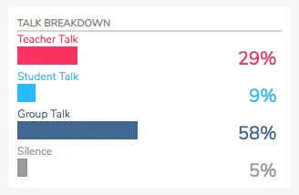
TeachFX.com
What I learned from a week of TeachFX | by Daniel Lee | TeachFX | Medium

Slide 42
Questioning Jot down ideas about how you might further develop questioning.
Activity
Notes:
This is the final activity – it can, however, be done throughout the training or at the end. Whatever works best in your context. This is also in the Questioning Part I resource pack.

Slide 43
“Learn from yesterday, live for today, hope for tomorrow. The important thing is to not stop questioning.” – Albert Einstein
“Trying to manage the learning that is happening in 30 different minds at the same time will always be extraordinarily challenging. But by increasing the engagement of students, and thus improving the feedback from the teacher, we can make a real difference. One teacher described the process as making the students' voices louder and making the teacher's hearing better. Sounds like a good place to start.”
Dylan Wiliam

Slide 44
Acknowledgements and Sources
Alexander, R., (2020) A Dialogic Teaching Companion, Routledge (access here)
Beard, A., (2018) Natural Born Learners, Our Incredible Capacity to Learn and How We can Harness It, Weindenfeld and Nicolson
Black, P. and William, D., (1998) Inside the Black Box: Raising Standards Through Classroom Assessment, GL Assessment Ltd.
Cain, S., (2012) Quiet, Penguin Books
Claxton, G., (2002) Building Learning Power: Helping Young People Become Better Learners, TLO Ltd
Davies, I., (2017) Debates in History Teaching (Debates in Subject Teaching), Routledge
Didau, D., (2015) What if everything you know about education was wrong? Crown House Publishing
Dweck, C.S., (2008) Mindset – The new Psychology or success, Ballantine Books, Paperback edition
Gershon, M., (2013), How to use Questioning in the Classroom: The Complete Guide, Mike Gershon
Hattie, J., (2009) Visible Learning: A synthesis of over 800 meta-analysis relating to achievement, Routledge
Howe, C. et al, (2019), Teacher-Student Dialogue during Classroom Teaching: Does It Really Impact on Student Outcomes?, Journal of Learning Sciences, Volume 28
Kerslake, L. and Wegerif, R., (Eds) (2018) The Theory of Teaching Thinking: International Perspectives, Routledge
Lemov, D., Practice Perfect (2012), Jossey-Bass
Paramore J., (2017) Questioning to stimulate dialogue, in Paige R, Lambert S and Geeson R (eds) Building skills for Effective Primary Teaching, London: Learning Matters
Myatt, M., (2020) Back on Track: Fewer things, greater depth, John Catt Education Ltd.
Major, Lee Elliot and Higgins, Steve, (2019) What Works? Research and Evidence for Successful Teaching, Bloomsbury Education
Notes:
Here are some further reading suggestions and some of the resources we used to create this presentation.

Slide 45
Acknowledgements and Sources
Rosenshine, B., (2012) The Principles of Instruction: Research-based Strategies that all teachers should know, American Educator
Sherrinton, T. and Caviglioni, O., (2020) Teaching Walkthrus, John Catt Education Ltd.
Thom, J. (2020) A Quiet Education – Challenging the extrovert ideal in our schools
Wiliam, D., (2014) The Right Questions, The Right Way, Educational Leadership Volume 71
Willingham, D., (2010) Why Don’t Students Like School? A Cognitive Scientist Answers Questions About How The Mind Works and What It Means for the Classroom,
Wragg EC and Brown G (2001) Questioning in the secondary school Jossey-Bass
Thinking Together Project – https://thinkingtogether.educ.cam.ac.uk/ Accessed May 2021
Ofsted Research and Handbook – Department for Education https://www.gov.uk/government/organisations/ofsted
Department for Education – Various including Teaching Standards and Early Career information
https://educationendowmentfoundation.org.uk/
https://visible-learning.org/hattie-ranking-influences-effect-sizes-learning-achievement/ (Hattie’s Meta analysis)
https://www.marymyatt.com/
https://learningspy.co.uk/about/
https://teacherhead.com/
https://natlib.govt.nz/schools/teaching-and-learning-resources/teaching-tools-resource-guides/fertile-questions
https://modelsofexcellence.eleducation.org/resources/austins-butterfly
Socratic Questions | 5JWS (wordpress.com)
Notes:
Here are some further reading suggestions and some of the resources we used to create this presentation.

