Slide 1
Generative Learning
Designing Lessons and Schemes of Work so that children remember more and can apply it independently.

Slide 2
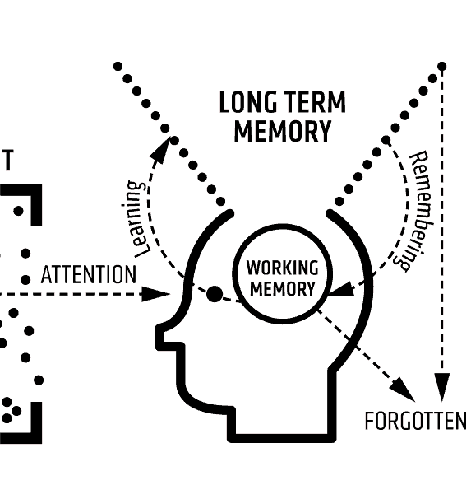
What is Generative Learning?
Generative learning is a cognitive process in which learners actively engage with new information, connecting it to their existing knowledge and experiences. It goes beyond rote memorization and encourages students to construct their own understanding by organizing and integrating new material into their mental frameworks.
If Rosenshein is the principles for effective teaching, then Generative learning is the principles for good learning.
Learning new information well enough to recall it easier in the future.
The teacher planning the best activities for children to embed new learning.

Slide 3
Summarising
Key information – getting to the point of what needs to be remembered.
Recalling information that has already been taught so that links are made.
Remembering key facts over time and reflecting on how secure children feel with these.
In lessons: sharing learning intentions, defining vocabulary and terms, recapping, specific activities in guided reading, plenaries.

Slide 4
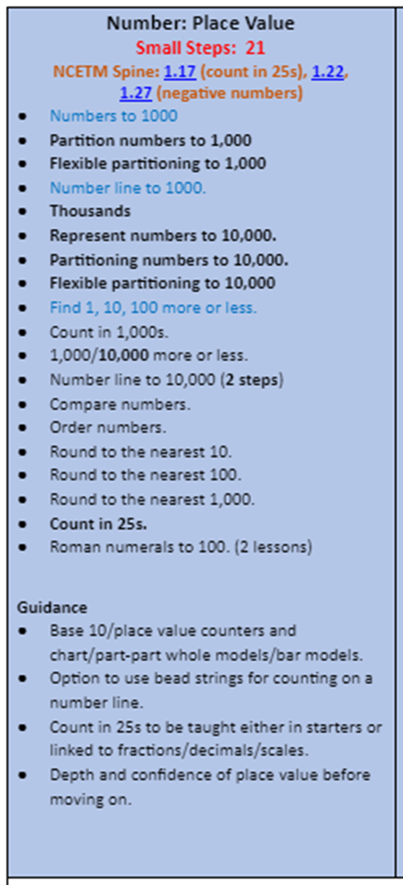
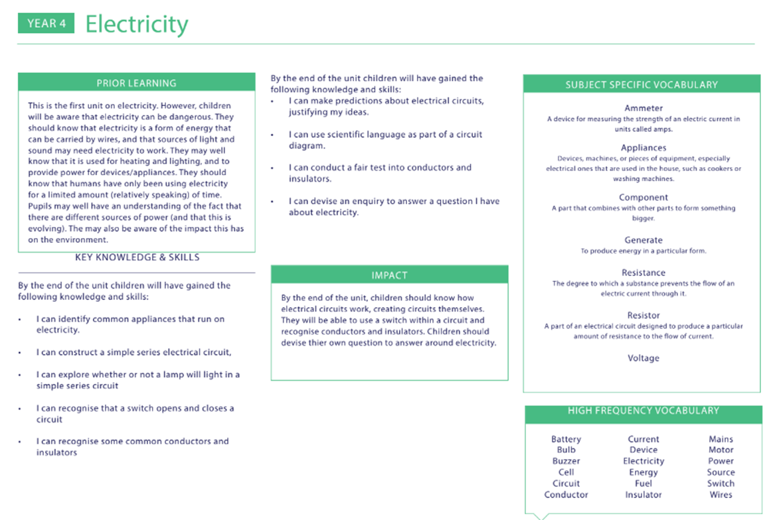
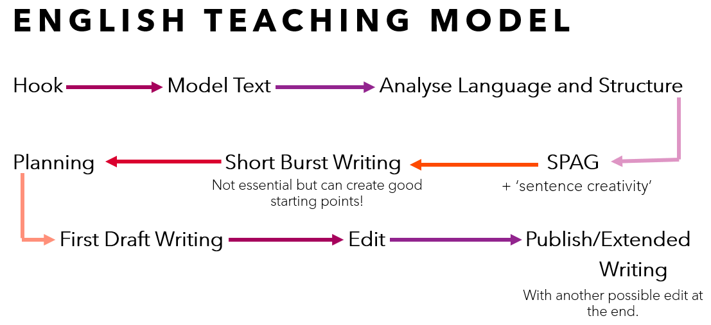
Mapping
Planning the sequence of learning in a logical order.
Children need to understand the order and make sense of it – lessons shouldn’t appear as ‘standalone’.

Slide 5
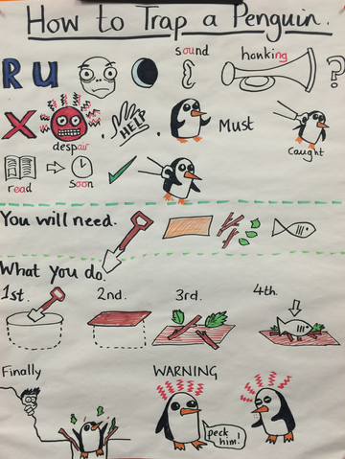
Drawing
Models and images to help children make sense of a concept
Pictorial representations: place value grids, bar models
Symbols in mapping

Slide 6
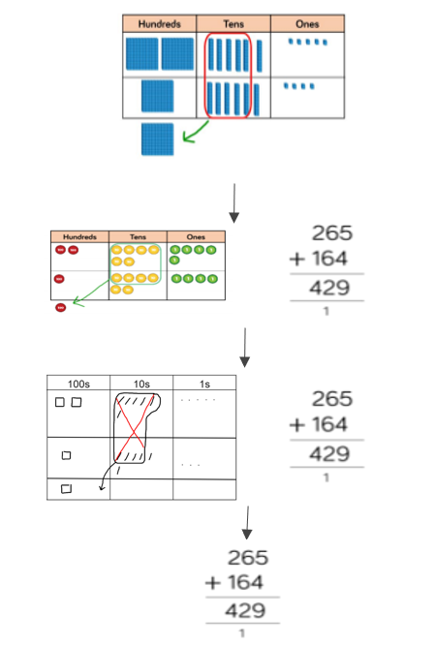
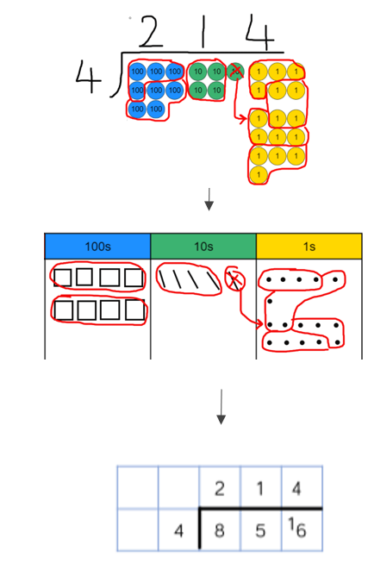

Slide 7
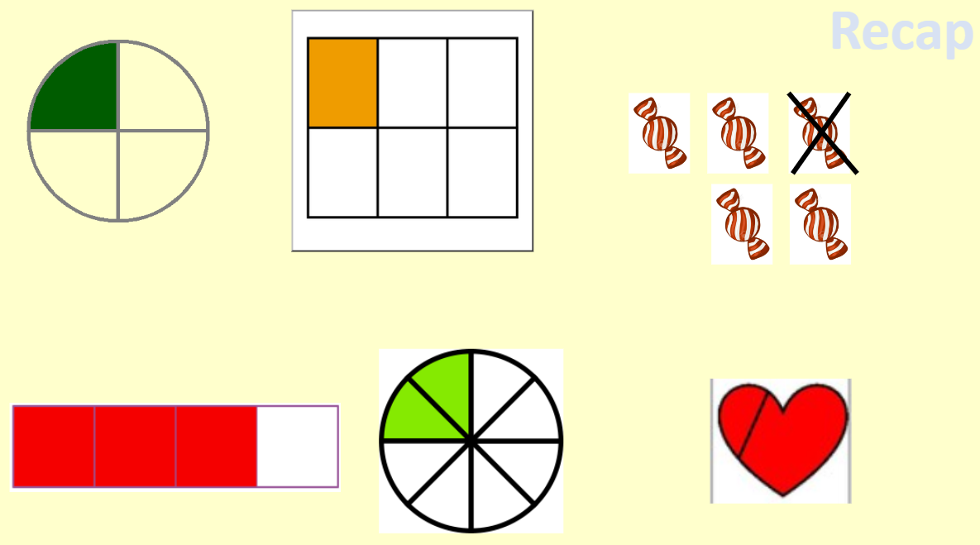
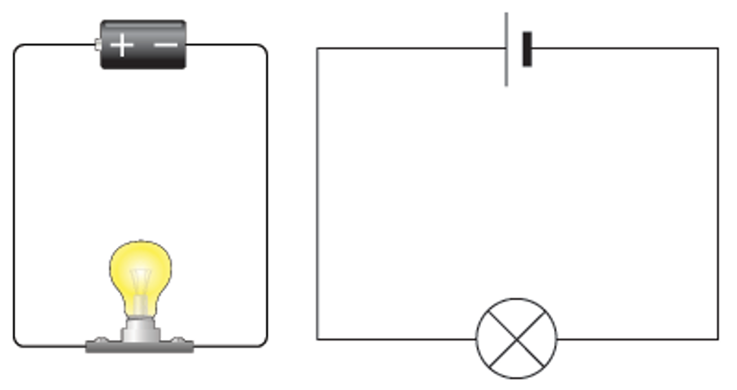

Slide 8
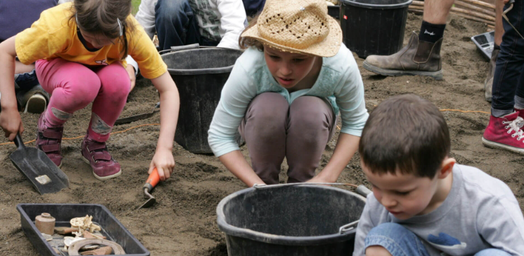
Enacting
Deepening children's understanding using drama, manipulatives, resources
Hot seating, freeze framing, conversations, etc.
Actions to help remember vocabulary
Stem sentences with actions
Dienes cubes, multilink, Numicon
Activities to create a context –Archaeology digs

Slide 9
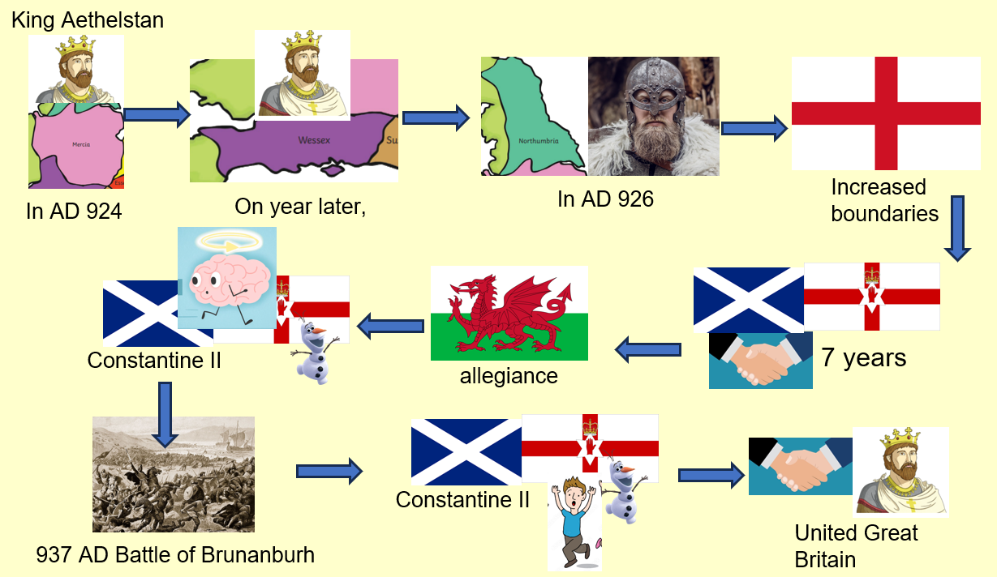
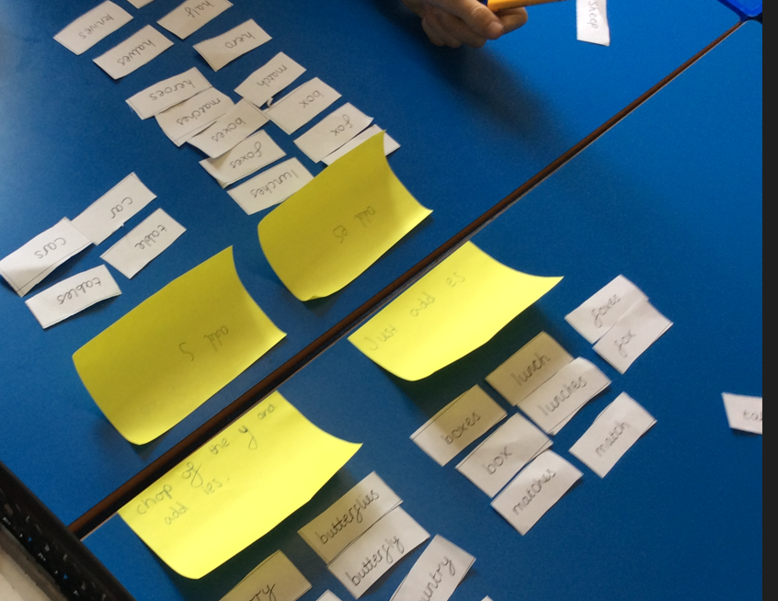
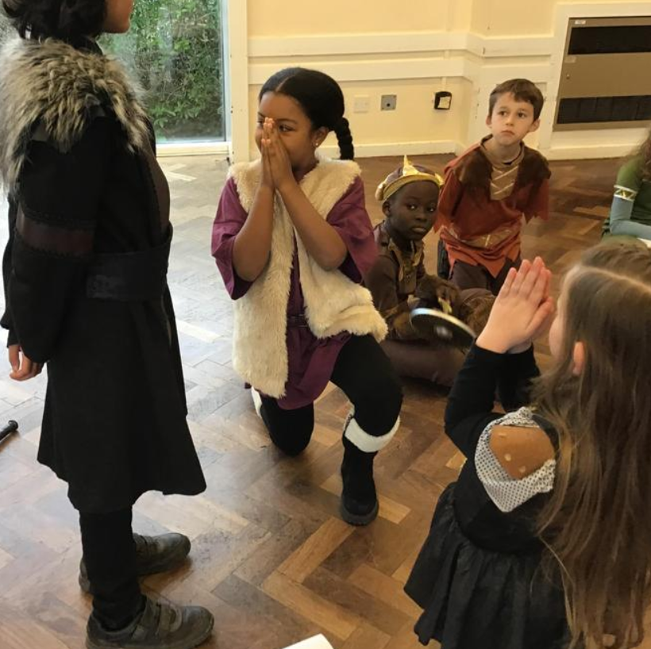
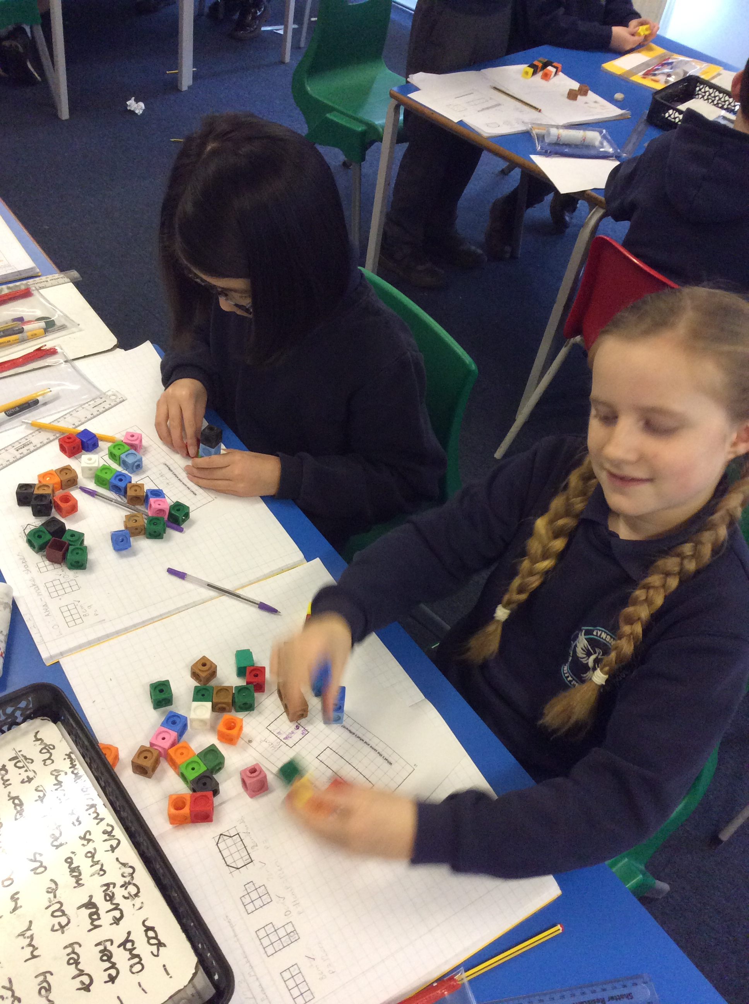

Slide 10
Imagining
Context for learning – experiences to draw on – Hooks
Scaffolding and slowly withdrawing them to develop independence
Prompts and ideas to generate mental images – linked to prior learning
Word problems

Slide 11
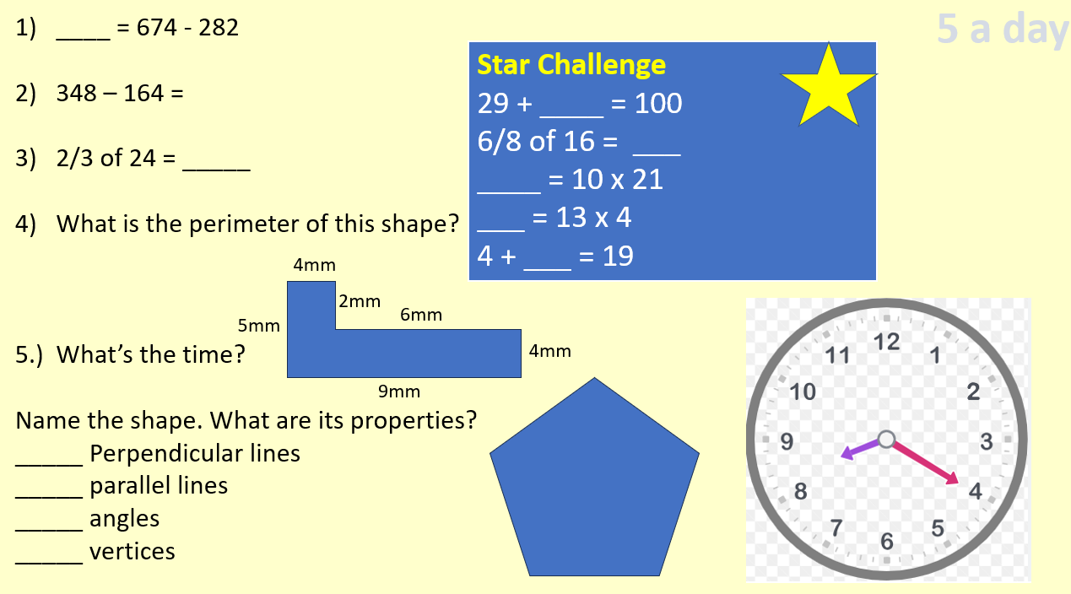
Self-testing
Low-stakes quizzing
Giving children chance to recall key facts
Fluency within a topic
Recapping at the start of lessons
Hinge questions – assessment for learning
Editing writing – Focusing on writing targets
Children take ownerships of their mistakes
Spelling of high-frequency words, government list words
Access to correct answers is key!

Slide 12
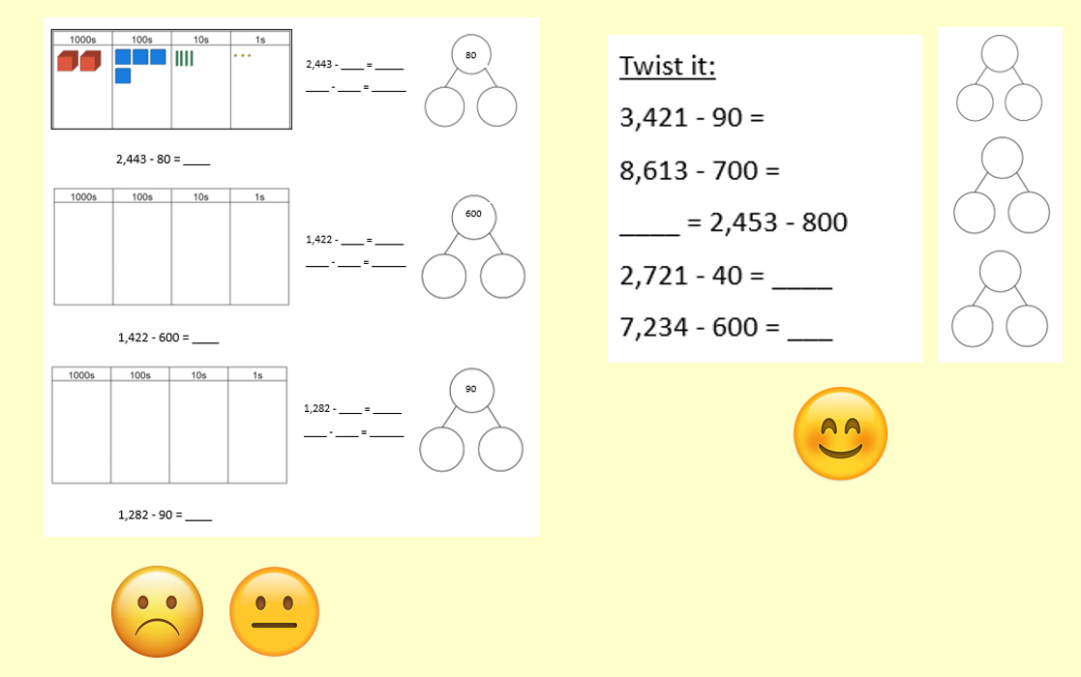
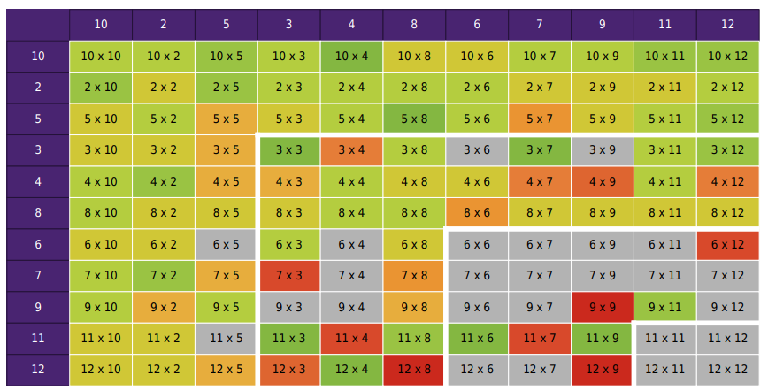

Slide 13
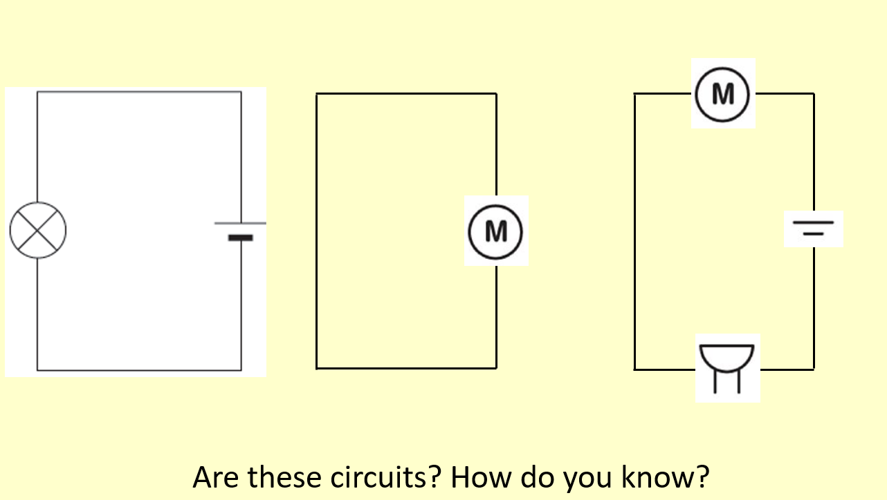
Self-explaining
Importance of questioning – think of several key questions that lead to self-explanation (How do you know? What evidence do you have? Tell me more…, Why is x important?)
Explaining their understanding of the key learning – address misconceptions
Time to check and consolidate
Children’s chance to summarise

Slide 14
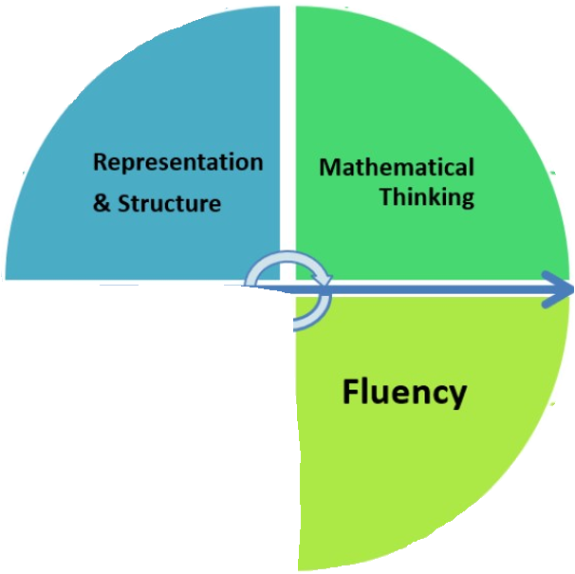
Fluency (Inc. Reasoning)
Prove this
Is there a quicker way?
Find the difference between …
Find and correct ‘x’ mistakes.
Write as a word problem
Is there another way?
Find the missing number …
Write and solve your own
Represent this another way …
How can you check this is correct?
How else could you …?
Can you make a rule?
Show an example …
Look for the pattern …

Slide 15
Reasoning and problem solving
Redo and explain …
How do you know?
Which one is wrong?
Which step did you miss?
What have you forgotten?
Explain how this works.
Explain the rule.
What is missing?
True or false? Explain.
Why didn’t you …
Spot the mistakes.
What do you notice about …?
What went wrong?
Why did you?
How many different ways …?
What would happen if …?
Can you think of a non-example?

Slide 16
Teaching
Mixed ability pairs
Peer explanation
Leading to GDS
Modelling to the whole class
Peer editing and marking

Slide 17
Key Messages
Each class and child is different. Do they all need all of these strategies or will it confuse/overwhelm?
Planning each strategy into lessons will provide greater opportunity to engage and remember
How can you adapt ‘brought in’ schemes to use each section?
Consider how much time on each section will have greater impact on the child
How can you use these strategies to benefit/control learning behaviour in all children?

Slide 18
A poor example (5 minutes)
Read through the plan – identify where each section is present.
What needs to improve?
Why might the teacher have planned this?
What advice would you give to this teacher?

Slide 19
Look at your planning
With colleagues in the same phase/year group
Look over your plans for tomorrow and adapt them using the feedback and information from this session.

