Slide 1
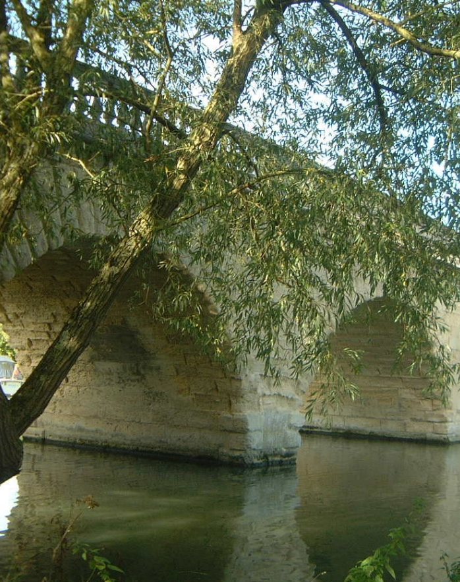
Active Learning – getting children thinking
EPA Primary Joint INSET January 2024

Slide 2
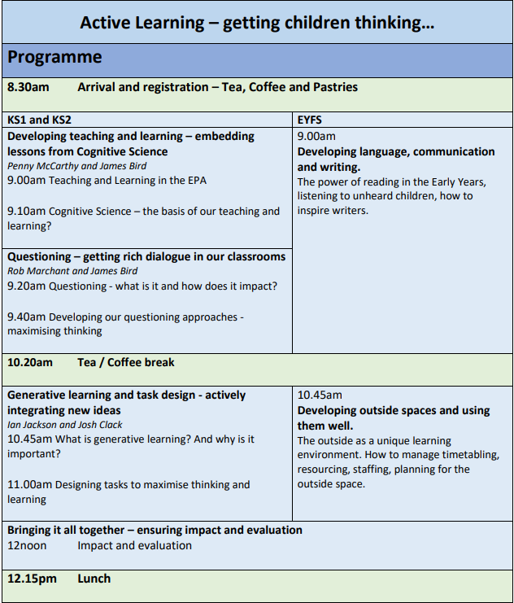
EPA Best Practice Research Group
Active Learning – getting children thinking
EPA Primary Joint INSET January 2024
EPA Primary INSET evaluation

Slide 3
Developing teaching and learning
Embedding lessons from Cognitive Science
EPA Primary Joint INSET, January 2024

Slide 4
Developing teaching and learning – embedding lessons from Cognitive Science

Slide 5
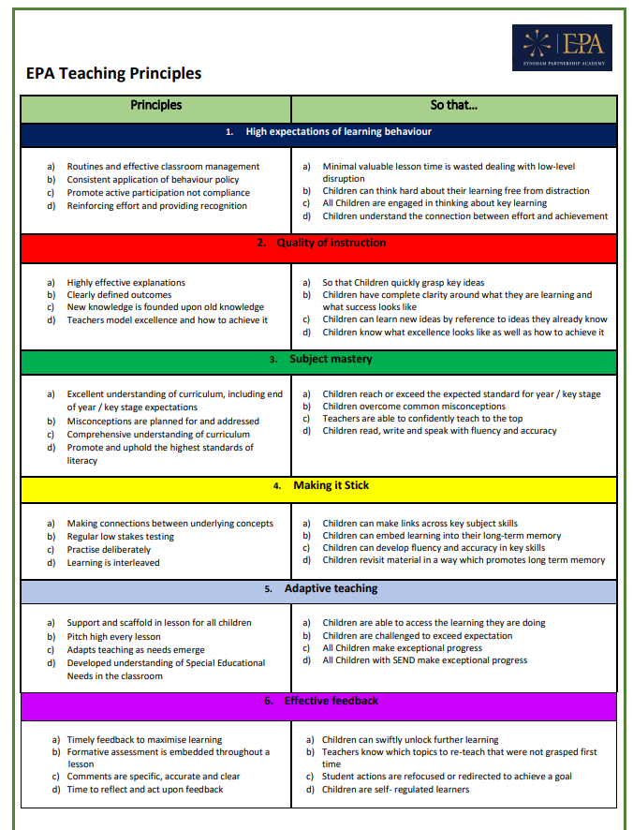
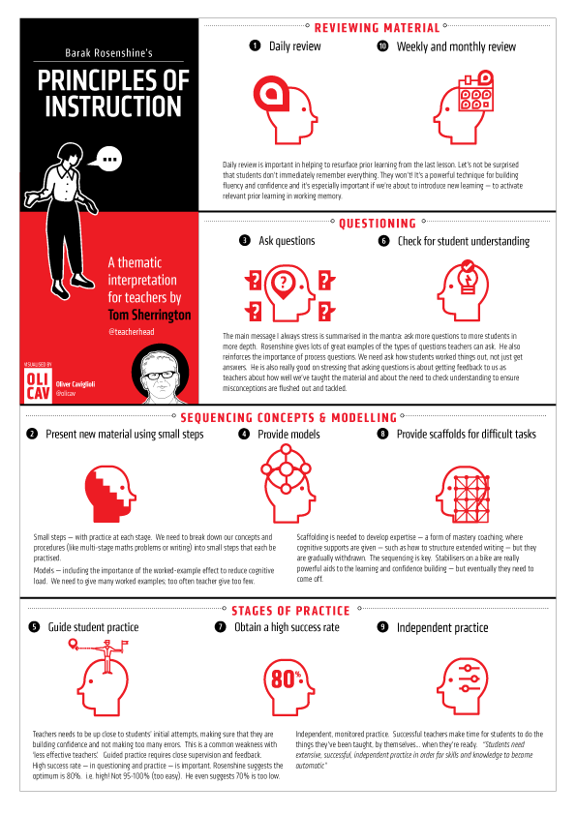
Developing teaching and learning – embedding lessons from Cognitive Science
Cognitive
Science
Rosenshine’s Principles
EPA Teaching Principles

Slide 6
Cognitive Science – the basis of our teaching and learning?

Slide 7
Cognitive Science – what is it?

Slide 8
Cognitive Science – what is it?
Cognitive psychology and Cognitive Neuroscience
Basically it’s probably our best way of knowing what is going on when we ‘learn’!
One of the appealing prospects for both these approaches is that they might reveal something fundamental about learning, memory, and the brain.
These understandings might be applicable across many contexts—to the extent to which humans share the same basic processes of learning and memory.

Slide 9
Cognitive Science – what is it?
Cognitive psychology and Cognitive Neuroscience
“Learning is defined as an alteration in long-term memory. If nothing has altered in long-term memory nothing has been learned.”
“Progress means knowing more and remembering more.”
Ofsted 2018

Slide 10
Cognitive Science – the basis of our teaching and learning?
Learning requires information to be committed to long-term memory.
Information is processed through the working memory.
The working memory has limited capacity and can be overloaded.
Key Principles

Slide 11
Cognitive Science – the basis of our teaching and learning?
Learning requires information to be committed to long-term memory.
Information is processed through the working memory.
The working memory has limited capacity and can be overloaded.
Key Principles

Slide 12
Working memory isn’t a box in the brain: it is the simultaneous short-term firing of brain cells, creating a temporary network in which prior knowledge is held together with new information. This firing of brain cells takes energy. The second stage is the consolidation of that pattern of connections as a long-term memory (sometimes called encoding).

Slide 13
Cognitive Science – the basis of our teaching and learning?
Initial Questions?

Slide 14
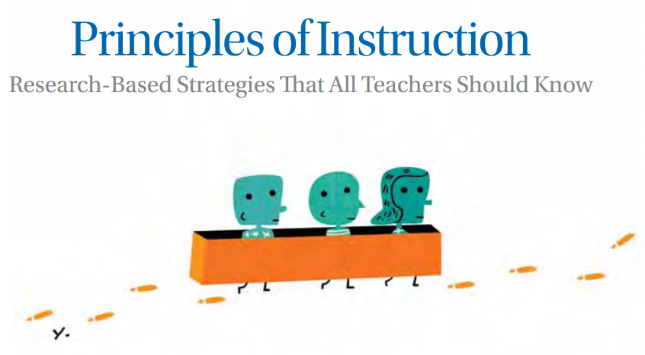
How can we use cognitive science to ensure our teaching allows children to remember more?
Barak Rosenshine's research is based on 3 sources:
Research in cognitive science
research of 'master' teachers
Research on cognitive supports.
American Educator 2012

Slide 15
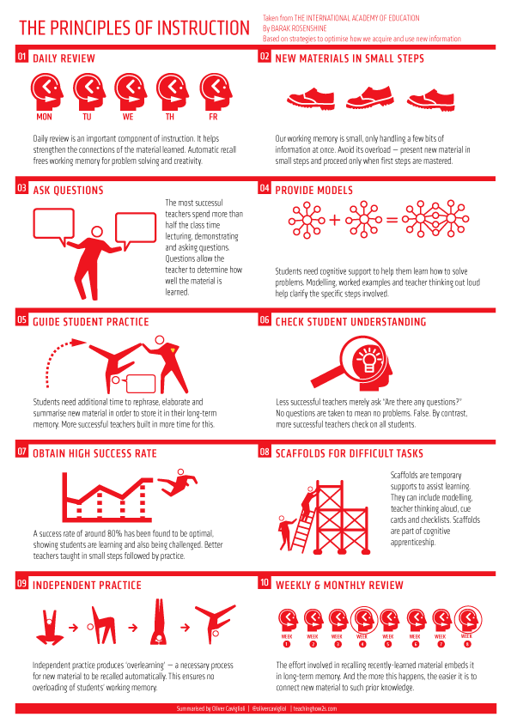
Rosenshine’s 10 Principles of Instruction
Daily review.
Present new material using small steps.
Ask questions.
Provide models.
Guide Student practice.
Check for student understanding.
Obtain a high success rate.
Provide scaffolds for difficult tasks.
Independent practice.
Weekly and monthly review.

Slide 16
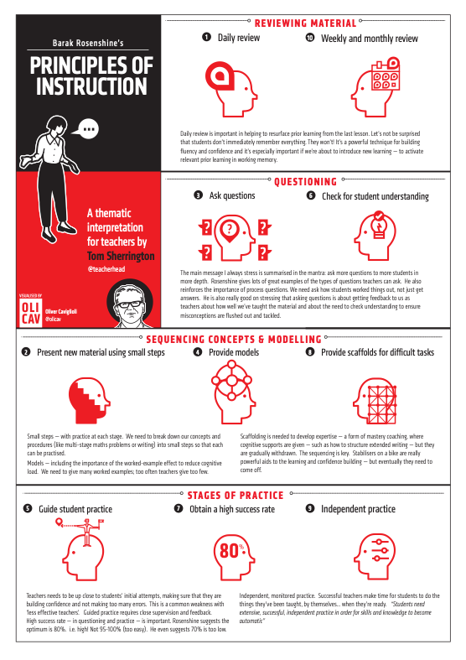
Tom Sherrington identifies 4 strands across Rosenshine's Principles of Instruction
Strand 1: Reviewing Material (principles 1 and 10)
Strand 2: Questioning (principles 3 and 6)
Strand 3: Sequencing Concepts and Modelling (principles 2,4 and 8)
Strand 4: Stages of Practice (principles 5, 7 and 9)

Slide 17
Strand 1: Reviewing Material
Strengthens connections between previous learning and new learning (schema)
Develops automaticity to free up working memory capacity allowing learners to focus on new learning.
Daily retrieval practice as well as going back over learning from last week/last month.

Slide 18
What does Retrieval Practice look like in the classroom?

Slide 19
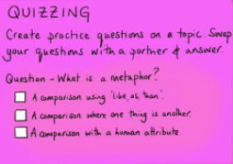
Low Stakes Quizzing

Slide 20
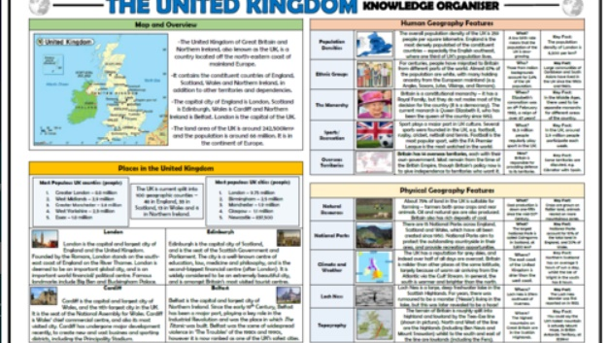
Children quiz each other using Knowledge Organisers.

Slide 21
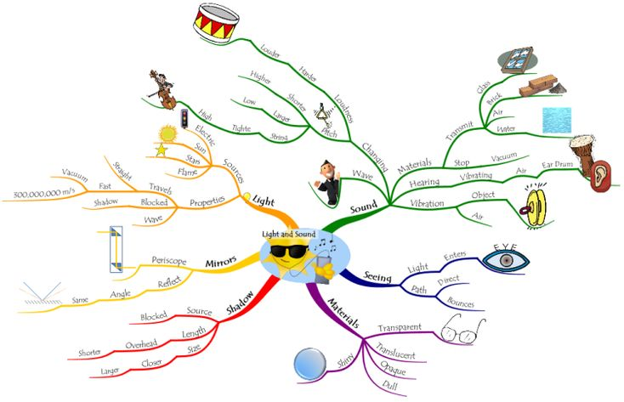
Mind Maps
MIND MAPS

Slide 22
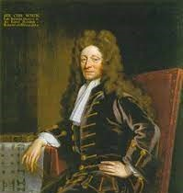
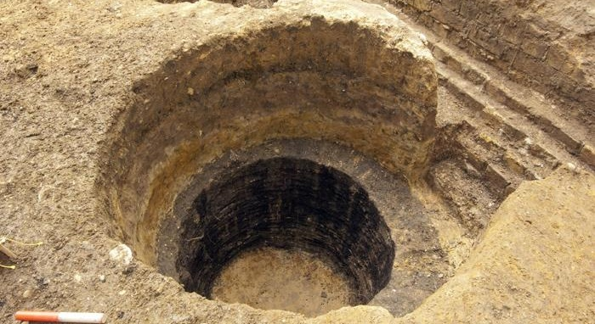
5 minutes to write as much as you can about the link between these pictures

Slide 23
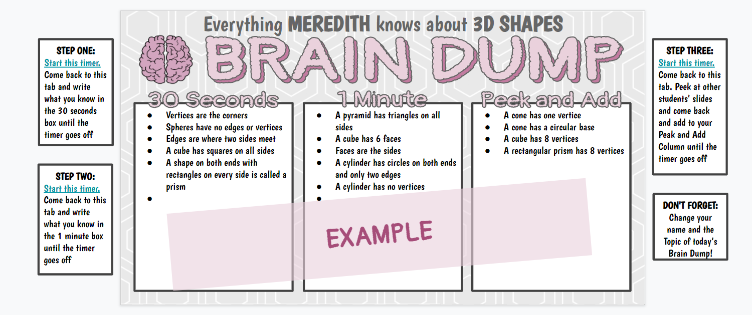
Brain Dump.

Slide 24
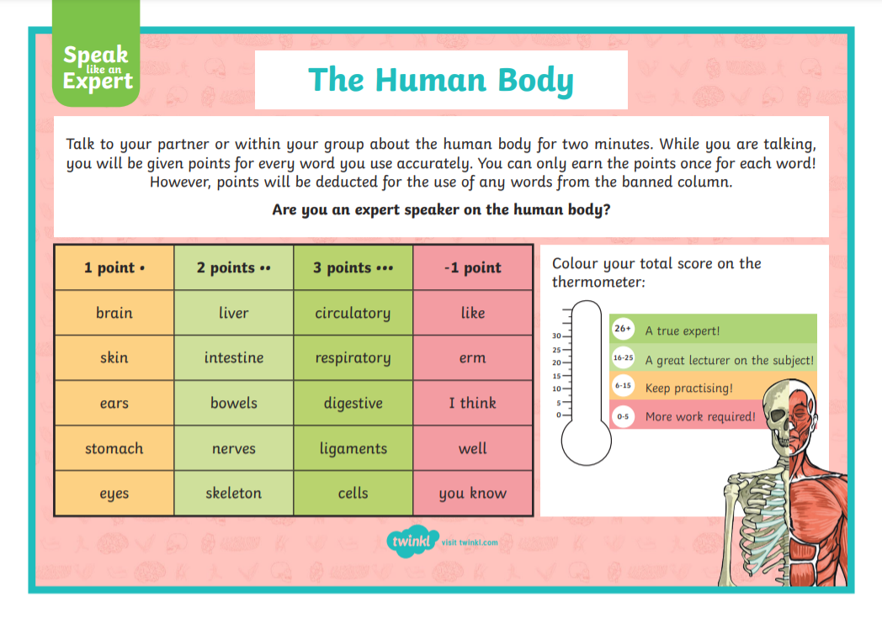
Speak Like an Expert

Slide 25
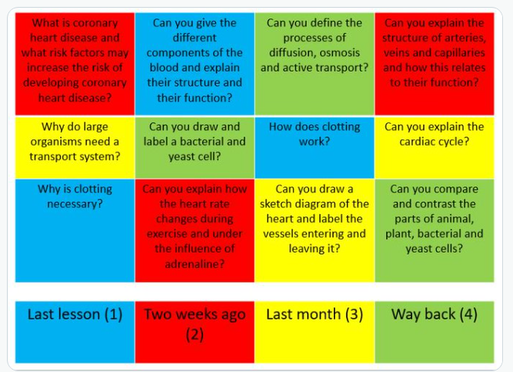
Challenge Grids
Review learning from last lesson, last week, last month and last term.

Slide 26
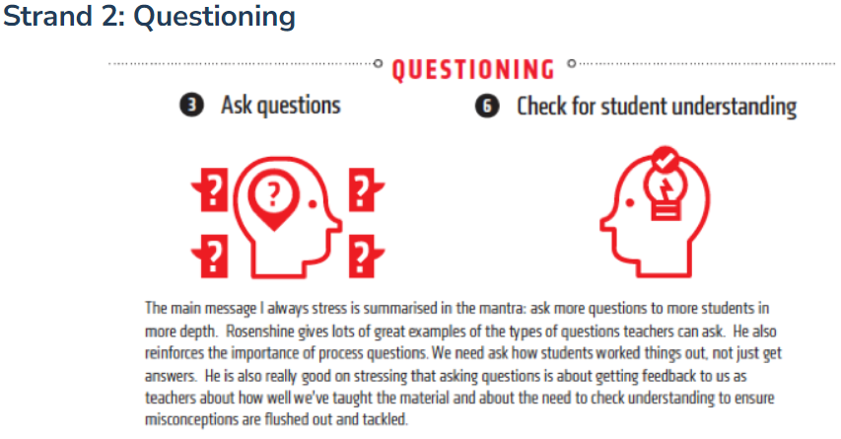
Strand 2: Questioning
Questioning has 2 main purposes.
Opportunities to practise using new learning.
Teacher to assess each pupils understanding.

Slide 28
Process Questions
Process questions involve deeper thinking and allow teachers to assess student's depth of understanding as well as giving students opportunity to build on their understanding through explaining and listening to other's explanations.
If I changed the number to_ what do you expect would happen?
What would happen if.......?
Why does x happen?
How did you work that out?
Why do you disagree with …...?

Slide 29
Tom Sherrington talks about ways to involve more pupils in each question, so teachers have a better understanding of where each pupil is in their understanding
Ask more questions, to more pupils, more of the time.

Slide 30
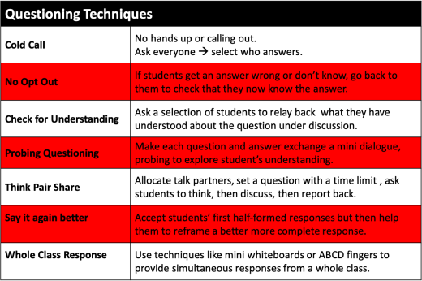

Slide 31
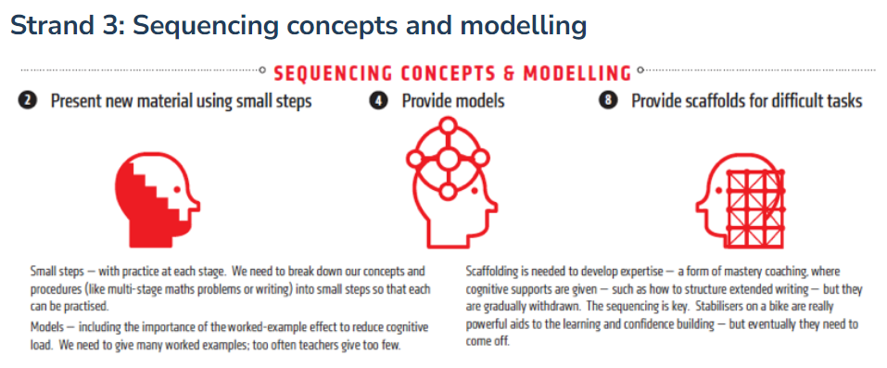
STRAND 3: Sequencing concepts and modelling

Slide 32
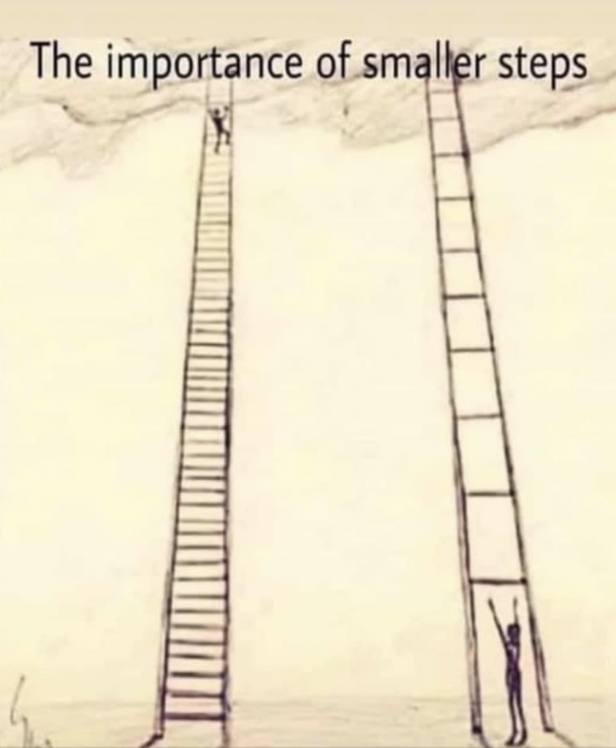
'The more effective teachers do not overwhelm their students by presenting too much new material at once. Rather, these teachers only present small amounts of new material at any time and then assist the students as they practice this material.
Only after students have mastered the first step do teachers proceed to the next step.'
Barak Rosenshine 2012

Slide 33
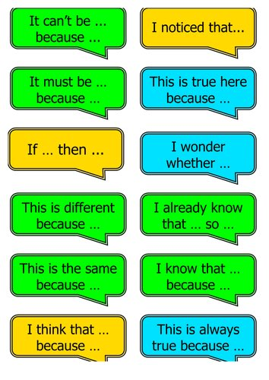
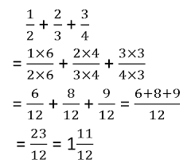
MODELLING

Slide 34
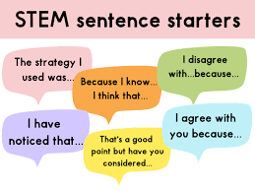
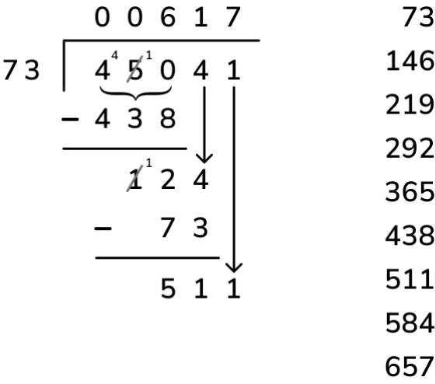
SCAFFOLDS FOR DIFFICULT TASKS
A scaffold is a temporary support that is used to assist a learner.

Slide 35
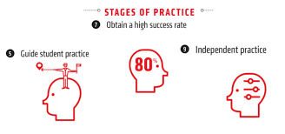
STRAND 4: STAGES OF PRACTICE

Slide 36
GUIDED PRACTICE AND INDEPENDENT PRACTICE
Students need to spend additional time rephrasing, elaborating and summarising new material in order to store this material in their long- term memory.

Slide 37
In guided practice the most successful teachers:
Presented material in small chunks
Asked carefully planned questions to gauge understanding and allow students to process new material.
Asked students to summarise the main points
Used formative assessment to address misconceptions quickly within the lesson.
Modelled examples
Thought aloud demonstrating their thought process
Prepared students adequately to be able to apply the new knowledge independently.
Students had a success rate of about 80%

Slide 38
Independent Practice
Principle 9
Independent practice is needed in order for a skill to become automatic.
When material is overlearned, it can be recalled automatically.
Reduces cognitive load when building on to this knowledge.
Daily, weekly, monthly review supports this.

