Slide 1
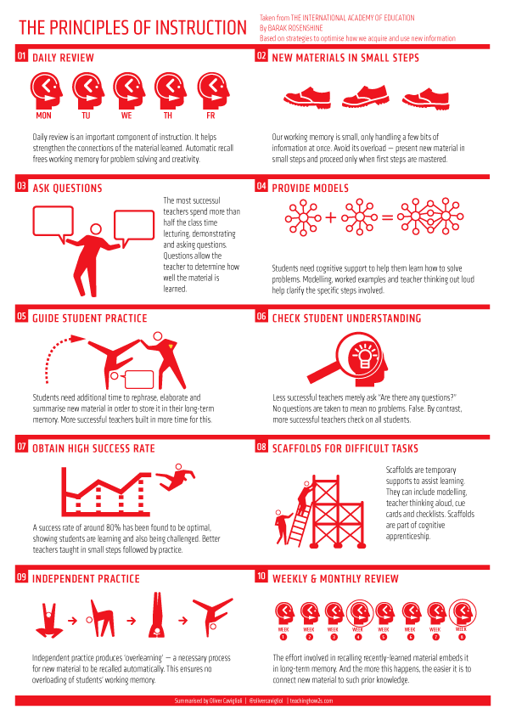
Rosenshine’s Principles of Instruction
Barak Rosenshine was a professor at the University of Illinois. He studied psychology and developed these principles for effective teaching
How did Rosenshine develop these principles?

Slide 2
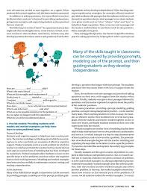
Rosenshine’s 10 Principles of Instruction
Daily review.
Present new material using small steps.
Ask questions.
Provide models.
Guide Student practice.
Check for student understanding.
Obtain a high success rate.
Provide scaffolds for difficult tasks.
Independent practice.
Weekly and monthly review.
https://files.eric.ed.gov/fulltext/EJ971753.pdf

Slide 3
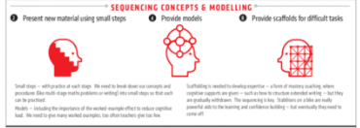
Sequencing and Modelling
Principles 2,4,8

Slide 4
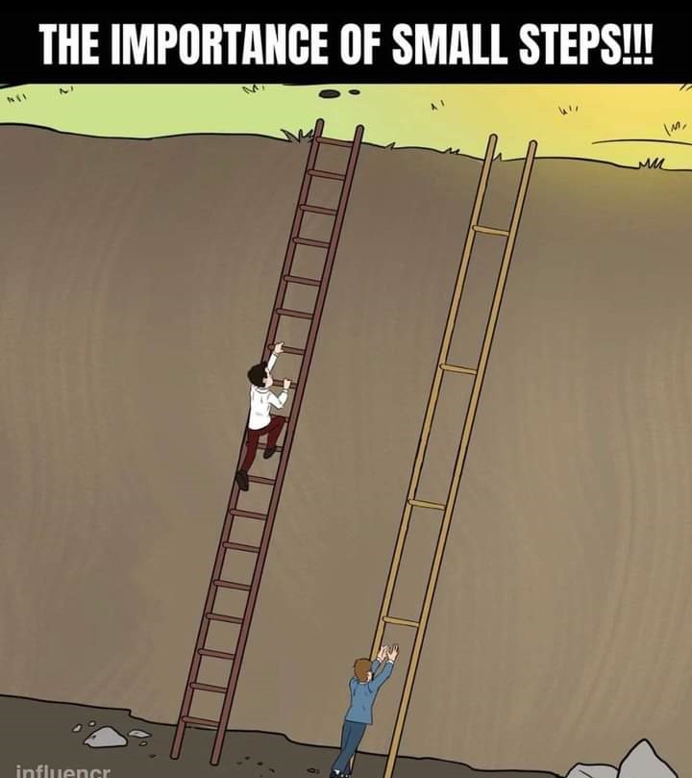
Small Steps (Principle 2)
Our working memory, the place where we process information is small. It can only handle a few bits of information at once-too much information swamps our working memory.
Therefore, the more effective teachers do not overwhelm their students by presenting too much new material at once.
Rosenshine (2010)

Slide 5
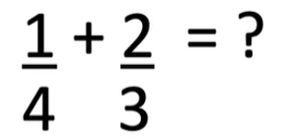
What prior knowledge do pupils need before being able to solve a problem like this?

Slide 7
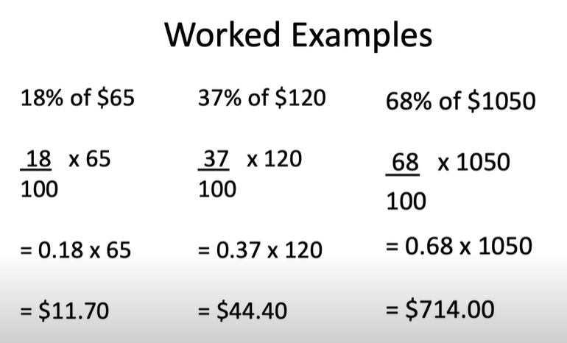
Provide Models (Principle 4)
Students need cognitive support to help them solve problems. The teacher modelling and thinking aloud while demonstrating how to solve a problem are examples of effective cognitive support. Worked examples (such as a maths problem for which the teacher has not only provided the solution but has clearly laid out each step) are another form of modelling that has been developed by researchers.
Worked examples allow students to focus on the specific steps to solve problems and thus reduces the cognitive load on their working memory.
Rosenshine (2010)

Slide 9
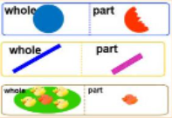
Variation
CONCEPTUAL
PROCEDURAL

Slide 10
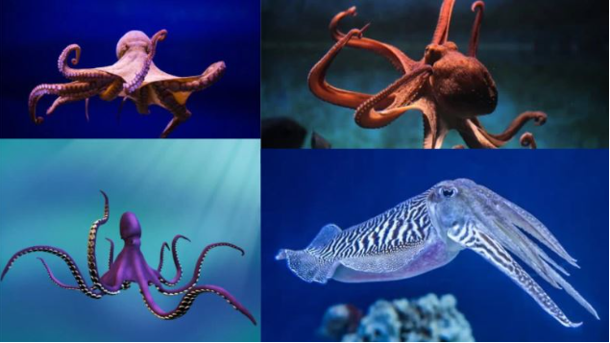
Conceptual
Similarities: live in water, change colour, move by jet propulsion, have eight arms.
Differences: Cuttlefish have backbones, octopuses have a round head but cuttlefish are triangular.
Conceptual Variation draws attention to the essential features of a concept by varying the non essential features

Slide 11
Use examples and non examples for children to understand the essential features and be able to explain them.

Slide 13
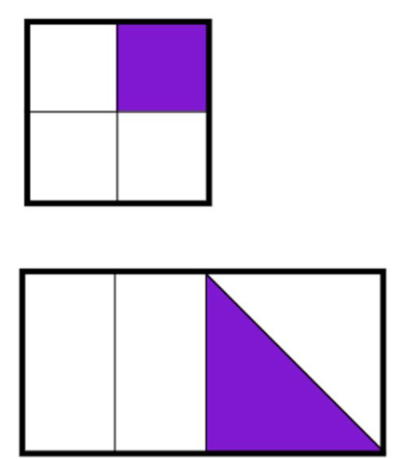
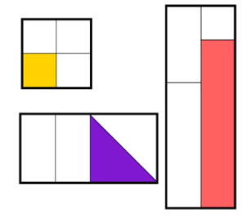
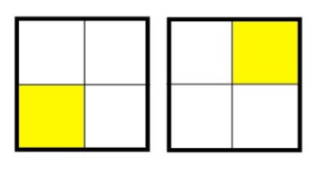

Slide 14
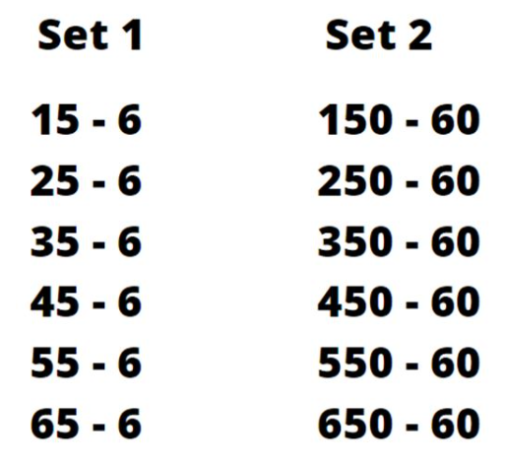
Procedural
Procedural variation draws attention to patterns and generalisations, quite often in number. It links one calculation to the next and establishes a connections and pattern.

Slide 15
8-3=5
9-4=5
10-5=5
11-6=5

Slide 16
Provide Scaffolds for Difficult Tasks (Principle 8)
Investigators have successfully provided students with scaffolds or instructional supports to help them learn difficult tasks. A scaffold is a temporary support which is used to support a learner. These scaffolds are gradually withdrawn as learners become more competent.
Rosenshine (2010)

Slide 17
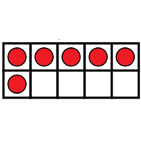
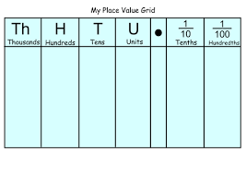

Slide 20
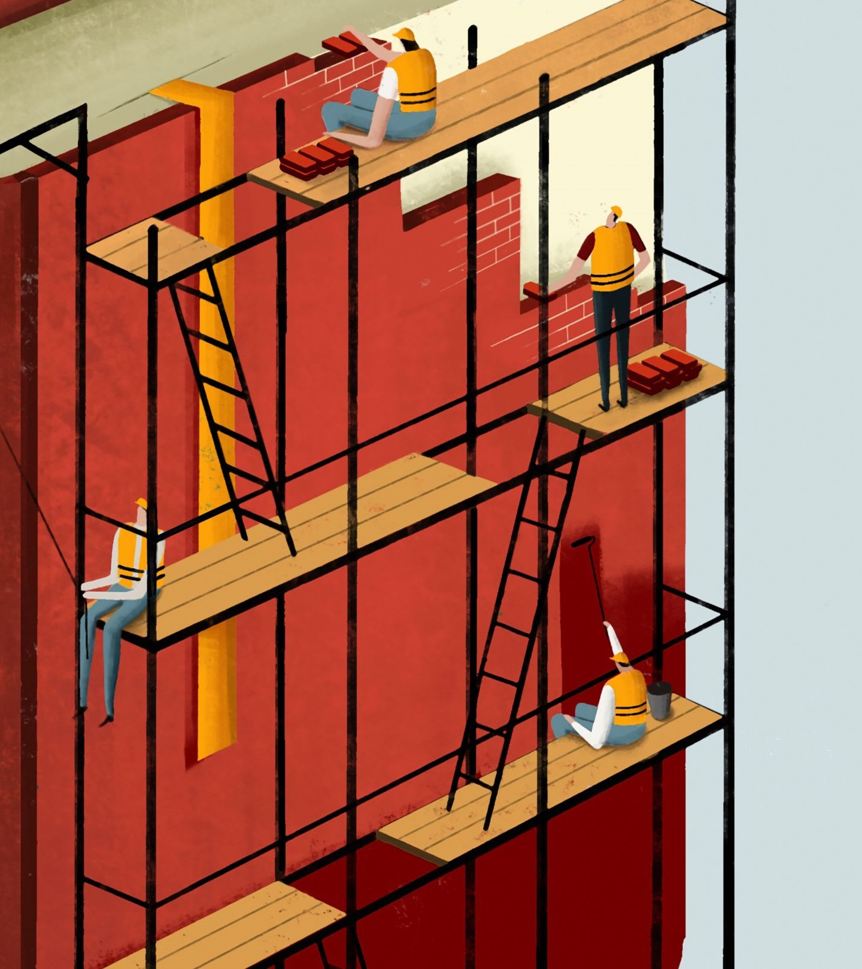
Scaffolds can also be built into the teaching through using Rosenshine’s Principles, such as:
small steps
modelling
questioning
review at start of lesson

Slide 21
Daily, weekly and monthly review.
(Principles 1 and 10)

Slide 22
https://www.youtube.com/watch?v=pYbbZJOQudk
Pooja Argawal

Slide 23
What does Retrieval Practice look like in the classroom?

Slide 24
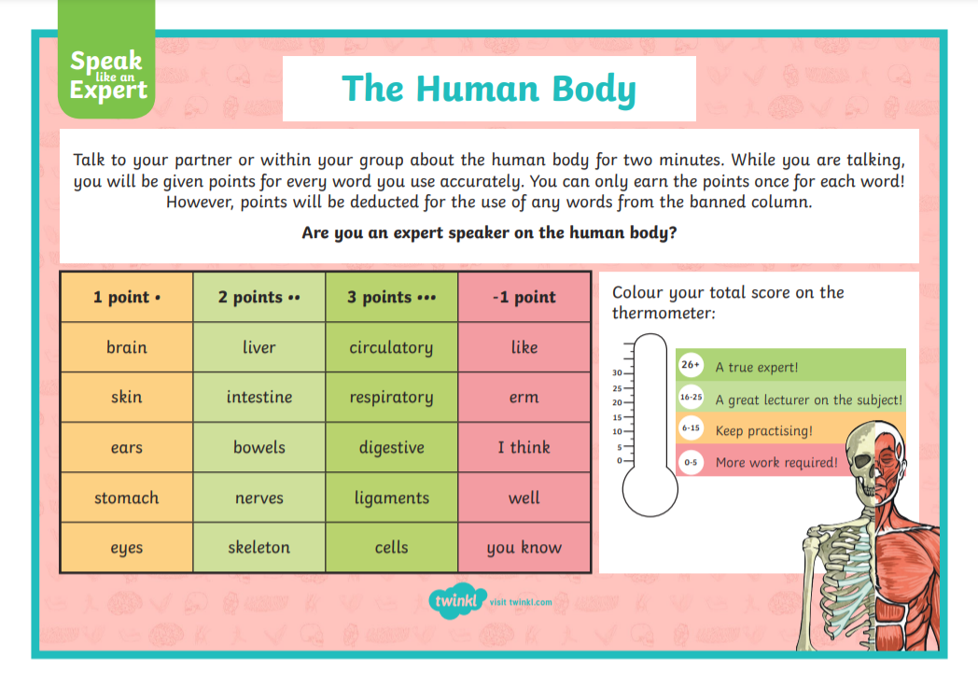
Speak Like an Expert

Slide 25
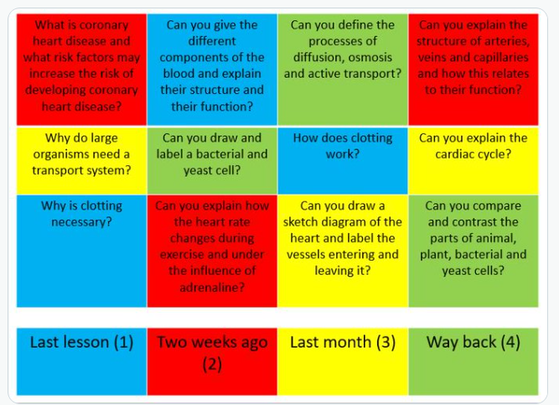
Challenge Grids
Review learning from last lesson, last week, last month and last term.

Slide 26
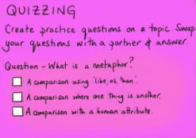
Low Stakes Quizzing

Slide 27
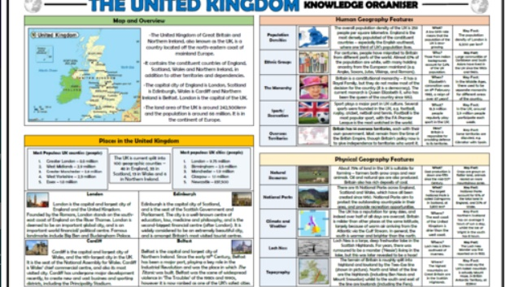
Children quiz each other using Knowledge Organisers.

Slide 28
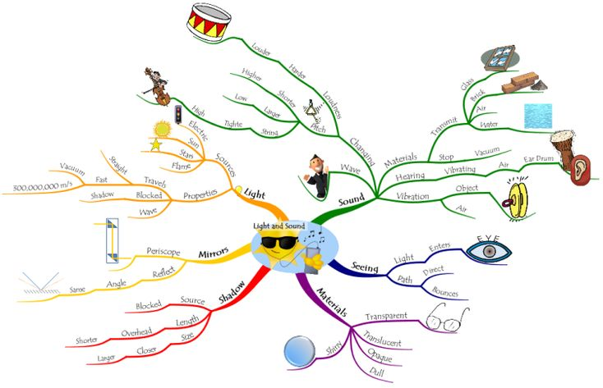
Mind Maps
MIND MAPS

Slide 29
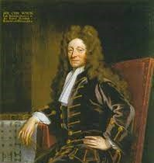
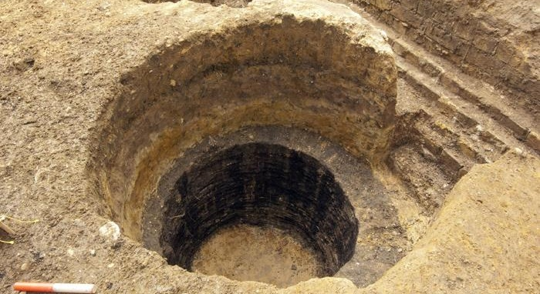
5 minutes to write as much as you can about the link between these pictures

Slide 30
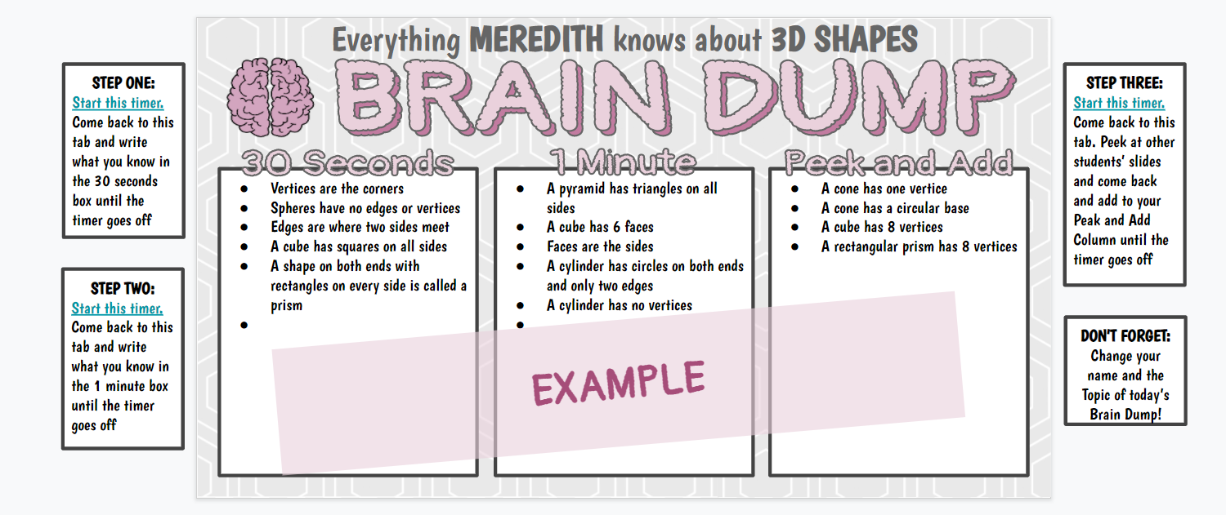
Brain Dump.

Slide 31
Think about everything you know about the Romans.
Time each other and complete a brain dump with two minutes to magpie at the end.

Slide 32
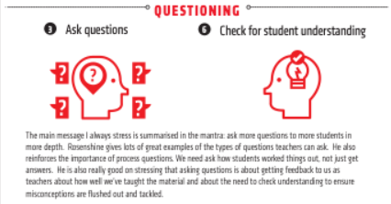
Questioning
(Principles 3 and 6)
‘One of the strongest implications from Rosenshine’s ‘Principles of instruction’ is that effective questioning lies at the heart of great instructional teaching. It’s clear that this needs to be a highly interactive, dynamic, responsive process.’
(Tom Sherrington)

Slide 33
Think about your class.
Which pupils do you think receive more of your attention during questioning?
What might possible reasons be for this?
Which pupils, on reflection, do you question least?
What might possible reasons be for this?

Slide 34
Ask more questions, to more pupils, more of the time.

Slide 35
Implications for the classroom
Questioning allows us to engage all pupils in the learning and to deepen their understanding.
Questioning allows us to assess if pupils have understood.

Slide 37
Tom Sherrington Questioning Techniques

Slide 38
Questions at key points in the lesson to assess pupil’s understanding.
A check for understanding at a hinge point in the lesson
Provides immediate and ‘actionable’ information to the teacher.
1 minute to respond
15 seconds to interpret
(302) Dylan Wiliam Hinge Questions - YouTube

Slide 39
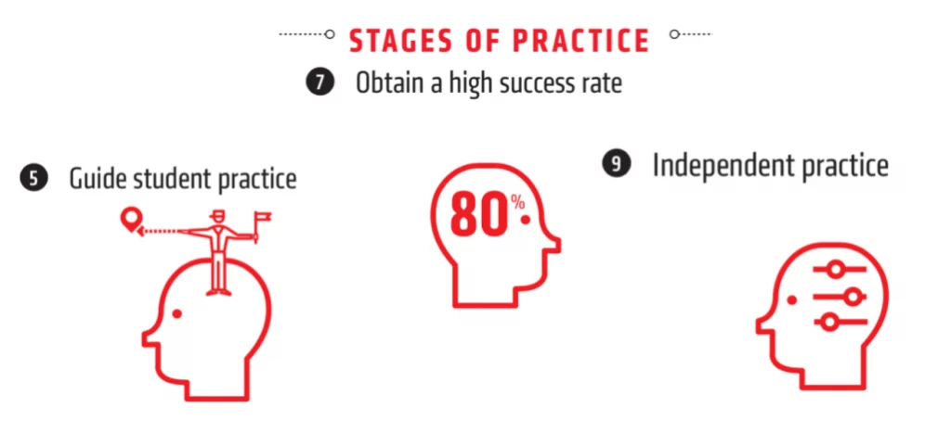
Stages of Practice
(Principles 5,7,9)

Slide 40
Guided Practice
Principle 5
Rosenshine found the most successful teachers:
Presented small amounts of information at a time followed by guided practice.
Spent more time on guided practice than other teachers.
Had more engaged pupils during independent work because they had a higher success rate and felt more confident.

Slide 42
High Success Rate
Principle 7

Slide 43
Independent Practice
Principle 9
Independent practice is needed in order for a skill to become automatic.
When material is overlearned, it can be recalled automatically.
Reduces cognitive load when building on to this knowledge.
Daily, weekly, monthly review supports this.

