Slide 1
Lesson Resources and GenAI

Slide 2
Why am I here?
GenAI can save you time!
To address the growing digital divide.

Slide 3
What do I not intend to do?
Tell you have to use GenAI tools. This is just about presenting some options which you can then decide if they are helpful or not for your practice.

Slide 4
Teachers using ChatGPT, alongside a guide to support them to use it effectively, can reduce their lesson planning time by 31 per cent (EEF, 2024)

Slide 5
259 teachers in 68 secondary schools across England took part in the randomised controlled trial. Of those, 129 teachers in 34 schools were randomly allocated to use ChatGPT alongside a guide on effective implementation, to support lesson and resource preparation for their Year 7 and 8 science classes. (EEF, 2024)

Slide 6
A sample of lesson materials and resources collected from teachers were reviewed by an independent panel of teachers. The analysis indicated no noticeable difference in quality between the two groups.
Teachers’ own perception of the quality of the resources they had produced also aligned with this finding. (EEF, 2024)

Slide 7
A survey of 9,138 teachers in the UK conducted by SchoolsWeek in August 2023 found that 33% of state school teachers surveyed had used GenAI tools, whereas this figure rose to 49% for respondents from independent schools.

Slide 8
Oriel Square carried out a survey of over 8,000 teachers in England between March and May 2023 and found that awareness of GenAI was higher in independent schools, with only 8% of respondents from independent schools being unaware of ChatGPT compared to 18% of respondents from state schools.

Slide 9
In the same Oriel Square survey, it was found that whilst 50% of respondents working in state-funded schools had not yet received guidance on the use of AI in school, this proportion fell to 25% for those working in independent schools.

Slide 10
What is GenAI?
Generative AI, a specific branch of AI, can "automatically generate content in response to prompts written in natural-language conversational interfaces" (UNESCO, 2023)

Slide 11
Session Plan
Introduction to Google NotebookLM
Few more ideas for how to use ChatGPT

Slide 12
Introduction to Google
NotebookLM

Slide 13
Why am I focusing on Google NotebookLM?
You control the sources
Clear citations - easier to check
Multimodal
Free!

Slide 14
Open Notebook LM
https://notebooklm.google/

Slide 15
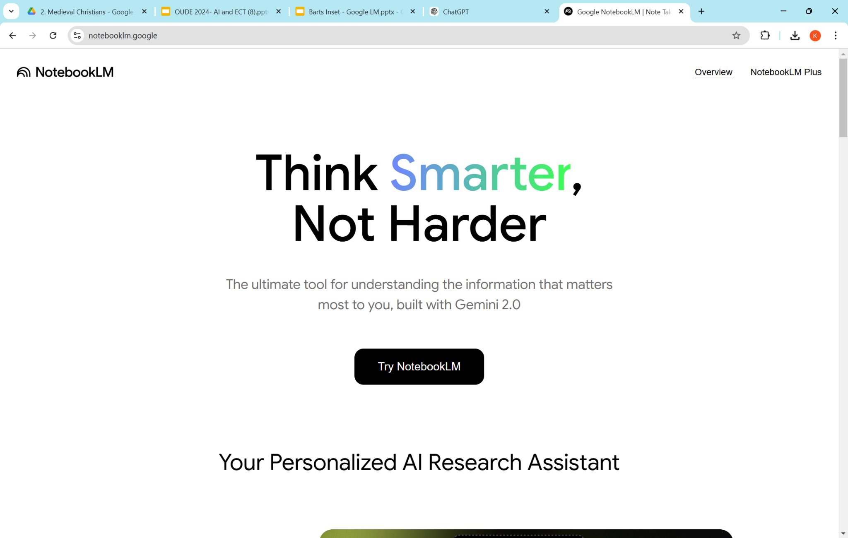
Click!

Slide 16
Create your Notebook

Slide 17
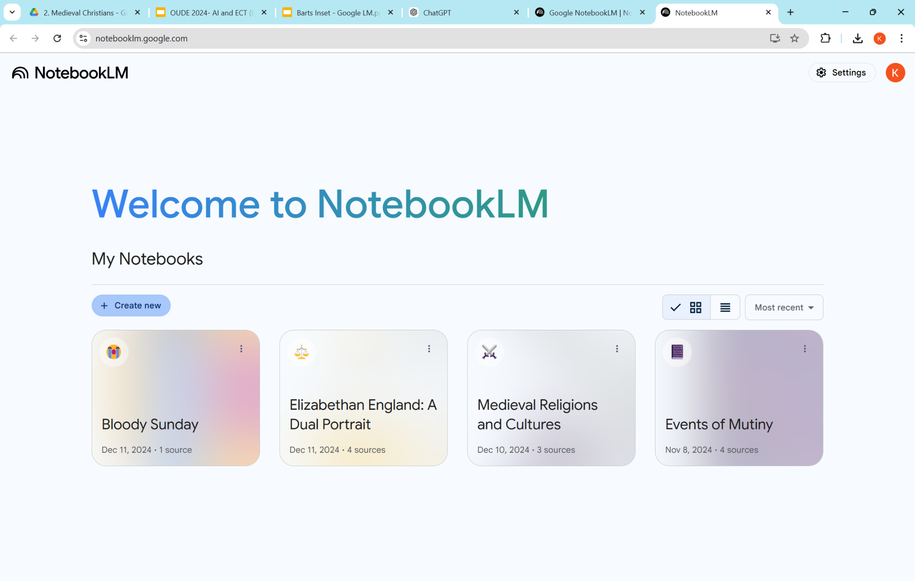

Slide 18
Upload your source

Slide 19
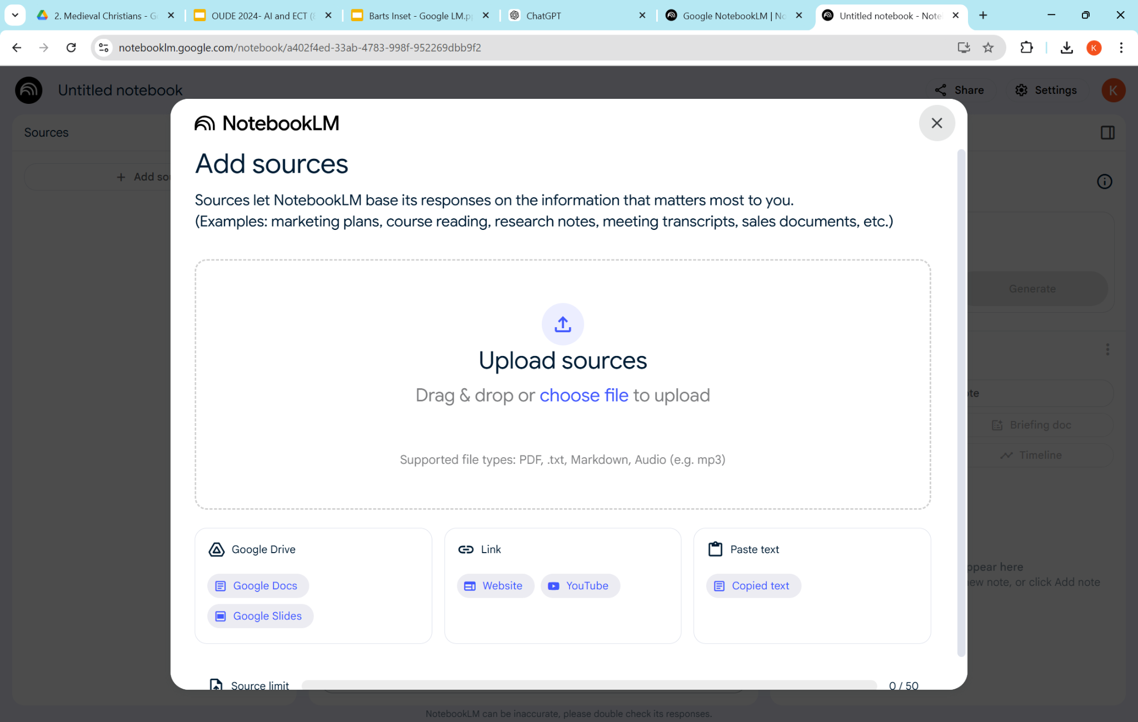

Slide 20
Explore the studio options

Slide 21
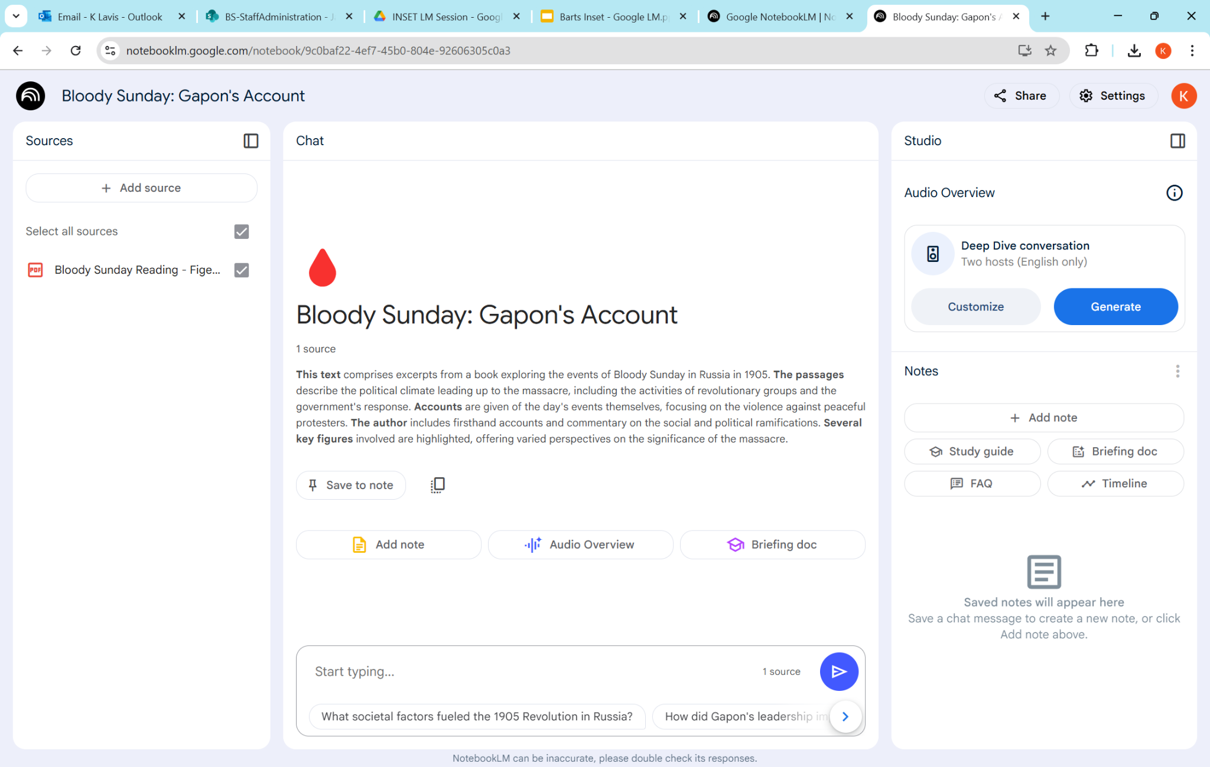

Slide 22
Produce a Briefing Document

Slide 23
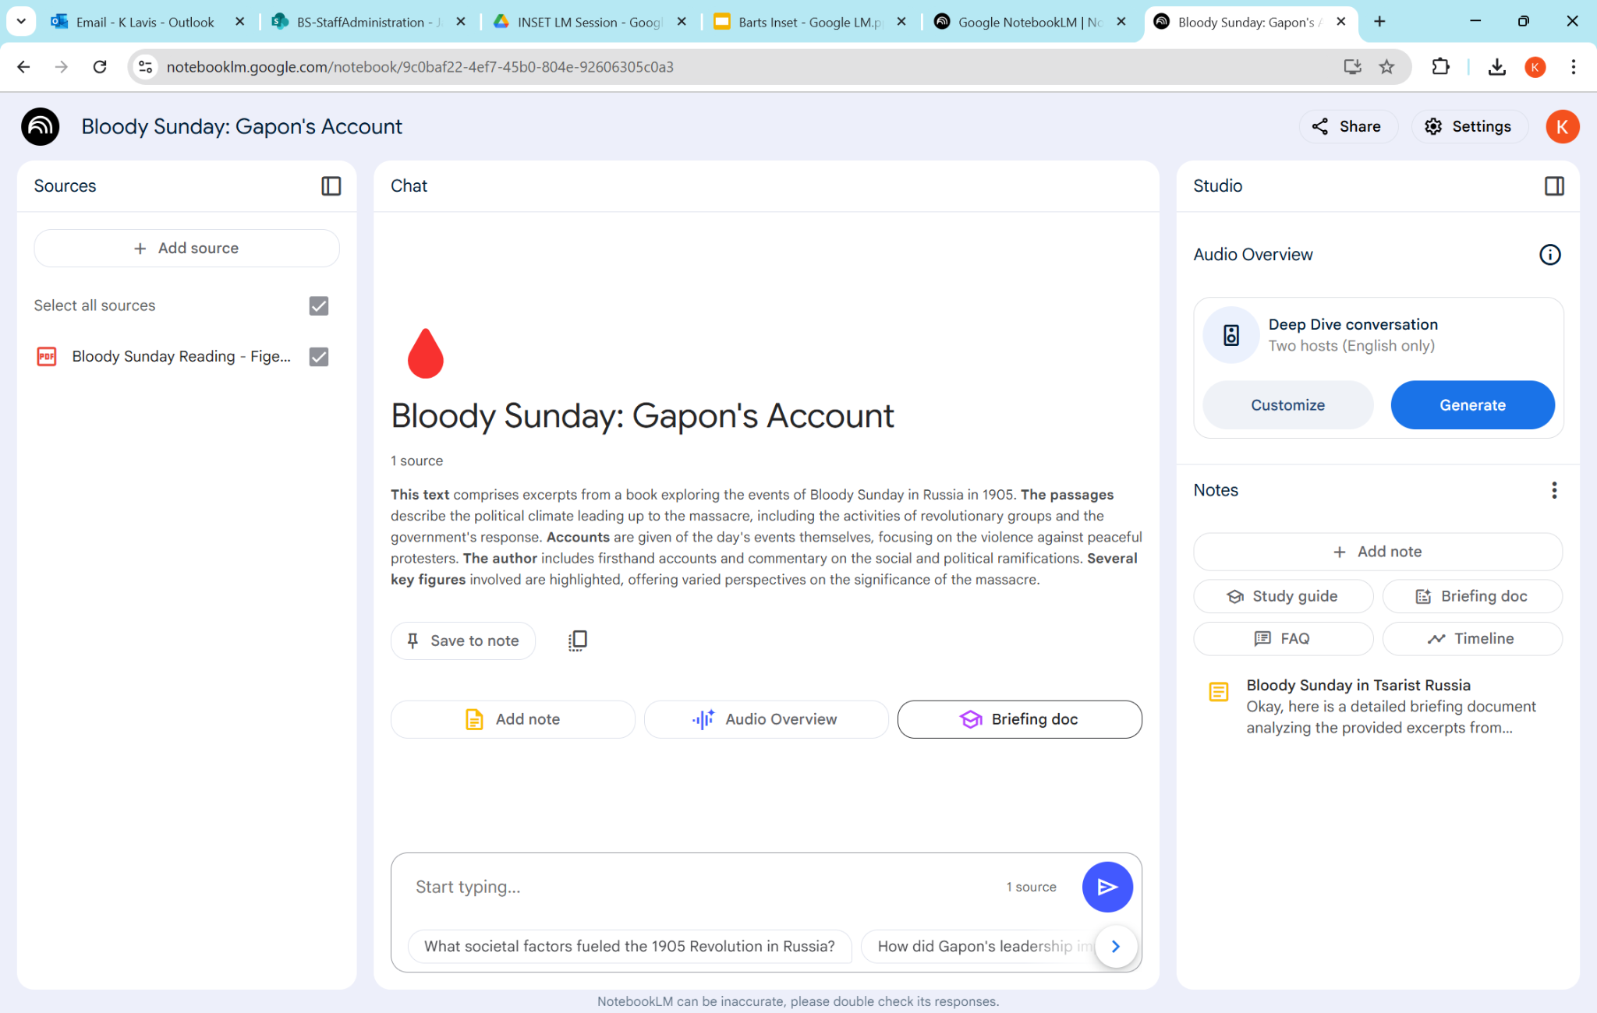

Slide 24
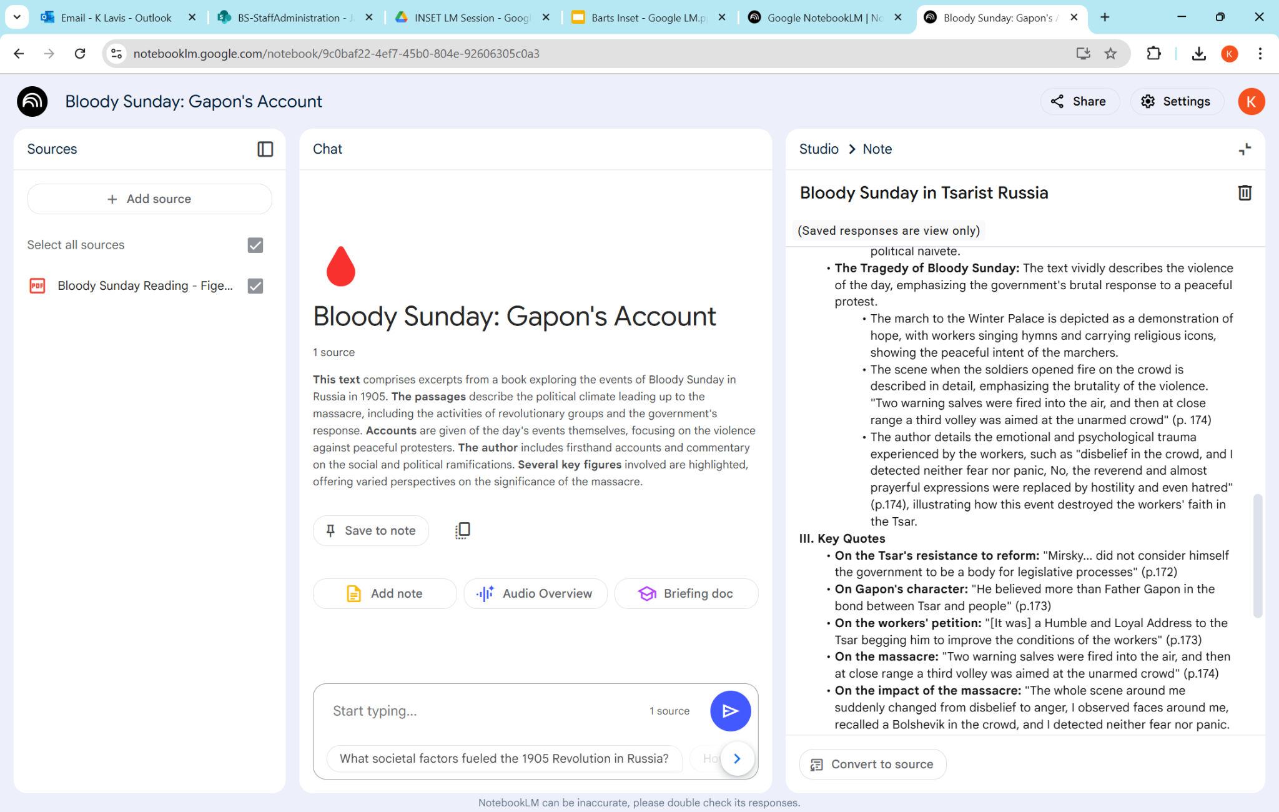

Slide 26
Produce a Study Guide

Slide 28
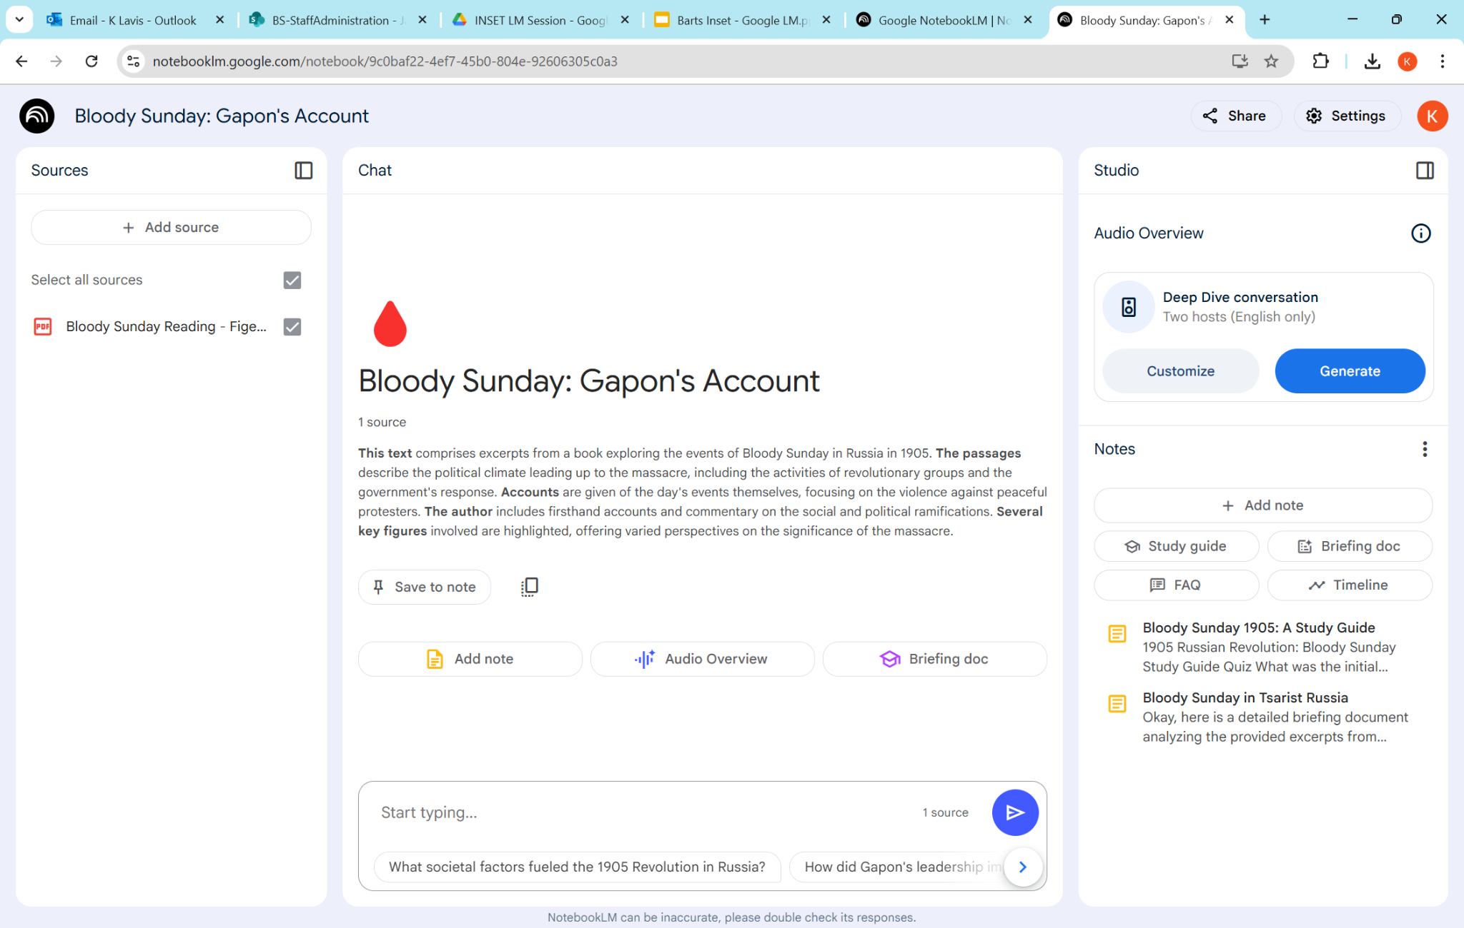

Slide 29
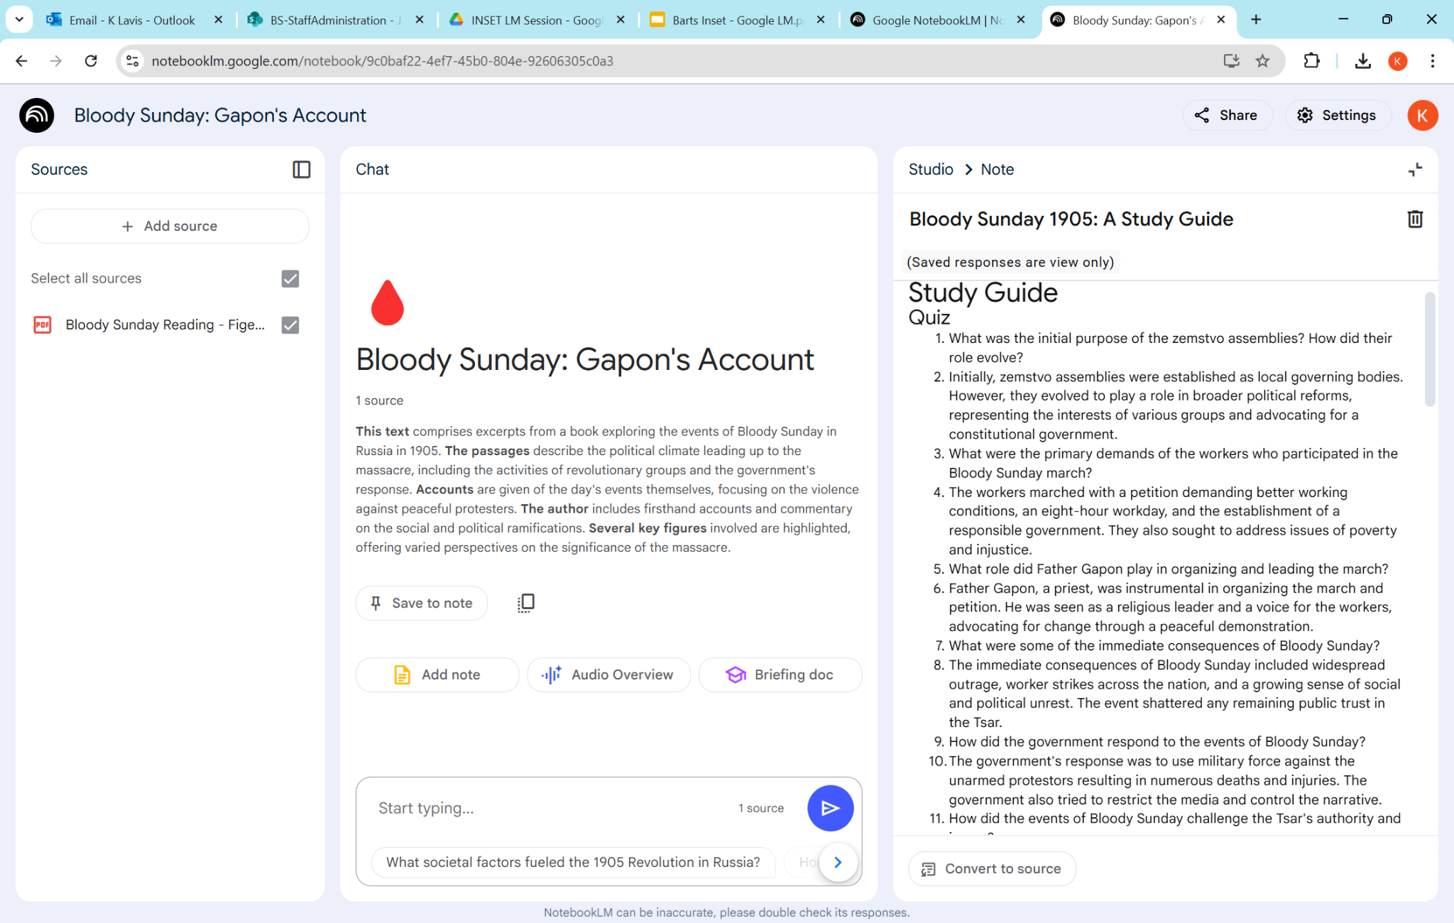

Slide 30
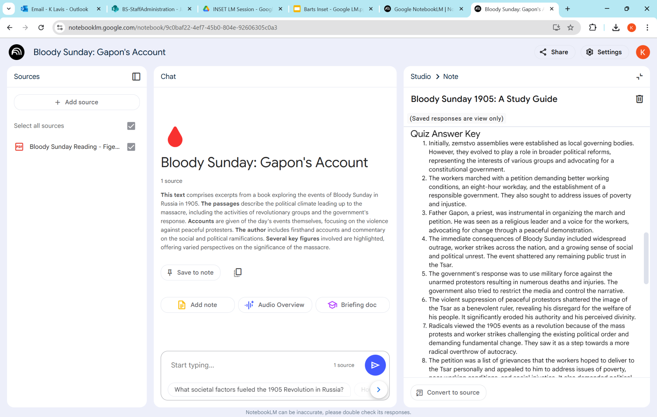

Slide 31
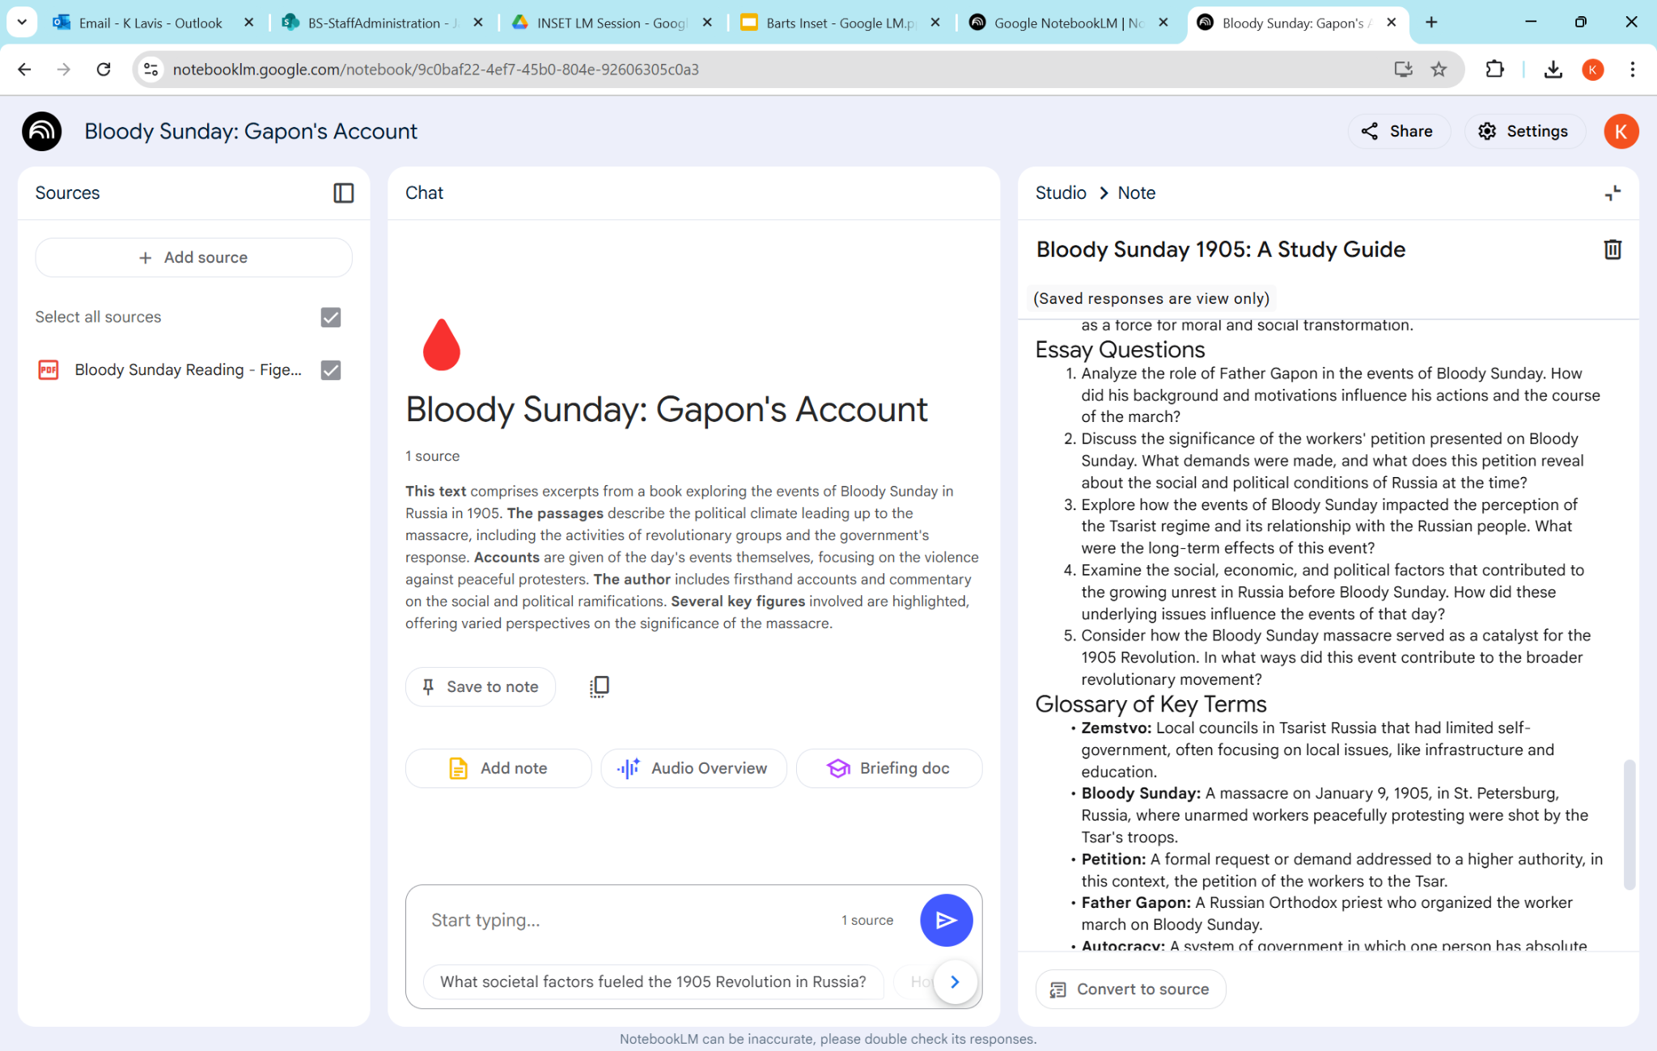

Slide 32
Produce an FAQ

Slide 33
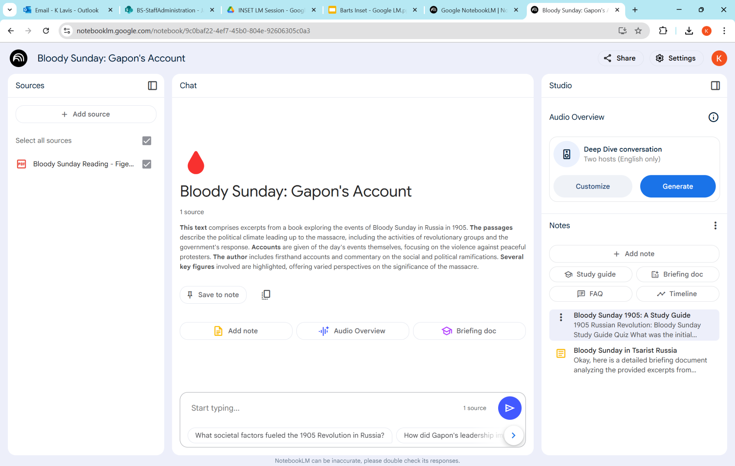

Slide 34
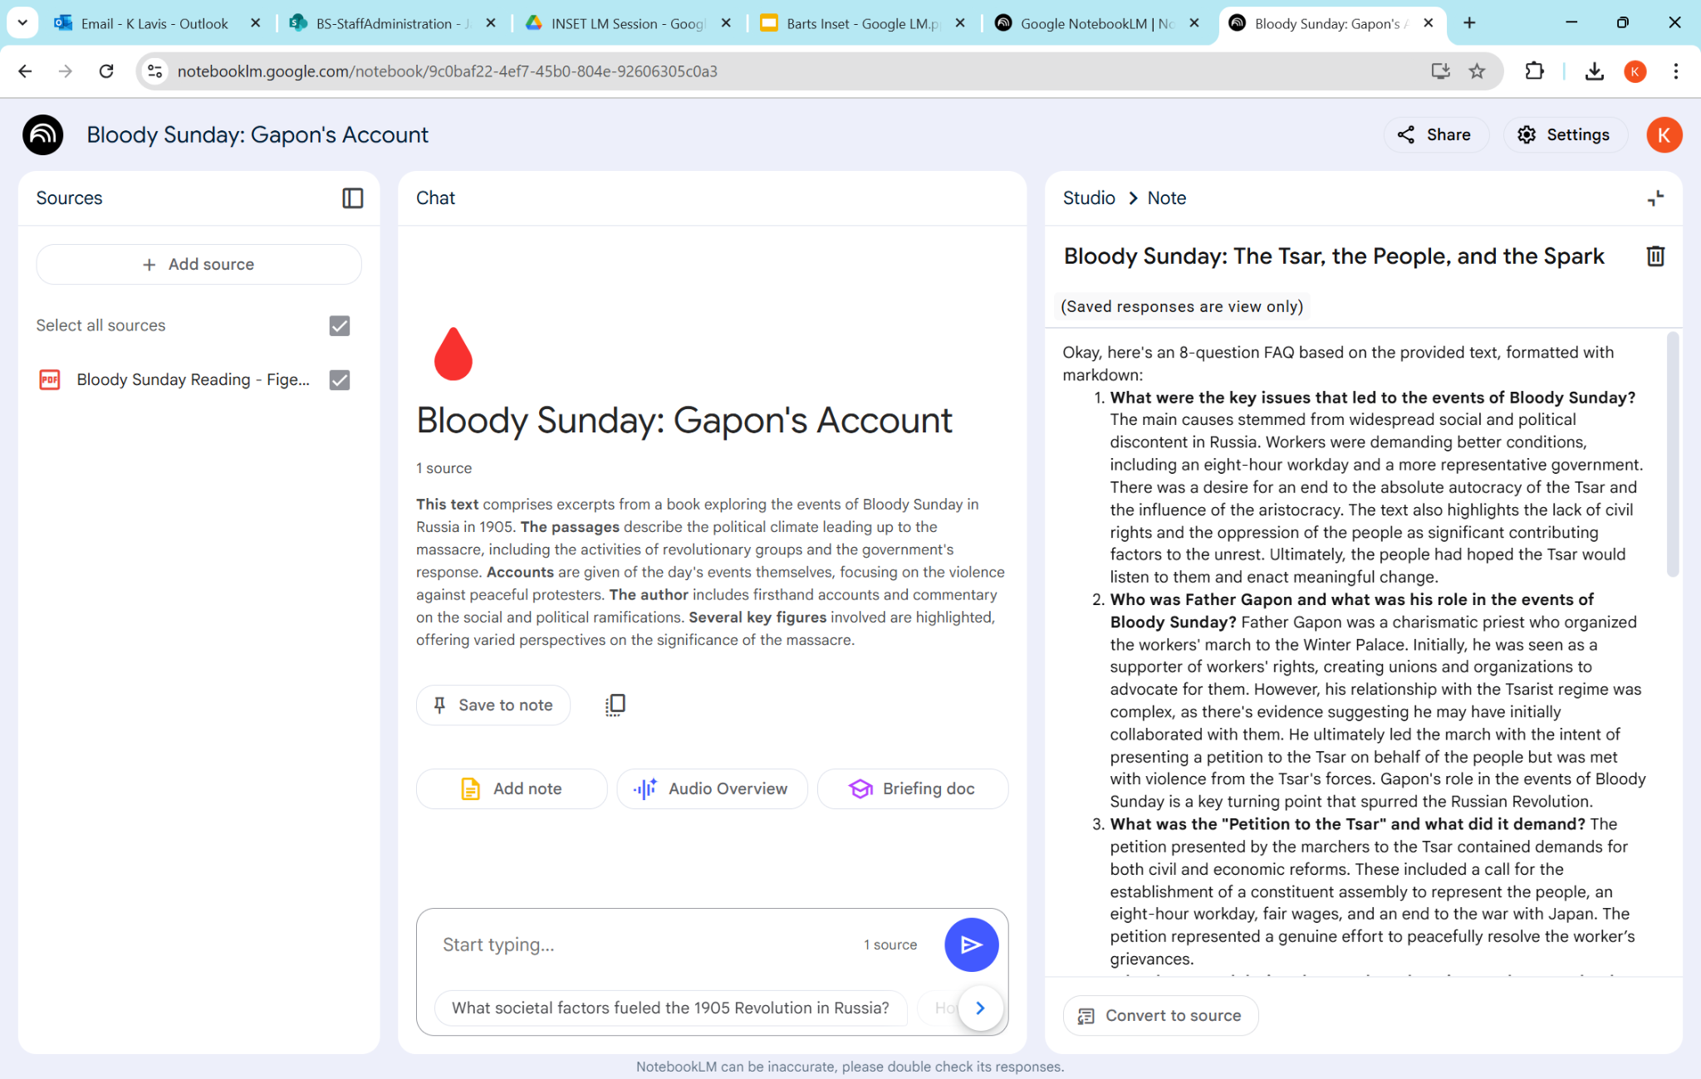

Slide 35
You can interrogate the source

Slide 36
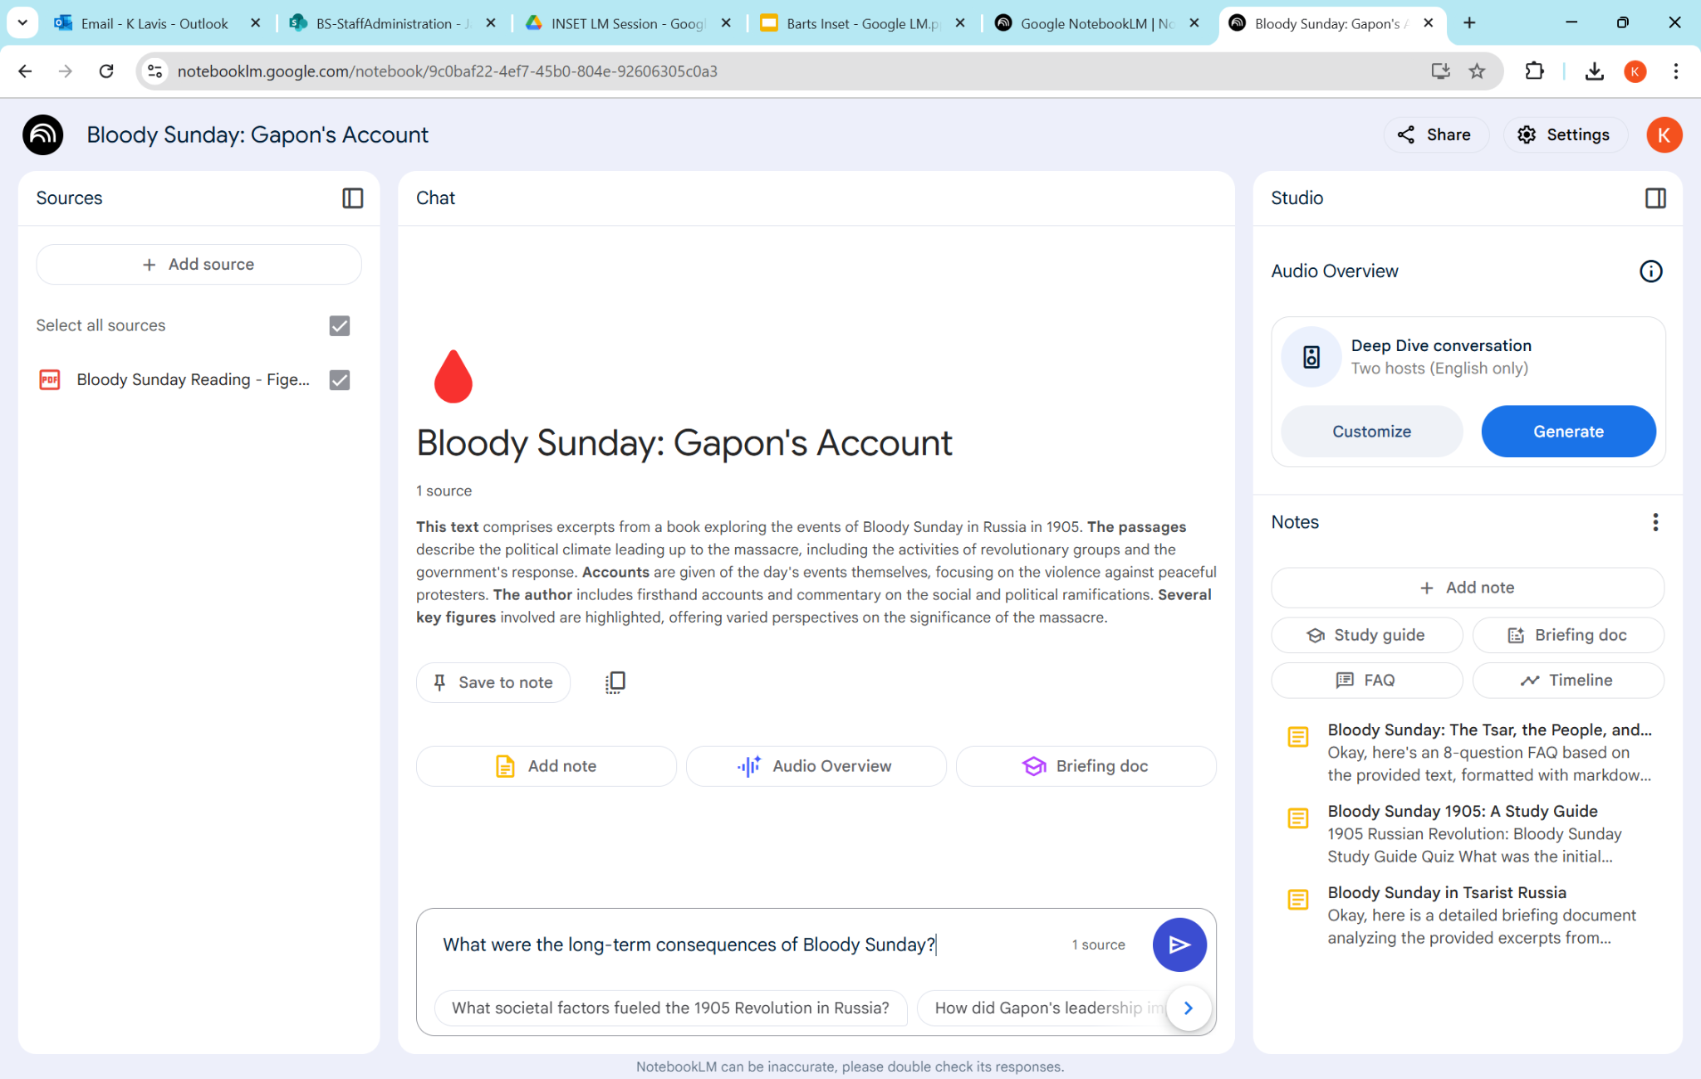

Slide 37
You can see where the information came from!

Slide 38
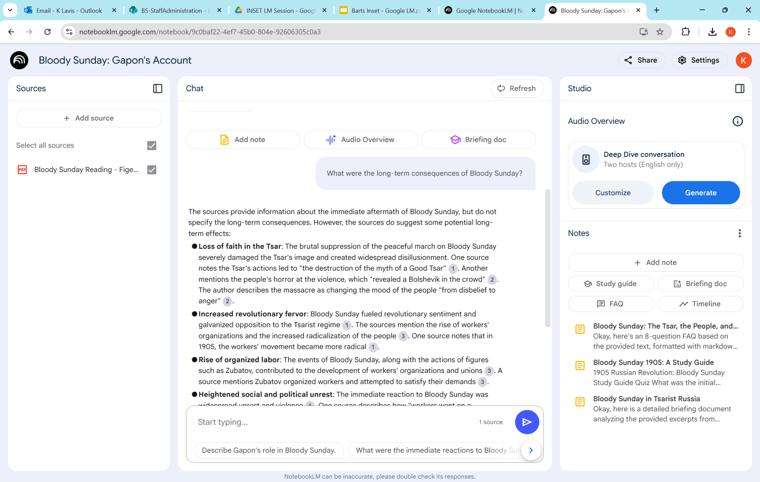

Slide 39
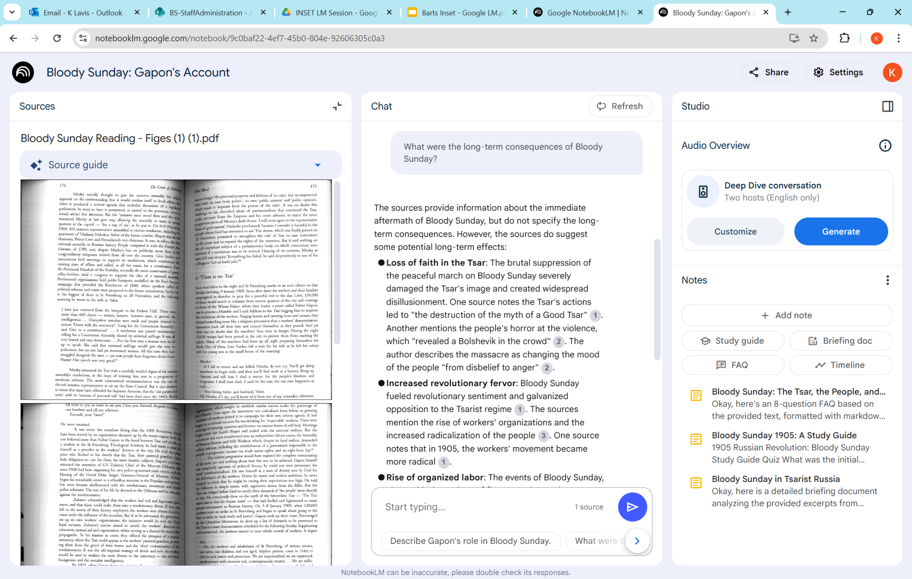

Slide 40
You can iterate to get the information you need

Slide 41
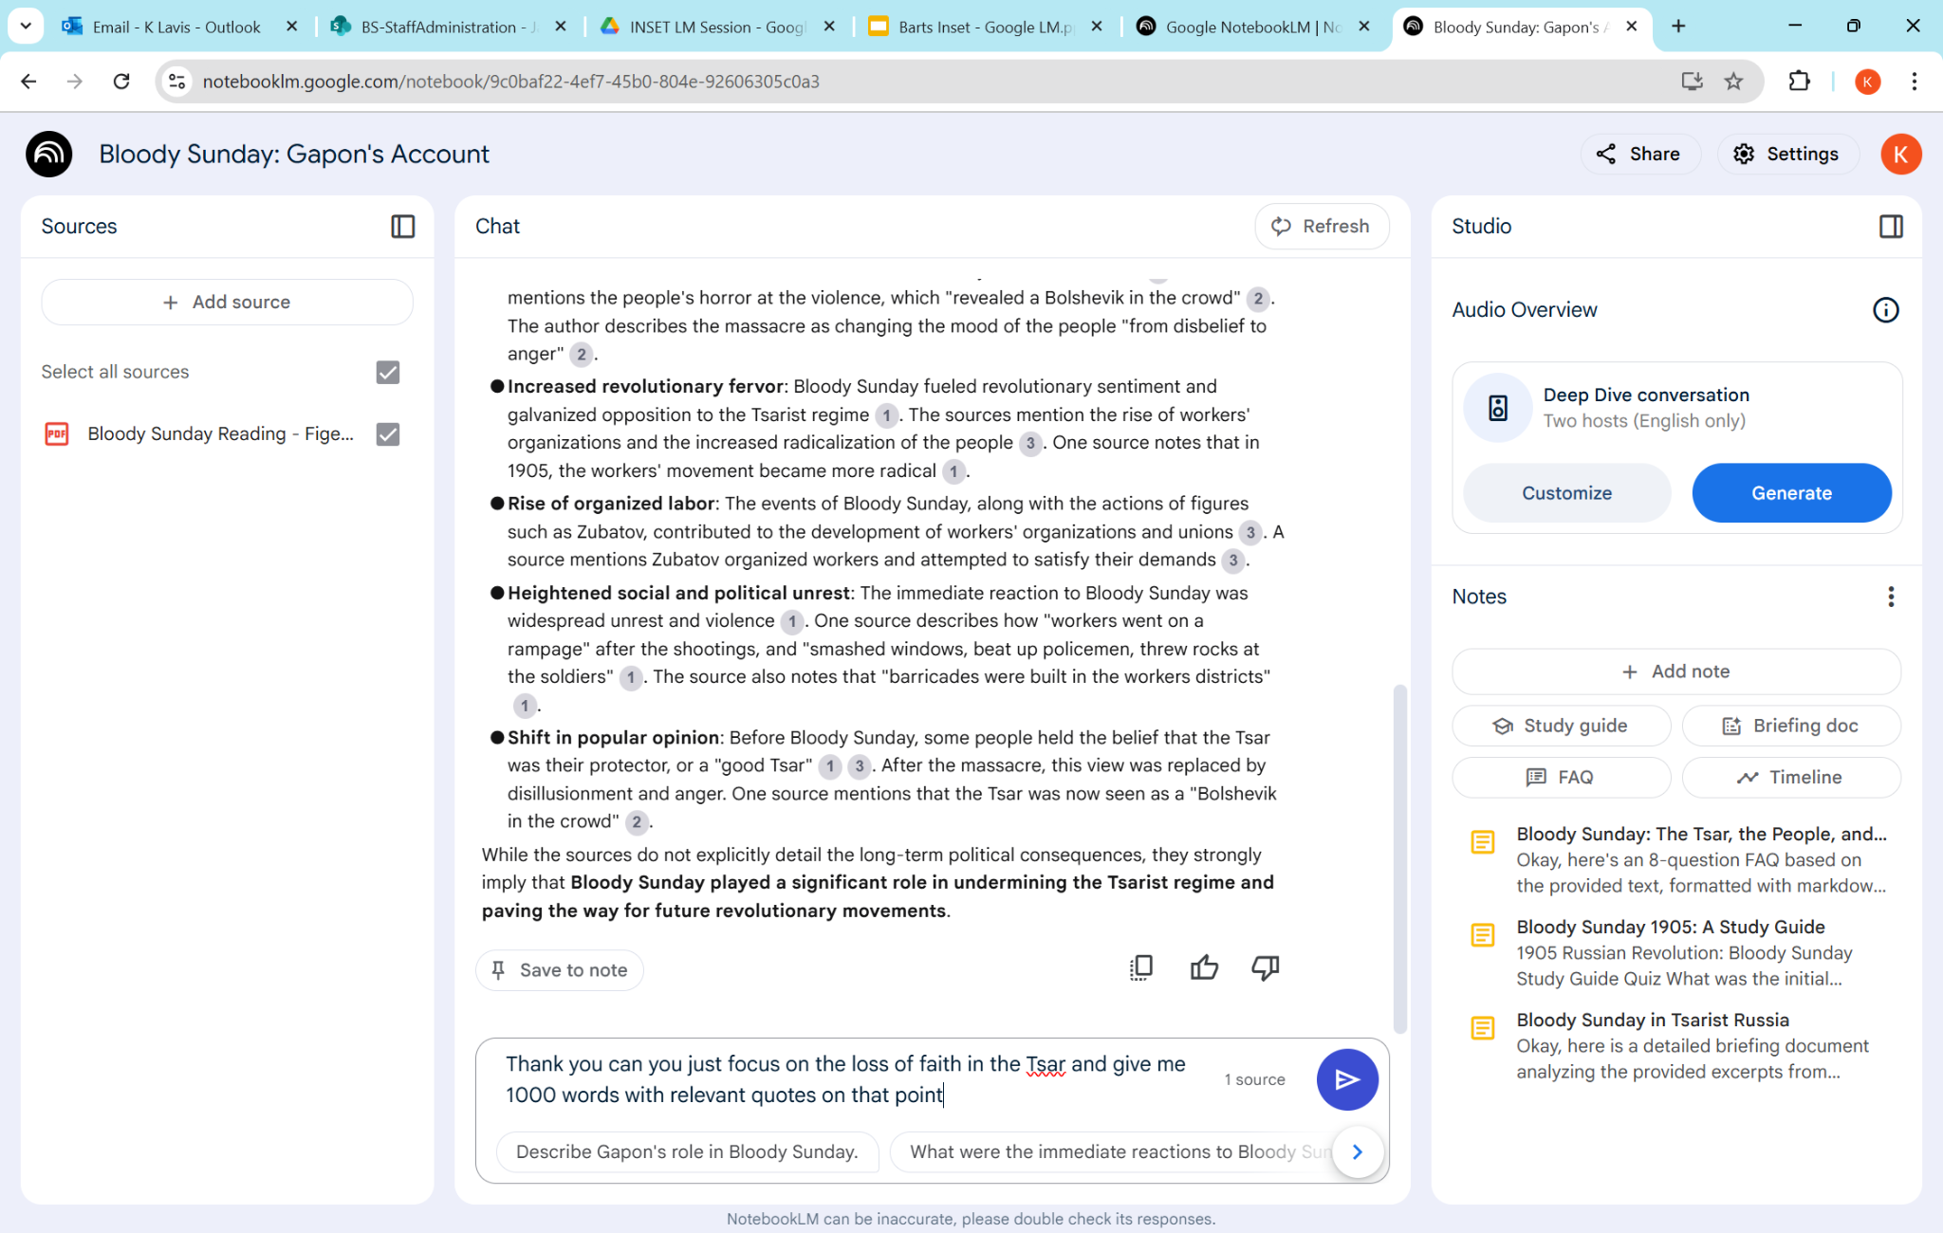

Slide 42
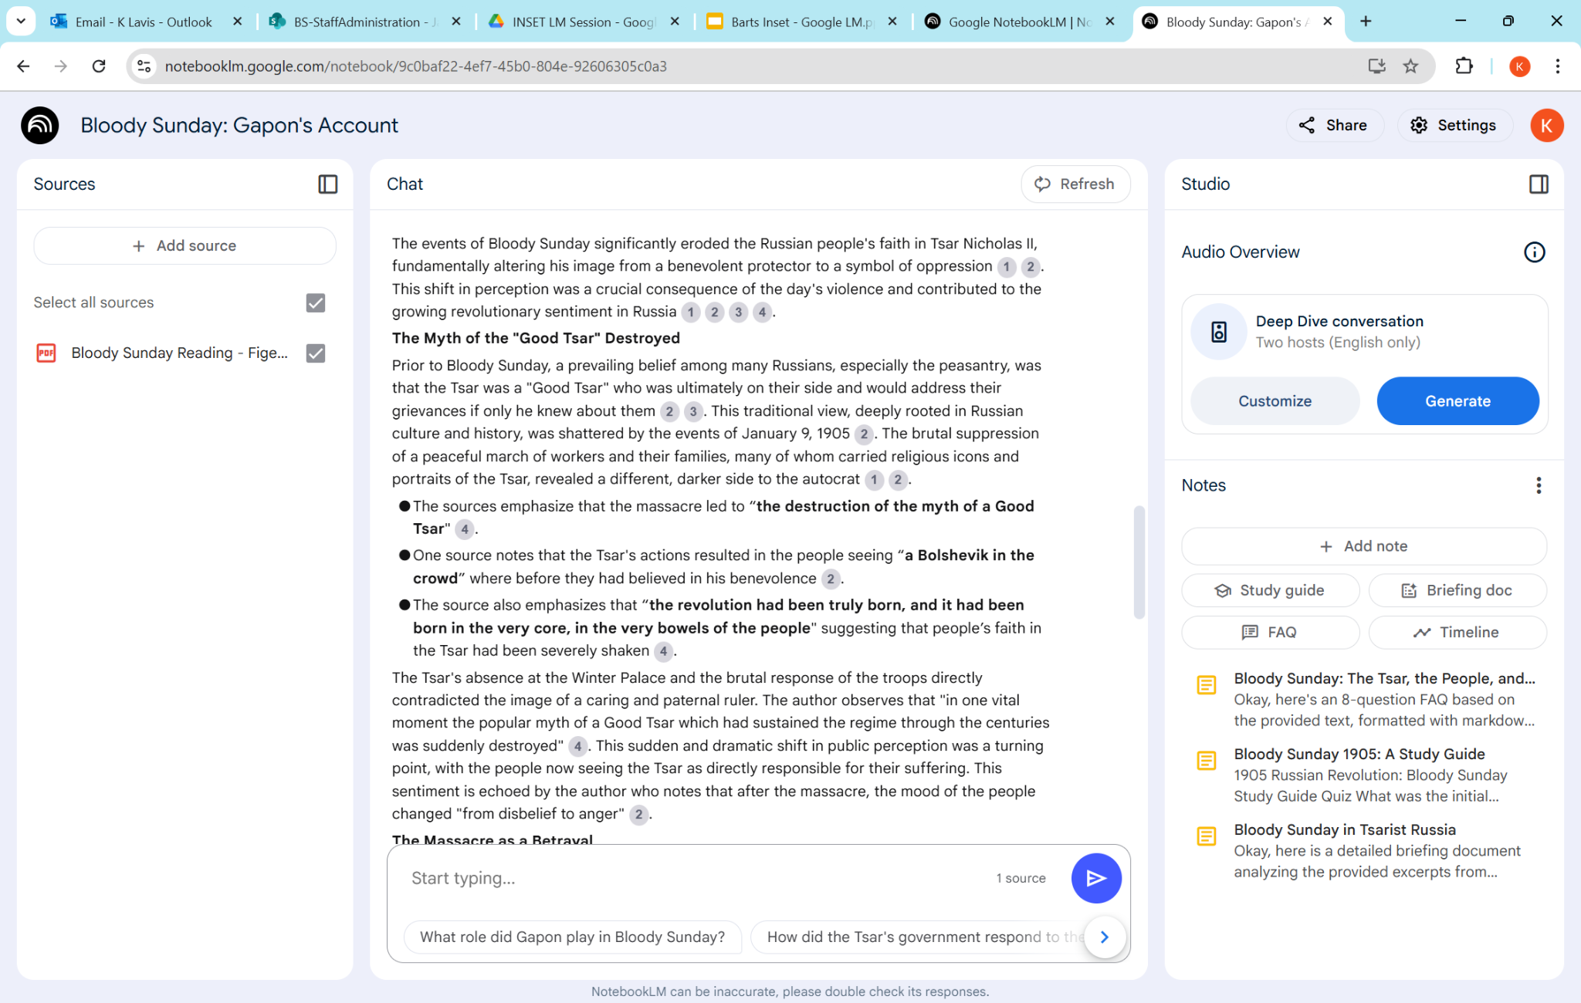

Slide 43
You can produce podcasts based only on your source

Slide 44
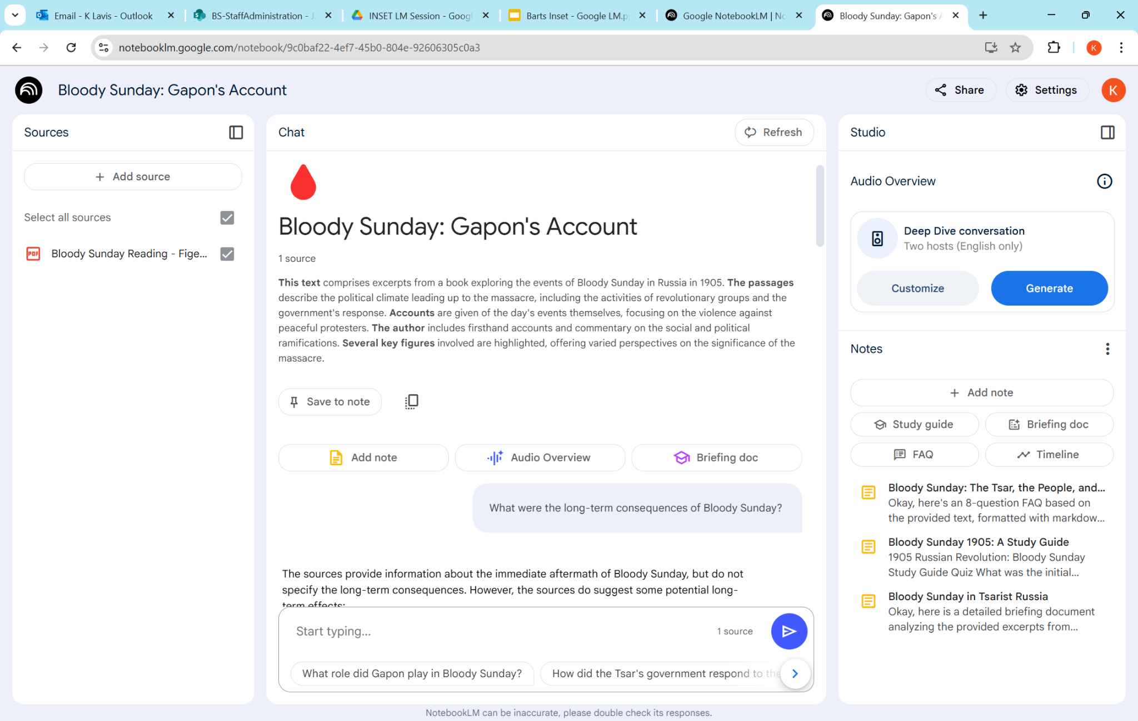

Slide 45
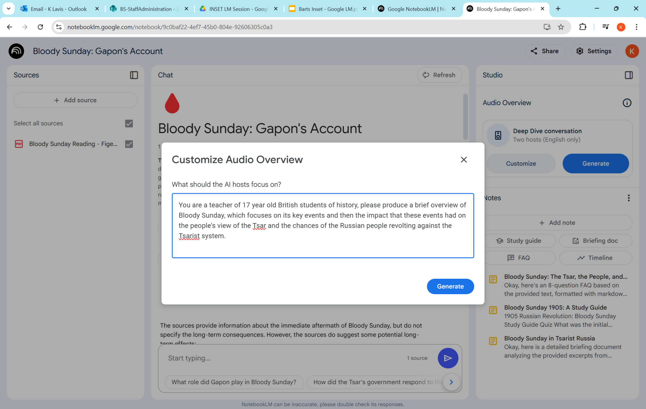

Slide 46
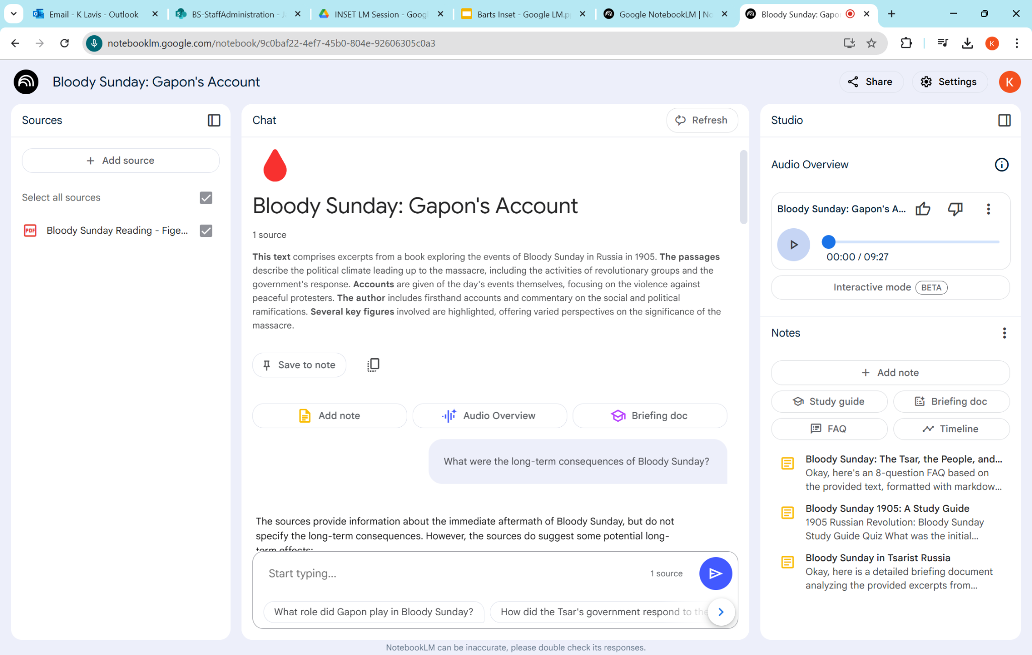

Slide 47
A few ChatGPT Ideas

Slide 48
Checking and Adapting Reading Ages

Slide 49
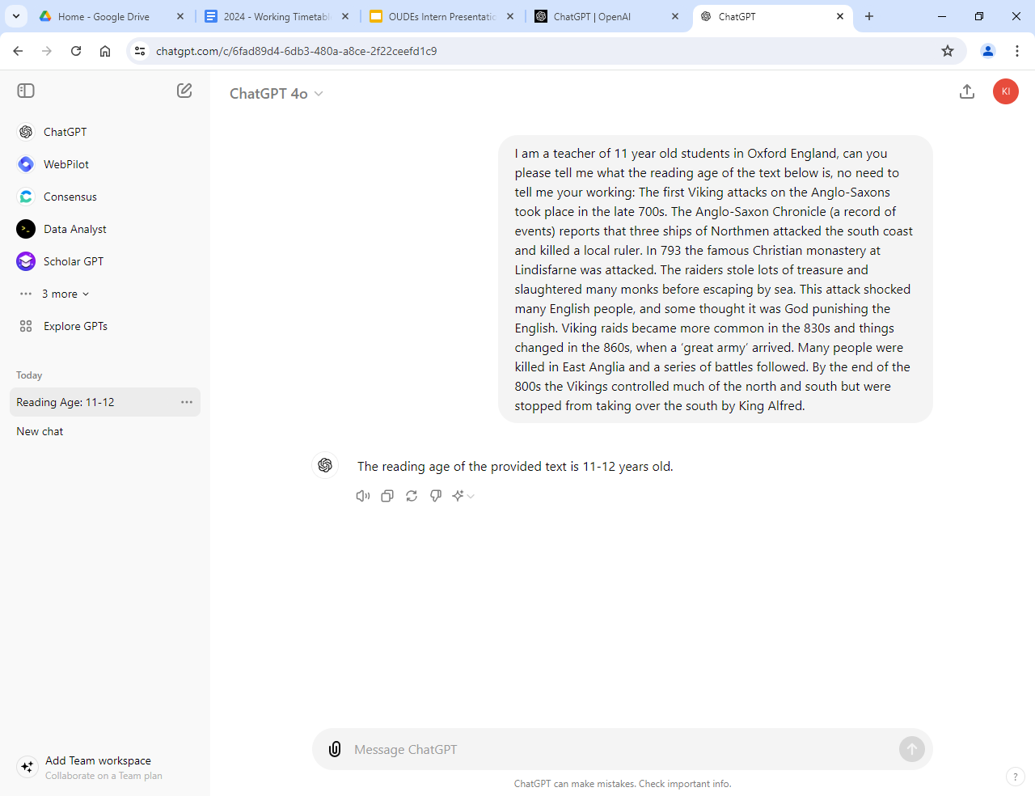

Slide 50
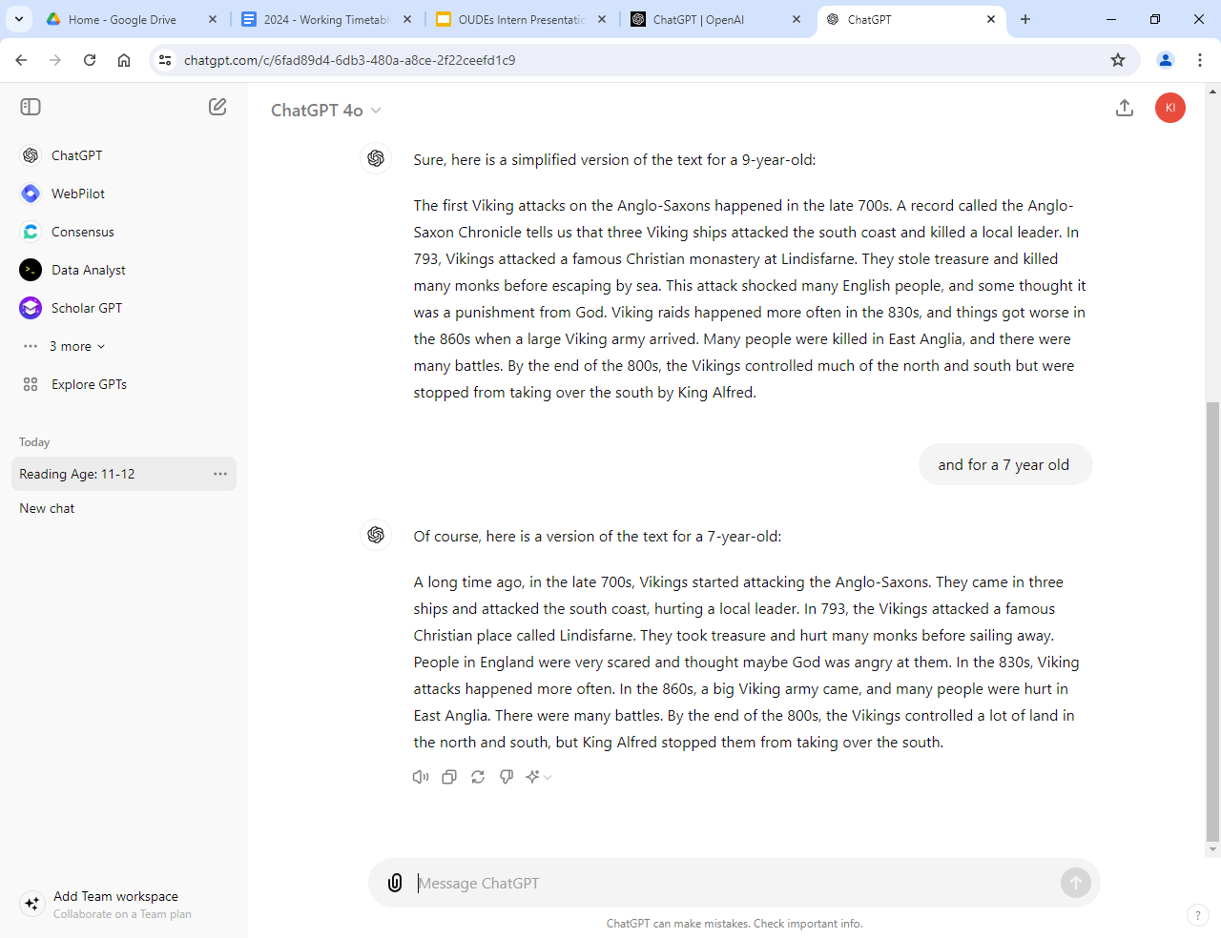

Slide 51
2. Extracting Text from Textbook Pages

Slide 52
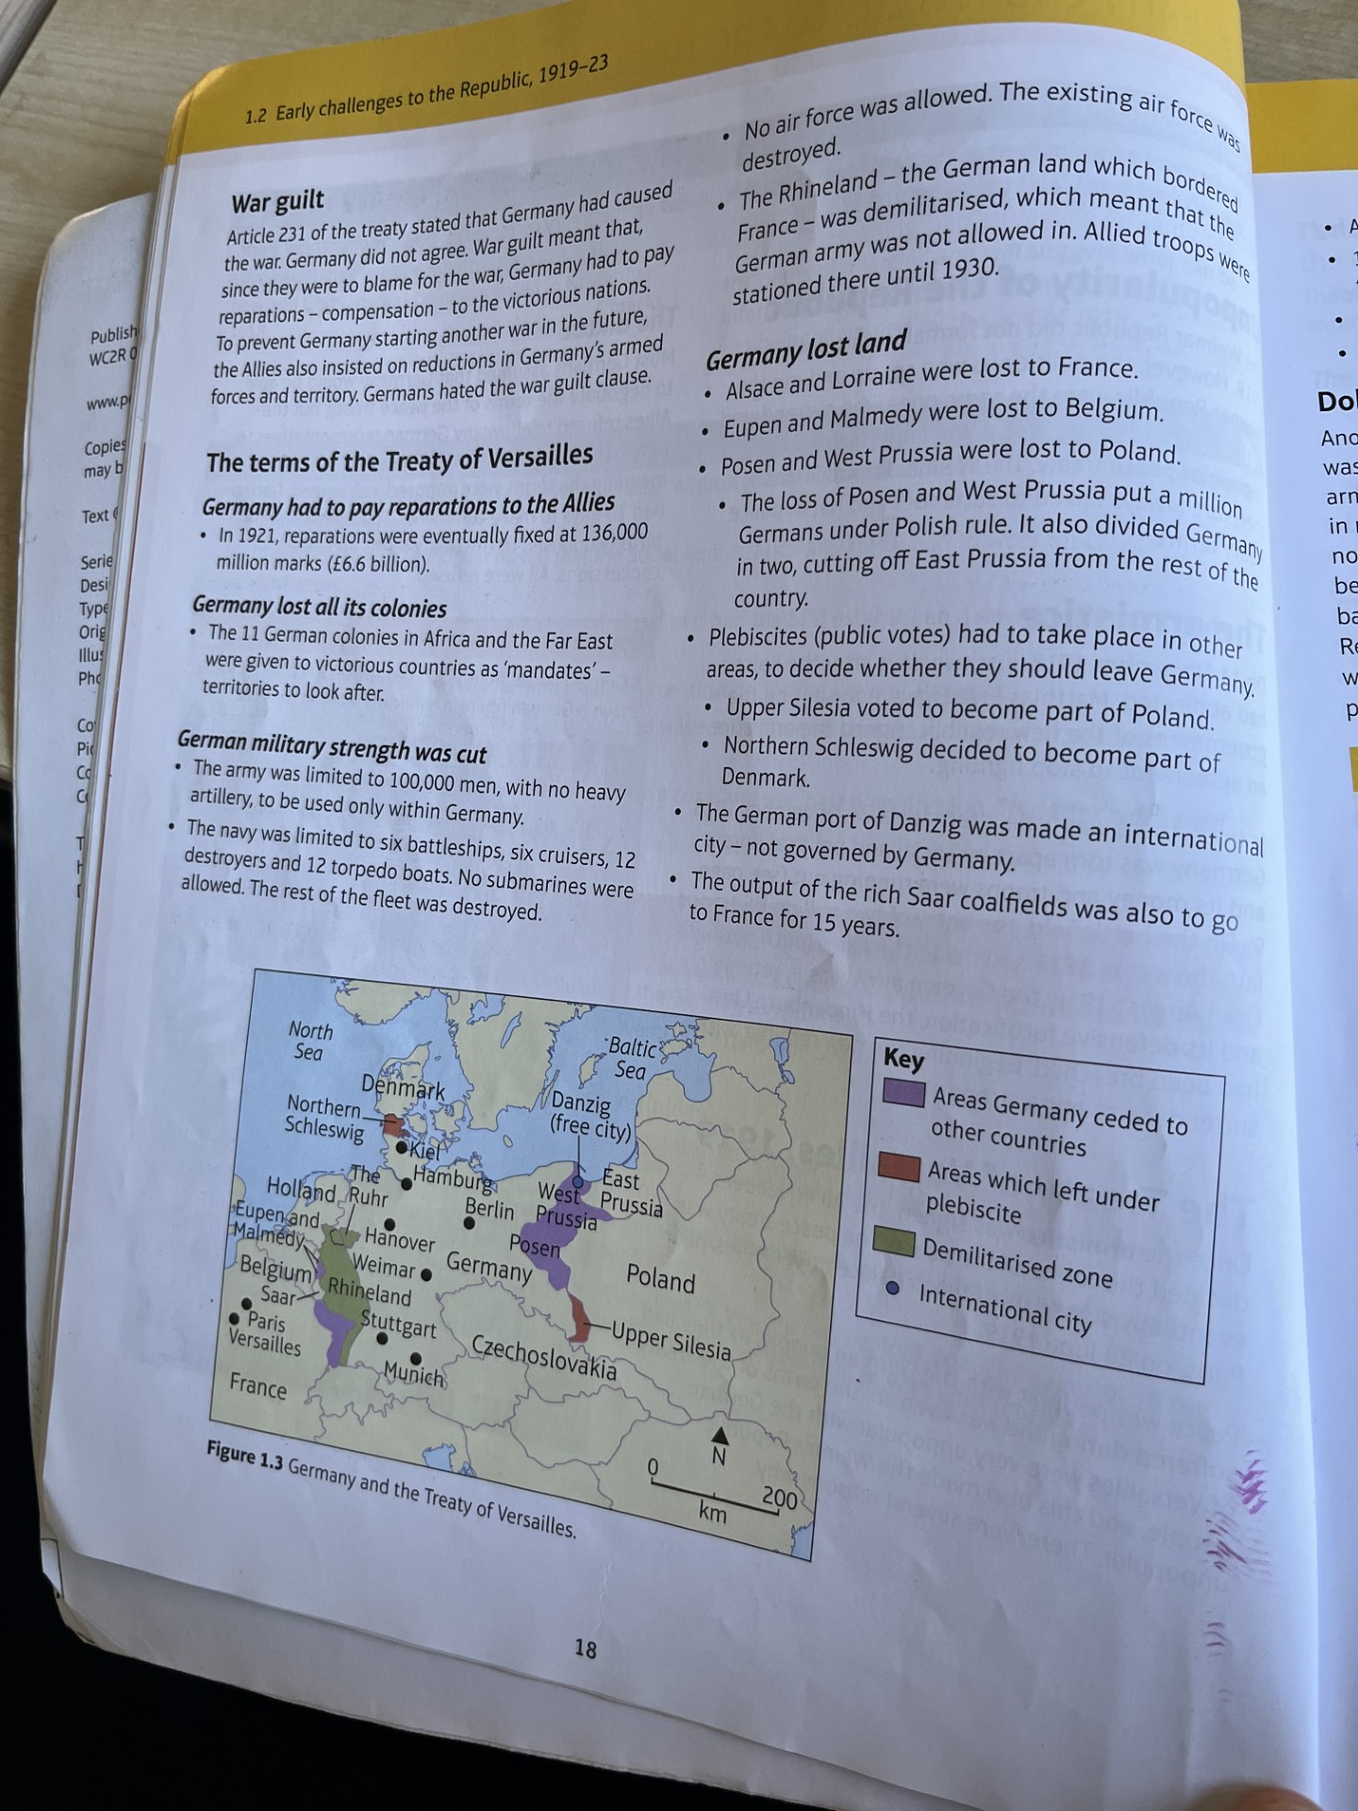

Slide 53
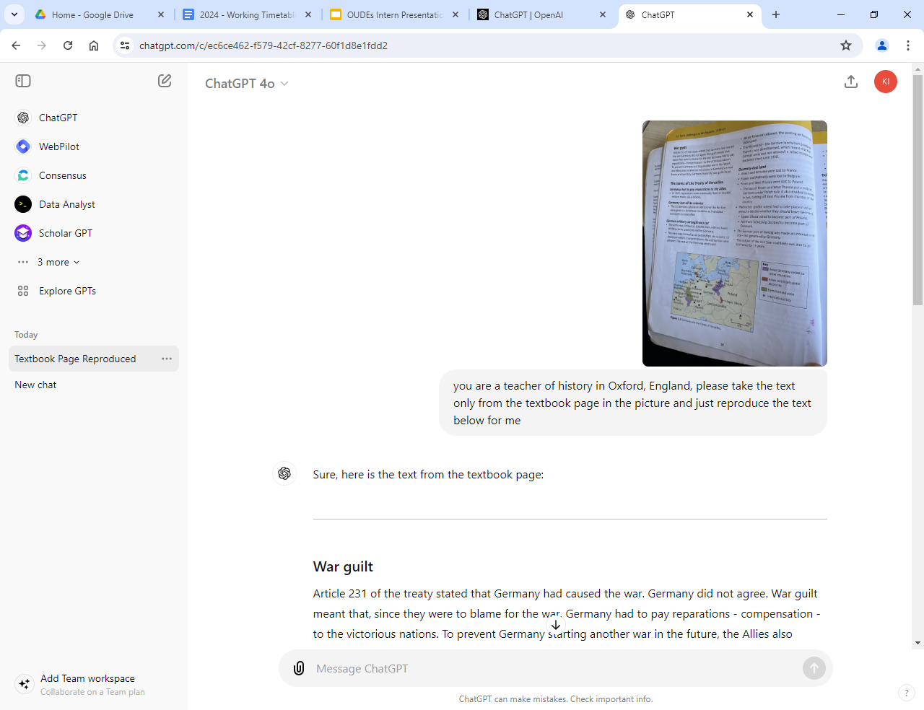

Slide 54
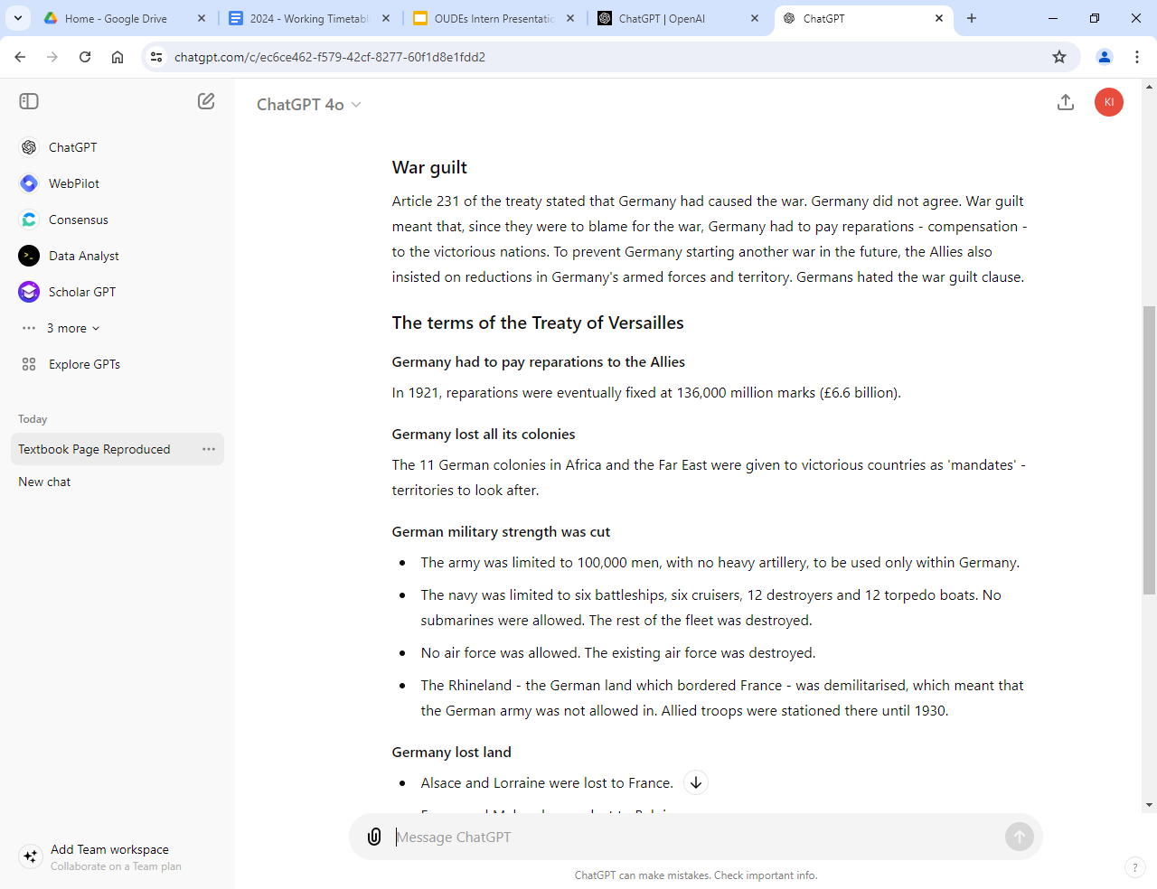

Slide 55
3. Producing MCQs to accompany YouTube clips

Slide 56
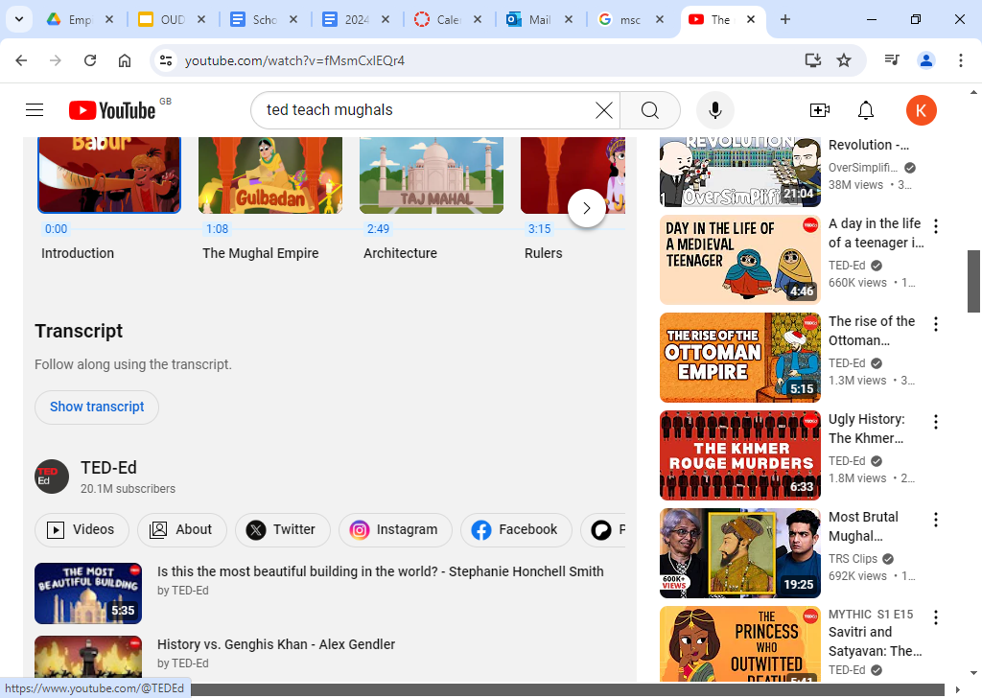

Slide 58
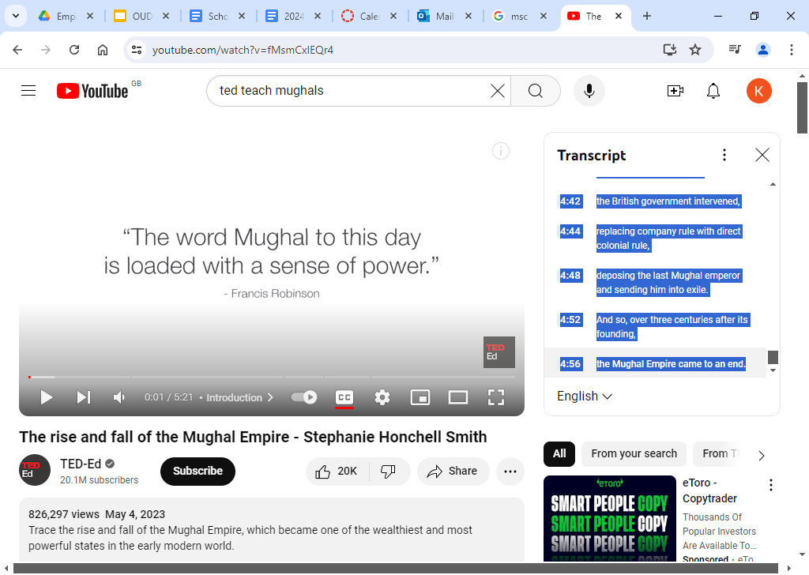

Slide 59
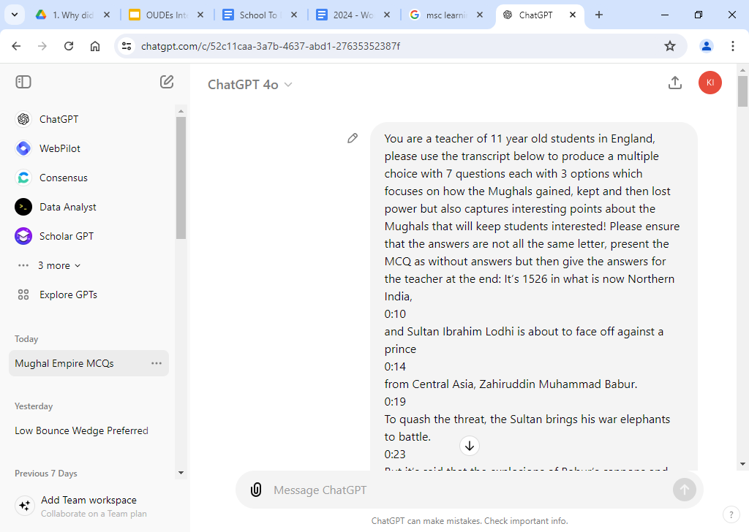

Slide 60
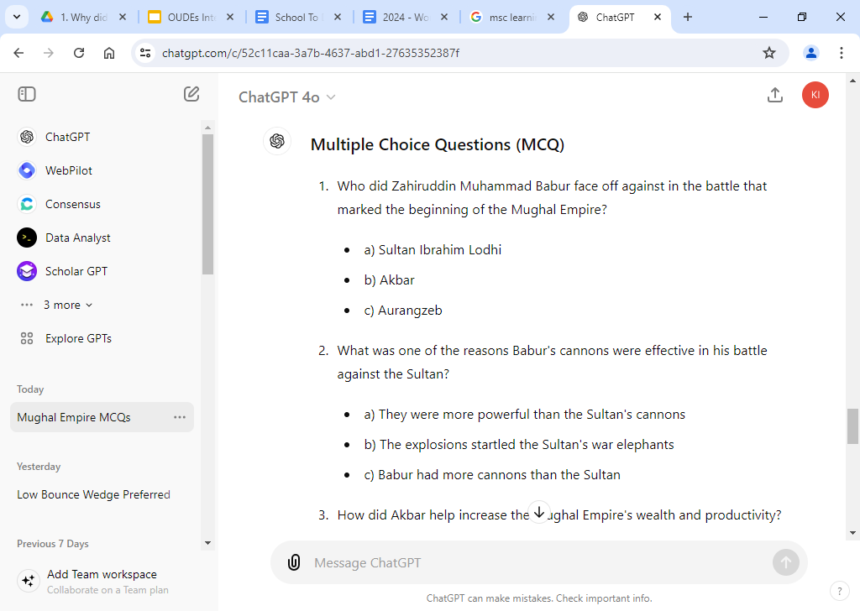

Slide 61
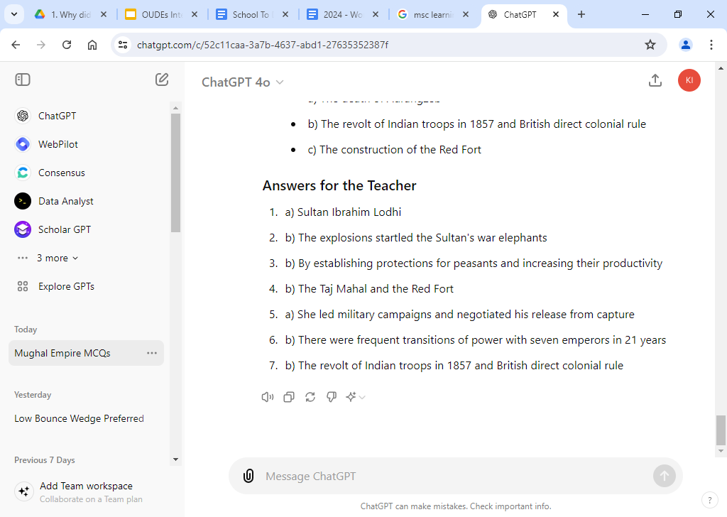

Slide 62
Questions!

