Slide 1
Adaptive Teaching with WIDGIT
Empowering All Learners
Total Duration: 2 Hours
(Includes 1 hours 45 mins of workshop content + 15 min break)
WiFi -

Slide 2
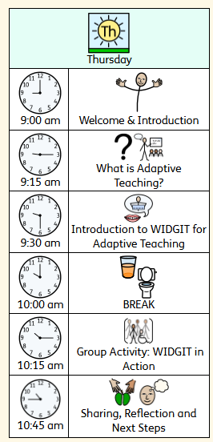
Workshop Schedule
09:00–09:15 | Welcome & Introduction
Icebreaker: “Describe your classroom using three words.” Overview of session goals Why adaptive teaching matters in Lower KS2 Quick intro to WIDGIT (visual communication software)
09:15–09:30 | What is Adaptive Teaching?
Key principles of adaptive teaching (DfE guidance)
Understanding learner diversity in Lower KS2 (SEN, EAL, working below age-related expectations)
Group discussion: “What adaptations do you currently use?”
09:30–10:00 | Introduction to WIDGIT for Adaptive Teaching
What is WIDGIT? Overview and interface demo Types of resources WIDGIT can produce: Visual timetables Symbol-supported text Instructional cards Labels and classroom signs
10:00–10:15 | BREAK (15 mins)
10:15 – 10:45 | Hands-on Activity: WIDGIT in Action
Use WIDGIT to adapt a task or text for a hypothetical diverse class Scaffolded instructions Symbol-supported vocabulary Visual step-by-step guides Goal: Each group creates a resource and explains who it helps and why
10:45 –11:00 | Sharing & Reflection, Wrap-Up & Next Steps
Group presentations (5 mins per group) Peer feedback Whole group reflection: What surprised you? How could this fit in your weekly planning? What are the barriers?
Recap key takeaways
Signposting further training/resources (e.g., WIDGIT online tutorials, SENDCo support, DfE guidance)
Exit slip: “One change I’ll make next week…”
📦 Optional takeaway: Printed “WIDGIT Quick Start for KS2” guide & planning template

Slide 3
Describe your classroom using three words.

Slide 4
Overview of session goals
Why adaptive teaching matters in Lower KS2
Introduction to WIDGIT (visual communication software)
Notes:
handout

Slide 5
What is Adaptive Teaching?
Being responsive to information about learning, then adjusting teaching to better match pupil need

Slide 6
The Early Career Framework breaks the term ​‘adaptive teaching’ into concrete recommendations for teaching. being responsive to information about learning, then adjusting teaching to better match pupil need
1. Anticipate barriers
2. Plan to address them
3. Use assessment to elicit evidence of learning
4. Make in-the-moment adaptations
https://d2tic4wvo1iusb.cloudfront.net/production/documents/Understanding-Adaptive-Teaching-v11.pdf?v=1748428590

Slide 7
Increased Diversity of Need
By Lower KS2, classrooms often have a wider range of needs, including:
Undiagnosed or newly identified SEND
EAL learners still acquiring English
Variations in emotional maturity and social skills
Adaptive teaching ensures all pupils can access the same ambitious curriculum, just through different pathways.

Slide 8
Supports Inclusion & Equity
Adaptive teaching avoids “one-size-fits-all” approaches.
It’s not about creating separate lessons, but adjusting content, delivery, and support so that all learners can participate meaningfully.
Embeds the principle that high expectations can coexist with flexibility and compassion.

Slide 9
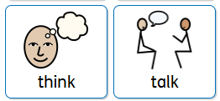
What adaptations do you currently use?

Slide 10
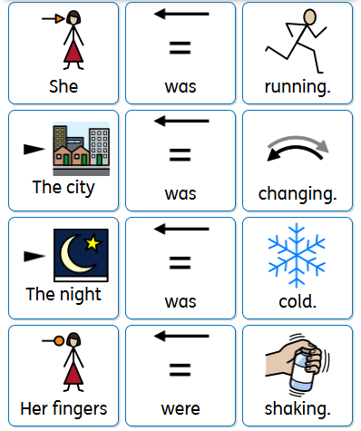
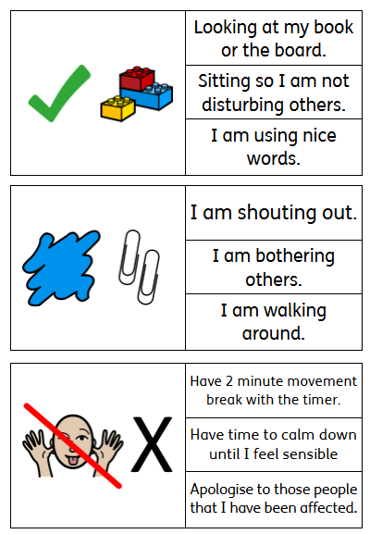
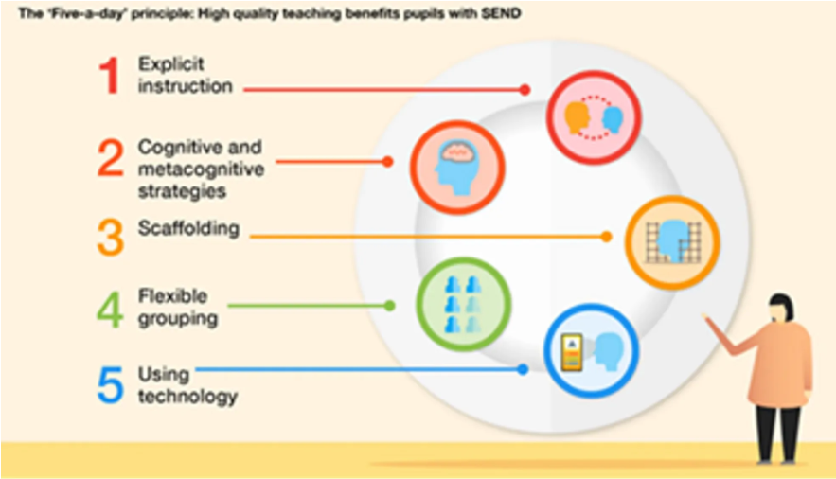
Adaption is about planning ahead to address barriers to learning
We can support learners who are likely to find the learning tricky, while developing independence. 5-a-day!

Slide 11
Check in
Do you understand that adaptive teaching is responsive, not individualized planning for all?

Slide 12
Introduction to WIDGIT for Adaptive Teaching
Widgit Symbols are used worldwide to support people to realise their full potential, regardless of age, ability or background.
Supports understanding of key vocabulary and instructions
Reduces cognitive load by pairing text with visuals
Improves independence and task engagement
Enables access to curriculum content for all learners

Slide 13
Types of resources WIDGIT can produce:
Visual timetables Symbol-supported text Instructional cards Labels and classroom signs

Slide 14
Match a resource type with an example of how this can be used within day-to-day school life.

Slide 15
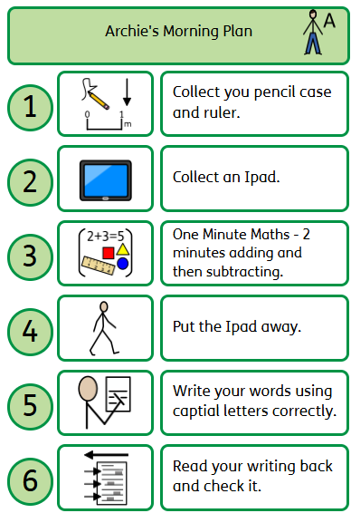

Slide 16
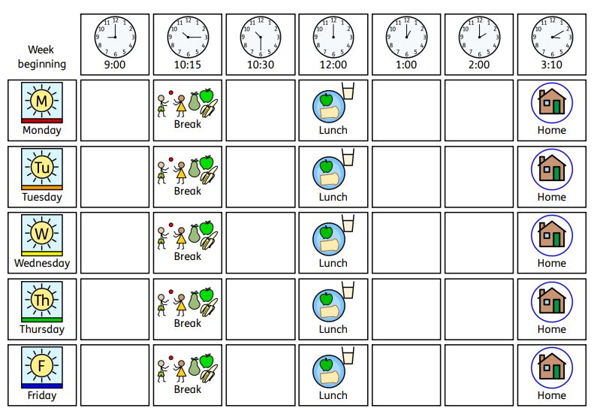

Slide 17
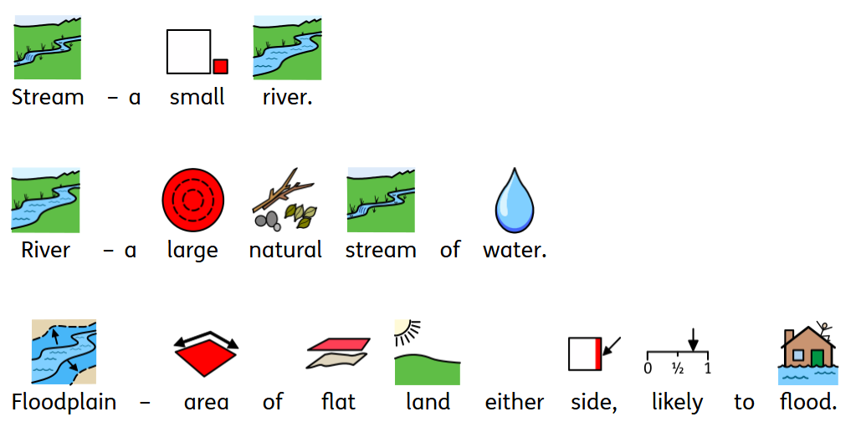

Slide 18
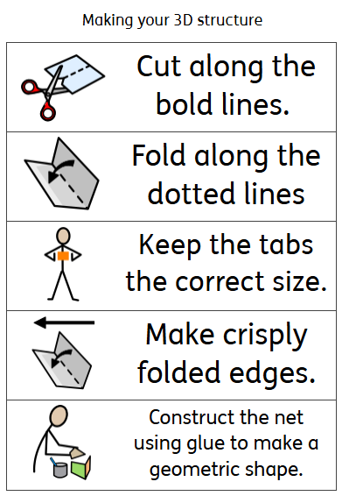

Slide 19
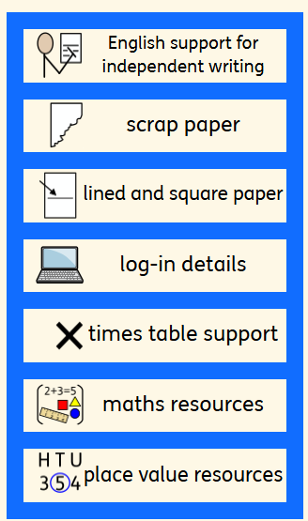

Slide 20
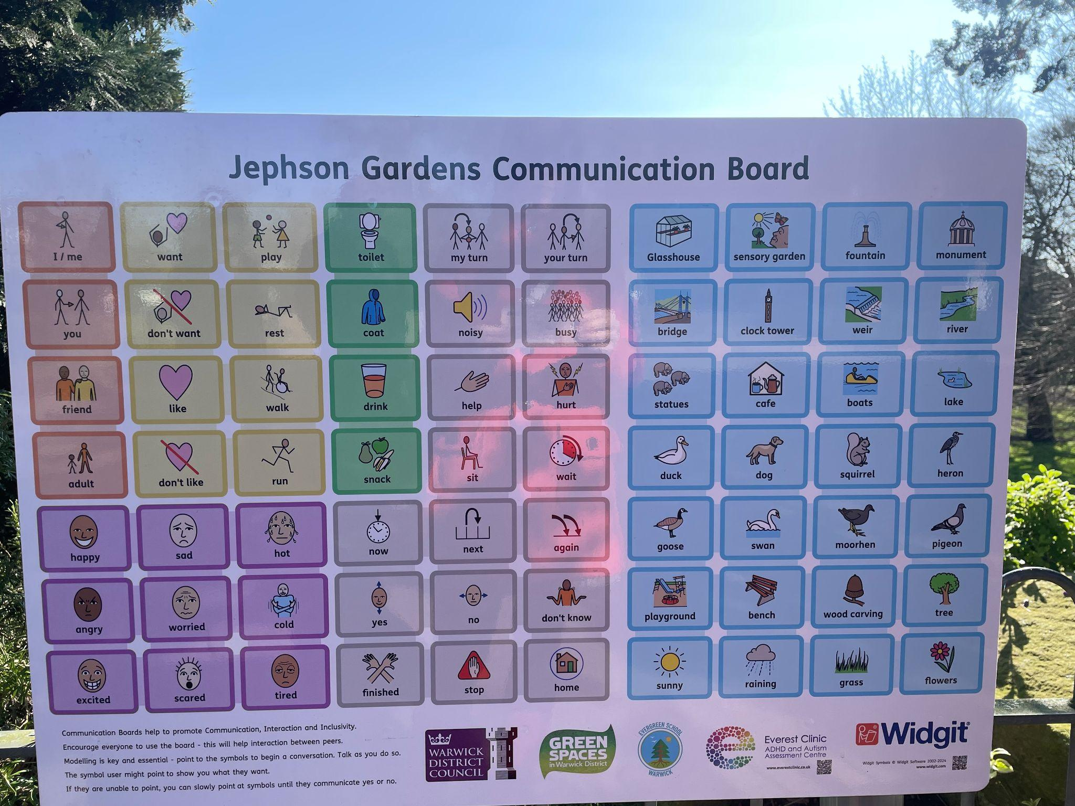
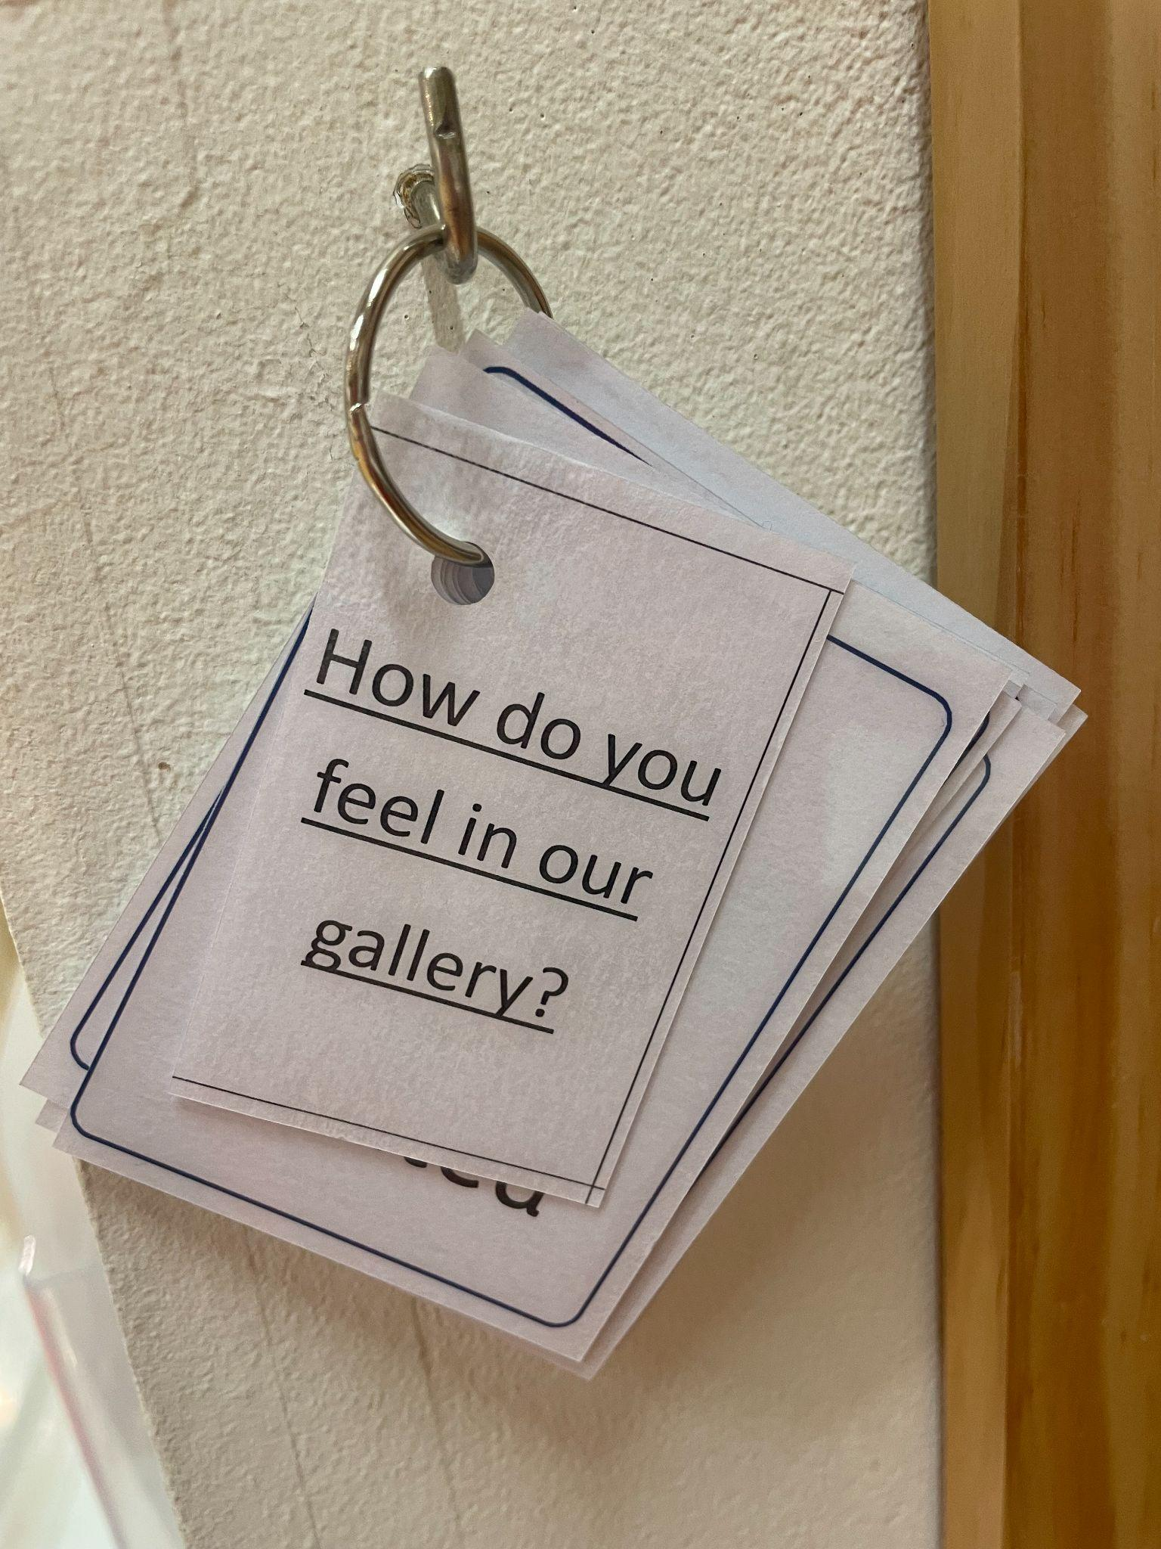
Examples of Widgit in the community (Royal Lemmington Spa)

Slide 21
Please do take the time to look at resources being used in KS2 classrooms and ask questions.

Slide 22
Getting Started in WIDGIT Online
Go to: www.widgitonline.com
Log in with your school account
Choose a template or create a new document
Add symbols by typing words (auto-generates symbols)
Format layout (columns, spacing, images)
Print or save as PDF

Slide 23
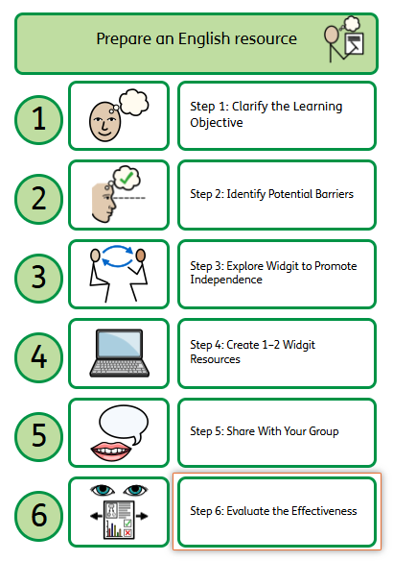
Hands-on Activity: WIDGIT in Action
Within your class you have broad range of children including those who have SEND, EAL and low literacy levels. You have one TA. How can you use Widgit to support independent learning for all?
Goal: prepare an English resource to support the Learning Objective: I can use adjectives to describe what a character looks like and how they behave.
Things to consider - What are potential barriers to learning?
How can you promote independence?
Notes:
Struggling with written instructions, Unfamiliar with key vocabulary, Needs help breaking down tasks

Slide 24
How Did Use WIDGIT?
Visual task instructions (e.g., “Draw, Write, Check”)
Symbol-supported LO with key vocabulary
Vocab mat with adjectives
Step-by-step guide to character creation

Slide 25
“One change I’ll make next week…”

