Slide 1
Using PiXL QLAs to fill gaps in learning

Slide 2
Quick guide to running interventions using PiXL resources
Download tests for AP point.
Complete with cohort, mark and record marks on QLA spreadsheet for that year group.
Record data on Sonar and identify key marginals in terms of attaining the standard in reading, writing and maths. Also key children, eg SEN or those close to greater depth.
Use QLAs to identify curriculum objectives which need to be taught to particular groups of children/individuals (check against Priority Elements which are in blue) on PiXL.
Timetable children, adults and subjects to ensure the interventions happen.
Train staff in how to find and deliver therapies (interventions) and monitor progress using the tests and subsequent AP data.
See slides for how and where to access PiXL therapies (intervention materials).

Slide 3
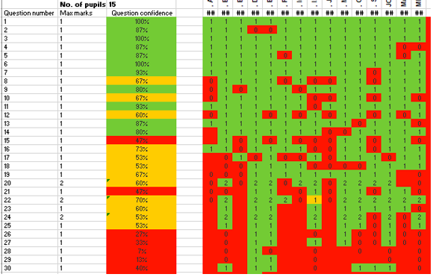
‘Question confidence’ column is useful for showing teachers how well their cohort understands a particular concept.

Slide 4
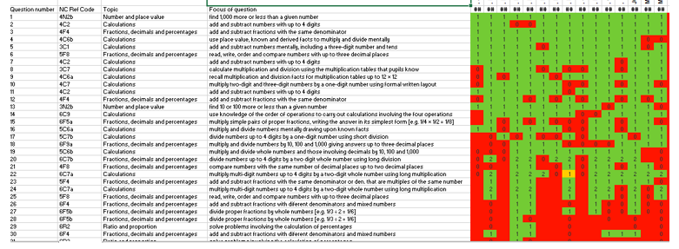
‘Focus of question’ shows which curriculum objective the question relates to. Use the rows and columns to find common objectives which key children need to revise with PiXL therapies.

Slide 5
When you log into PiXL, click on the big blue ‘Primary Wise’ button to access resources.

Slide 6
To find therapies to use for interventions with key children, click on personalised learning checklists.

Slide 7
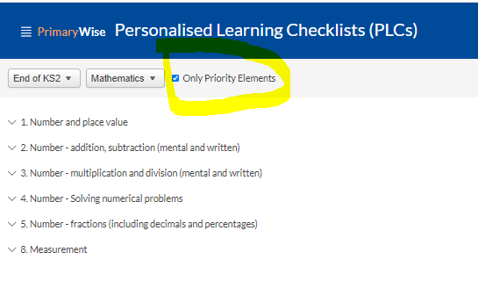
Select a year group or key stage as required, also select the subject you require. Remember to select ‘only priority elements’ as you want to gain the most that you can from interventions by targeting the most important aspects of the curriculum.

Slide 8
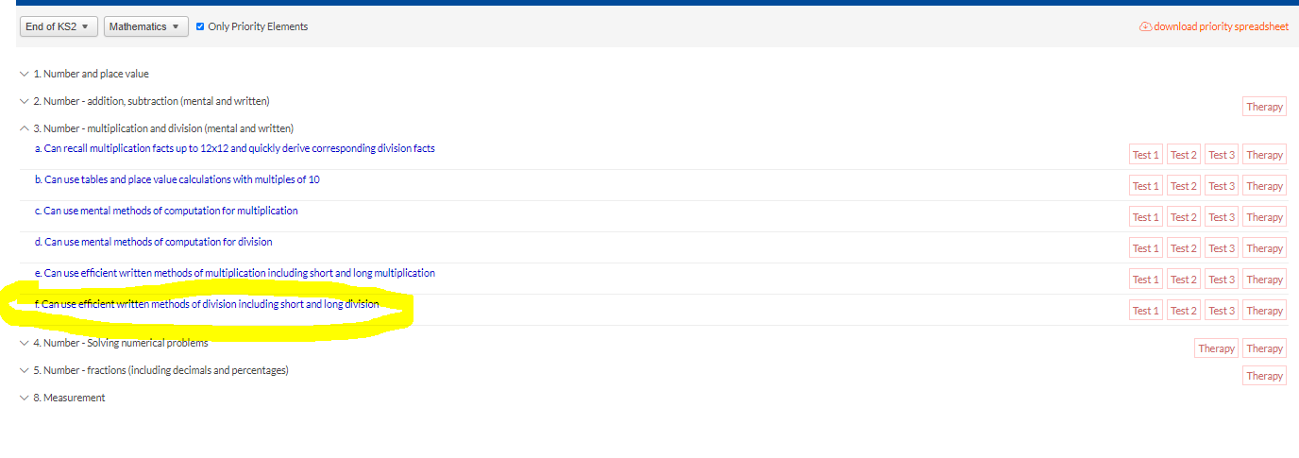
Use your question level analysis spreadsheet to identify objectives and then select the relevant ones which your filters produce. There are tests and therapies to teach and test these objectives with your key pupils in your interventions.

Slide 9
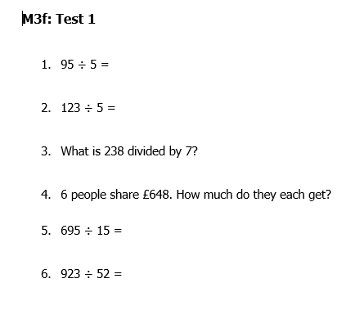
Here is an example test and the front page of the powerpoint presentation therapy which is used to teach the objective in intervention. Do test 1, teach the therapy. Do test 2. Revise any gaps which emerge, do test 3. Review the intervention.

Slide 10
Monitor the success of the intervention programme for each pupil using the tests and formulate the next steps according to your findings.
Ask yourself if you need to:
- reteach the materials because the pupil/pupils still hasn’t/haven’t quite grasped the learning
- move back to an objective which is the prior learning to the one you have been doing as the pupil(s) are fundamentally unable to access the learning
- move onto a new objective as the pupil/pupils have mastered the one you have been working on
- reassess your groupings and objectives as you have successfully gap-filled for this group of pupils

Slide 11
Any questions?

